Slide 1
Construction Use Tax
City of Loveland
Sales Tax division

Slide 2
Construction Use Tax is a 3% tax applied to construction and building materials pursuant to Tax Code 3.16.040. It is paid along with your Building Permit Fees.

Slide 3
BUILDING PERMIT
The Building Division will collect all taxes/fees due before issuing your building permit.
When purchasing construction materials for your project, show your building permit to each vendor. This will allow you to purchase materials for your project without paying City of Loveland Sales Tax.
Give a copy of the building permit to your subcontractors for their material purchases.
Once your project is completed and you’ve received the final Certificate of Occupancy or Letter of Compliance, file the Job Cost Reconciliation (JCR) with the City of Loveland, Revenue Division.

Slide 4
BUILDING PERMIT cont…
IF your project is for a tax-exempt organization, you MUST:
    FIRST apply for a contractor’s exempt certificate with the Colorado Dept. of Revenue. (This process can take several weeks so plan accordingly.)
    The exempt number will start with 89-xxxxx.
    Provide your exempt certificate to the City of Loveland Building Division when getting a building permit.

Slide 5
Job Cost Reconciliation (JCR)
The JCR is a spreadsheet that accounts for all invoices and all money related to the project.
You must maintain records for all projects for a minimum of 3 years from the Certificate of Occupancy date.
The Sales Tax Department will review the JCR and communicate with you when further documentation is needed.
        Examples of additional documentation:
            Invoices, change orders, the building contract.
        Subcontractors may also be called for clarification on invoices.
The JCR will reconcile for the city construction use tax only. The county has their own reconciliation process, and you will have to contact them for the county use tax.

Slide 6
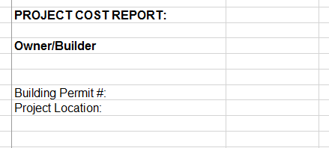
JCR – In Detail
Add the owner/builder name and address in the column to the right of Owner/Builder. This is the name and address that will go on any refunds or balance due notices.
Add the building permit # and the project location. This is needed to properly reconcile the construction use tax per the building permit.

Slide 7
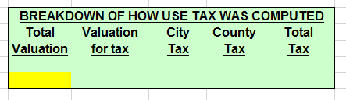
JCR – In Detail cont….
Enter the total valuation from your building permit in the yellow box.
The spreadsheet has a formula that will auto calculate the rest of the cells in this box.

Slide 8
JCR – In Detail cont….
Example Categories:
Concrete
Interior Doors
Electrical
Drywall
Landscaping
Example Vendor & SubContractor:
ABC Corp
John’s Flooring
Concrete Guys
Drywall LLC
Painting Pro’s
The Invoice Total includes everything on the invoice.
Choose the correct column for the taxable materials.
If a non-taxable item is listed on the invoice, i.e. Labor, put it in the Non Tax/ Other column.
Take the actual tax paid per the invoice and place it in the correct columns.
  Note – If City of Loveland tax was paid on invoices, please provide electronic copies of those invoices when submitting the JCR.
Example Comment By Owner/Builder:
Used 50/50
Example Comment By Auditor:
Reviewed invoice – no change

Slide 9
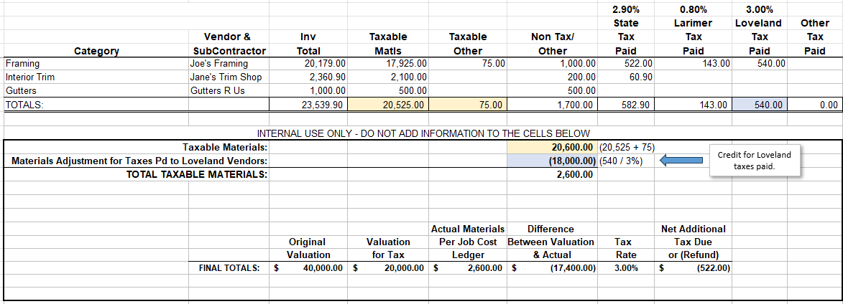
JCR – In Detail cont….
Net Tax-Refund Due - Example
This bolded box is located at the bottom of the spreadsheet and this data automatically populates.

Slide 10
THANK YOU FOR ATTENDING !
City of Loveland Contact Information
Pamela (JCRs): Pamela.Hemingway@cityofloveland.org
970-962-2702
General Sales Tax: 970-962-2708
Website: www.lovgov.org/salestax
Larimer County Contact Information
Phone number: 970-498-5935
Website: www.Larimer.org

