Slide 1
2024 Community Development Block Grant Process

Slide 2
Agenda
Grant guide and portal access
Funds available
2024 schedule
General & specific information
Federal regulations
Document submission
Q&A

Slide 3
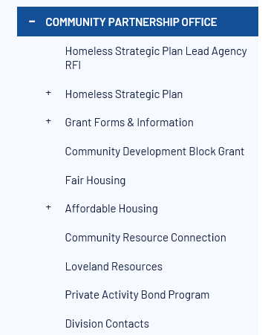
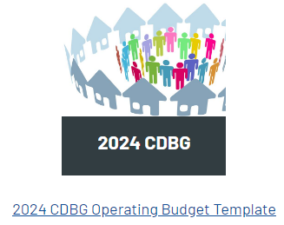
Grant guides
www.cityofloveland.org/communitypartnership

Slide 4

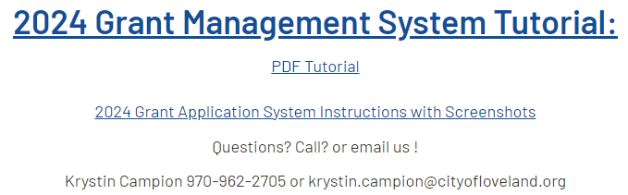
Grant portal
www.cityofloveland.org/communitypartnership

Slide 5

Funds Available for Projects
Estimated amount: $313,000

Slide 6
2023 Schedule
Pre-Application due Thursday, April 11th before midnight (confirmation email indicates success)
Grant Proposal due Thursday, May 16th before midnight (confirmation email)
Presentation email Friday, May 17th before noon
Grant presentations: June 10th
Allocations: June 10th
City Council: July 2nd
Grant year begins October 1st with executed contract

Slide 7
General Information
MUST HAVE: SAMS.gov registration, UEI number
Presentation: 20 minutes
Contracts
Reports: Due quarterly
Documents available on the website
Grant guide
2024 HUD income guidelines as soon as available
Quarterly report (this year and next year)
Grant funds spent by July 31st or explanation for extension

Slide 8
Grant guide specifics
Questions in pre-application copy to application
MINI CONTRACT (p.8). Please read.
One proposal for all types of projects (if housing, if public facility, skip if …)
Technical assistance available
Project budget – can use your own or ours
Minimum you need (Q16) … how to answer
Operating budget – rarely used. We will email to you.
Quarterly reports – one question is 4th quarter only

Slide 9
Federal regulations
Davis Bacon. Applies if $ > $2,000 or 8 or more units of housing
Uniform Relocation Act
Section 3 if > $200,000
Build American, Buy American if >$250,00
Lead paint
ALL CONSTRUCTION CONTRACTS WILL REQUIRE A PRE-CONTRACT MEETING

Slide 10
Document Submission
Online grant management system for pre-app and proposal
Strongly recommend submitting during business hours
DON’T WAIT UNTIL THE LAST MINUTE!
No spell check in system. Use WORD and cut and paste.
Video and PDF tutorials available on website
Reports and draw downs submitted online
Documents available on website: PDF of grant guide
Notes:
Will merge agency history in new system.

Slide 11
Questions for Affordable housing Commission
Q&A

