Slide 1


12th Major Millennium GDP Amendment
City Council – September 19, 2023

Slide 2
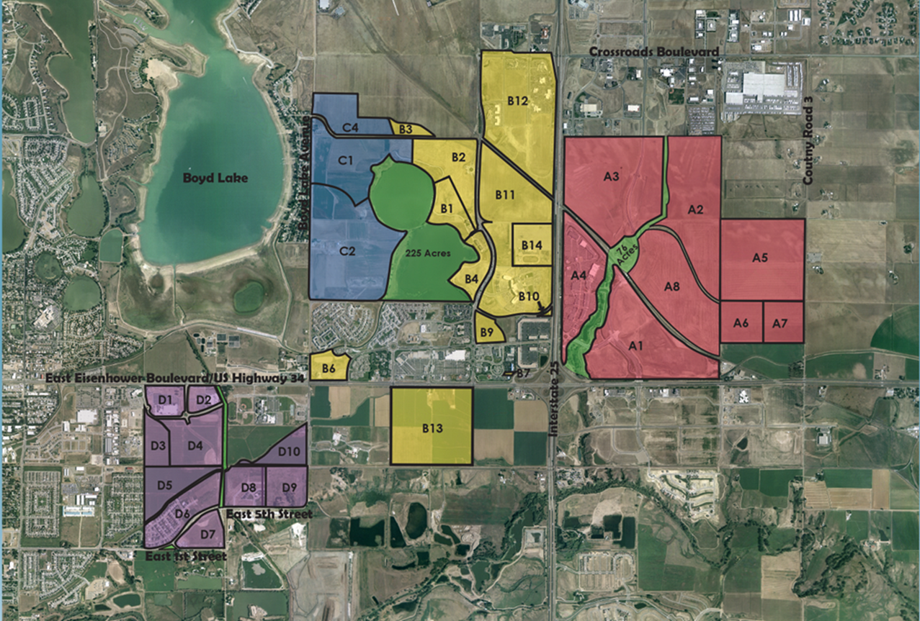
Millennium General Development Plan
Boyd Lake Shores.
The Lakes.
Lost Creek Dr.
Not a part of 12th GDP
Amendment
Boyd Lake Ave.
Highway 34
2

Slide 3
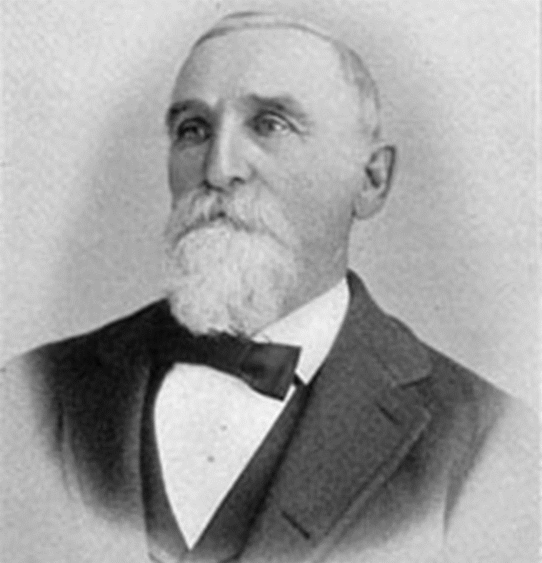
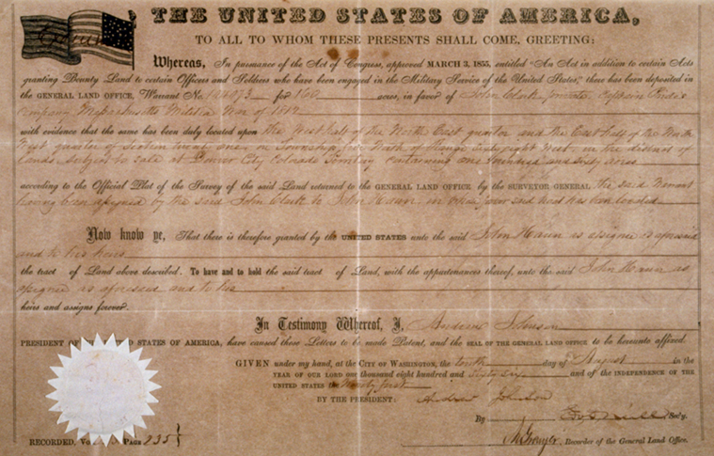
McWhinney History in Loveland
John Hahn, Chad and Troy McWhinney’s great-great grandfather homesteaded in Loveland in 1860
County Commissioner
Greeley-Loveland Irrigation Company Board Member
Business owner
Farmer and cattle rancher

Slide 4
GDP Major Amendment 12
Boyd Lake Shores.
Action Items:
Millennium GDP Amendment
Annexation and Development Agreement Amendment
Environmental Fees Agreement Amendment
The Lakes.
Lost Creek Dr.
Boyd Lake Ave.
Highway 34
4

Slide 5
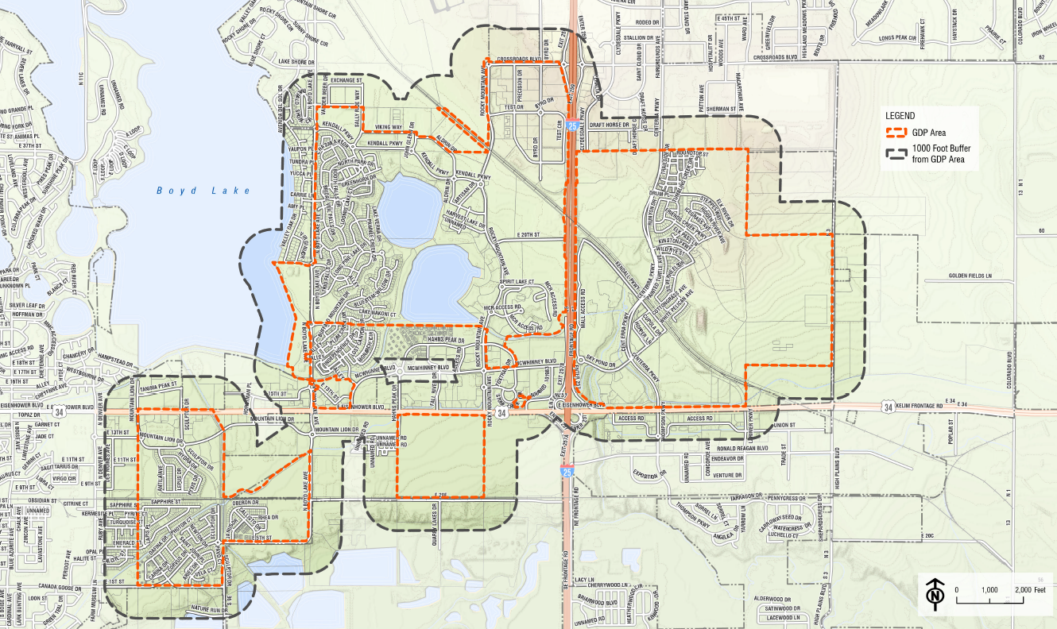
Notice Recipients

Slide 6
Millennium GDP Major Amendment 12
Summary of high-level changes:
Sections 1 – 5, 11 – 13 and 15
Additional residential units and more flexibility to allocate units between Parcels
Refined processes for GDP interpretation, deviations from performance standards, role of Centerra DRC
Definition updates
Formatting and technical changes
6

Slide 7
Use Transfer

Slide 8

Residential Unit Addition
General Locations
Parcel A – Approximately 2,000 units
Parcel B – Approximately 1,500 units
Parcel D – Approximately 300 units

Slide 9
Comprehensive Plan: Density and Housing
“Neighborhoods that include a variety of housing types and residents tend to be more resilient to economic and school challenges that would otherwise impact homogeneous homes or populations.”
“The incorporation of multifamily and mixed use housing translates to a more diversified housing market overall, with greater variation in housing types, tenures, affordability and uses.”
“While multifamily and mixed use housing will help address housing affordability, a number of residents explicitly stated the need for increased affordable housing throughout the City.”
“We are a community that encourages affordable housing, and considers housing affordability in land use decisions.”
“A community that provides a wide range of housing types is more likely to have a housing supply and market that adequately serves people across the income spectrum.”
“Density also plays a role in allowing market rate housing to be affordable because higher density housing has lower land costs per unit and can therefore be sold or rented for a lower price.”
“This comprehensive plan supports housing affordability by facilitating the mixed density neighborhoods, close to transit service and ensuring that sufficient density is allowed in order to keep land costs per housing units reasonable.”

Slide 10
Zoning Document Criteria
The Zoning Document is consistent with the policies and goals of the Comprehensive Plan, any applicable adopted area plan, or community plan of the City, or reflects stated conditions that have changed since the adoption of the Comprehensive Plan;
The Zoning Document either:
Advances the following policy objectives:
Promoting more economical and efficient use of land while providing a harmonious grouping of a variety of land uses;
Allowing for a project that assists in the implementation of adopted City plans (and not as a device to circumvent the standards of this UDC and good planning practice);
Addressing a unique situation or conferring a substantial benefit to the City; or
The creation of a PUD zone is the only practical way to avoid completely prohibiting a legal, permitted business use within the City.
The PUD complies with all applicable City standards not specifically modified or waived by the Zoning Document;
The PUD is integrated and connected with adjacent development through street connections, sidewalks, trails, multi-use pathways, and similar features;
To the maximum extent feasible, the proposal mitigates any potential significant adverse impacts on adjacent properties or on the general community;
Sufficient public safety, transportation, and utility facilities and services are available to serve the subject property, while maintaining sufficient levels of service to existing development; and
The same development could not be accomplished through the use of other techniques, such as complete neighborhood development, application of the Enhanced Corridor Overlay Zone, height exceptions, variances, minor modifications, or a planned unit development is a preferable way to regulate the subject property due to its large land area or multi-year build-out schedule; and
As applicable, the proposed phasing plan for development of the PUD is rational in terms of available infrastructure, and capacity.

Slide 11
Rezoning Criteria
The amendment will not reduce the level of protection for significant natural resources on the property or expose additional people or personal property to unmitigated natural hazards.
The zoning is consistent with its Comprehensive Plan land use designation or a Comprehensive Plan amendment has been approved.
Rezoning will provide a benefit to the community or immediate area that cannot be provided under the existing zoning, and the balance between the anticipated benefit, if any, and the anticipated burden, if any, is either neutral or favors the rezoning.
Rezoning would not cause an I zone to share a boundary with an ER, R1e, R1, R2, R3e, or R3 zones.
Adequate community facilities are available to serve development in accordance with Section 18.15.02.05; or the proposed zone would limit demands upon community facilities more than the existing zone; or reasonable assurances are provided that adequate community facilities will be made available to serve new development.
The proposed zone is more appropriate than the existing zone to implement an adopted or approved current City Plan.

Slide 12
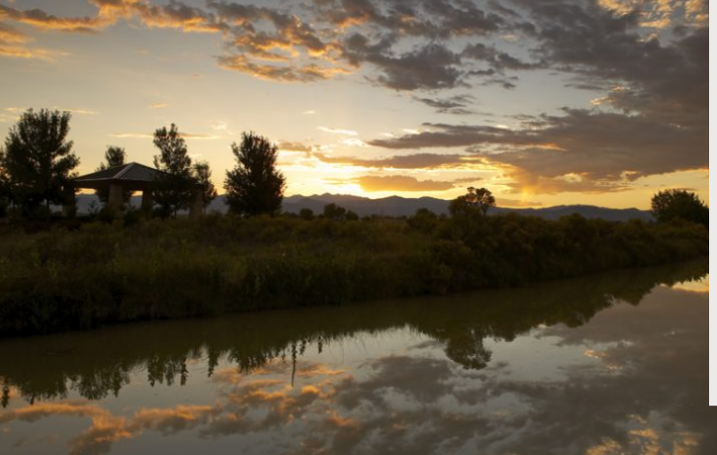


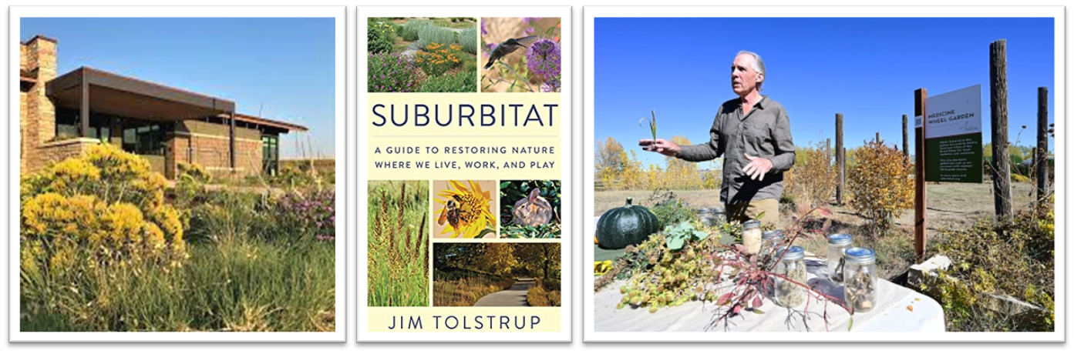
Sustainability

Slide 13
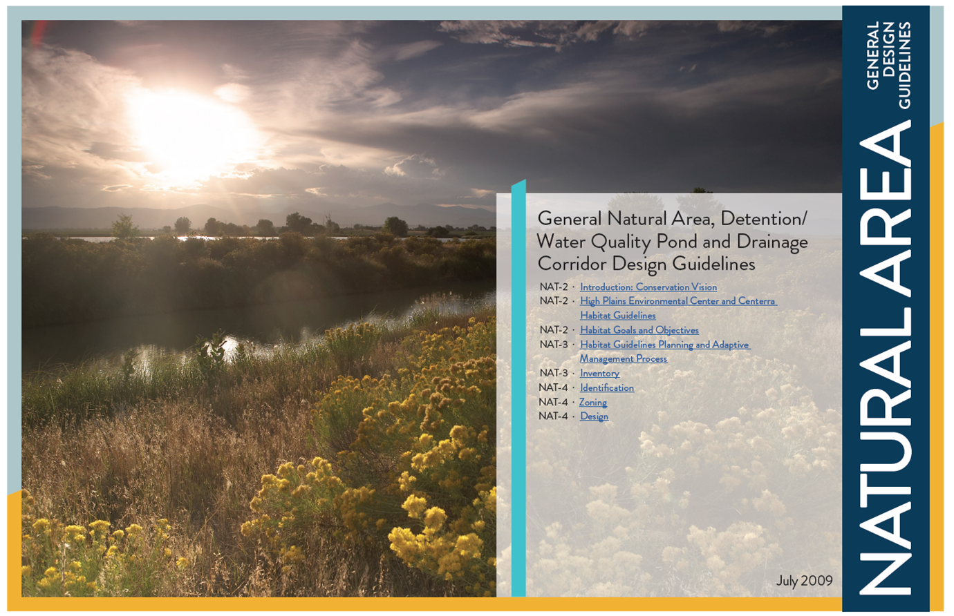

Sustainability
Over $5 Million in self-imposed Environmental Fees have been paid to High Plains Environmental Center for development in Centerra
Natural Area Drainage and Detention Pond Guidelines
Hydrozones for all common area landscape irrigation
Approved Plant List by the High Plains Environmental Center
Research (in third year) testing grasses for low water needs and resistance to snow melt and CSU Plant Select plants
Changing out annual flower beds to perennials
Planting native grass areas wherever possible
Awarded Sustainable Landscape Community and certified Sustainable Landscape Management program
Increasing wildlife and continuous surveys to track progress
Pollinator support
Environmental education
Partnerships between HPEC and Thompson School District, CSU, Butterfly Pavilion, Denver Botanic Garden
Support of transit and multi-modal transportation options
EV Charging stations

Slide 14
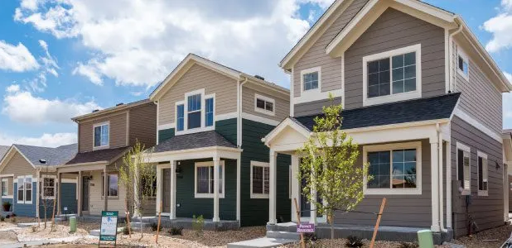
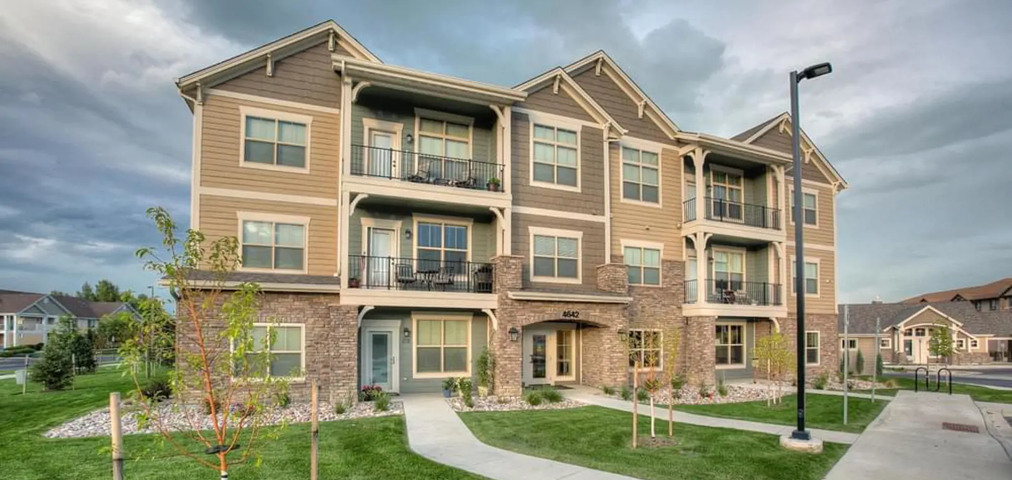
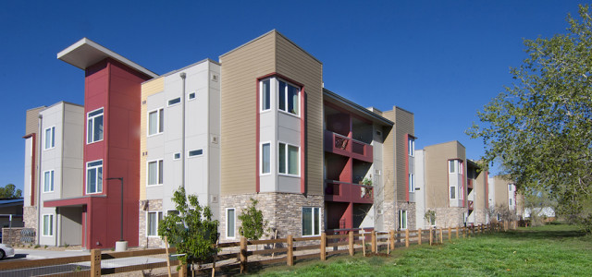
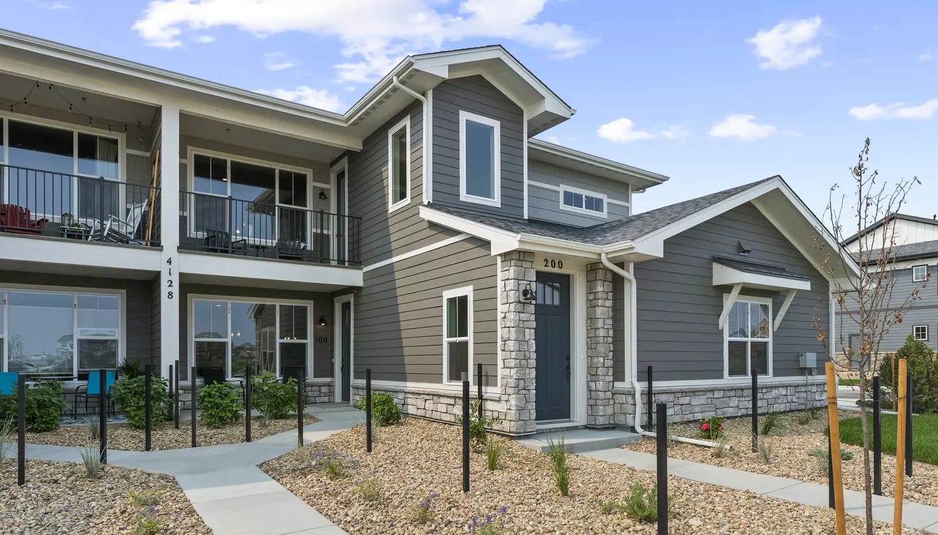
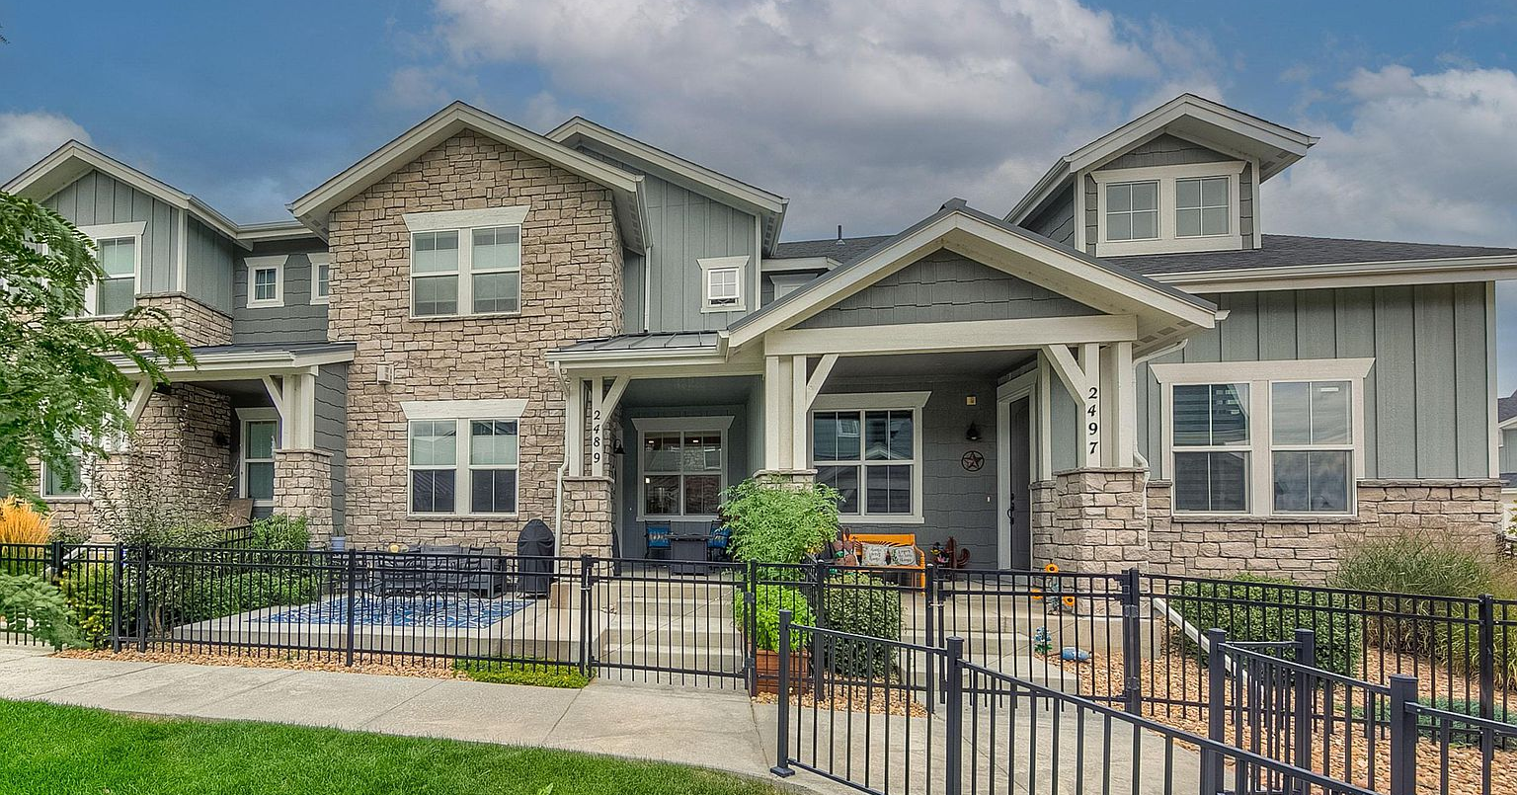
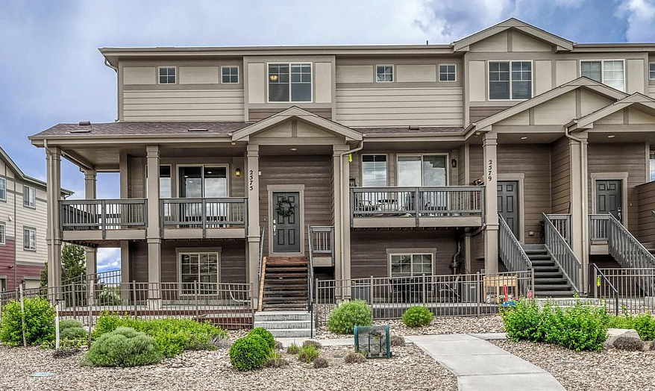
Examples of Affordable and Attainable Residential Housing in the GDP
Boyd Lake Shores.
The Lakes.
The Lakes - Wee Cottages by Boulder Creek
The Lakes - Condos/The Flats by Landmark
VDW - Future Edge Apartments by LHA
New C3
Lost Creek Dr.
Boyd Lake Ave.
The Lakes – Condos/Discovery by Landmark
The Lakes – Townhomes by Landmark
Highway 34
The Lakes – Townhomes by Boulder Creek
14

Slide 15
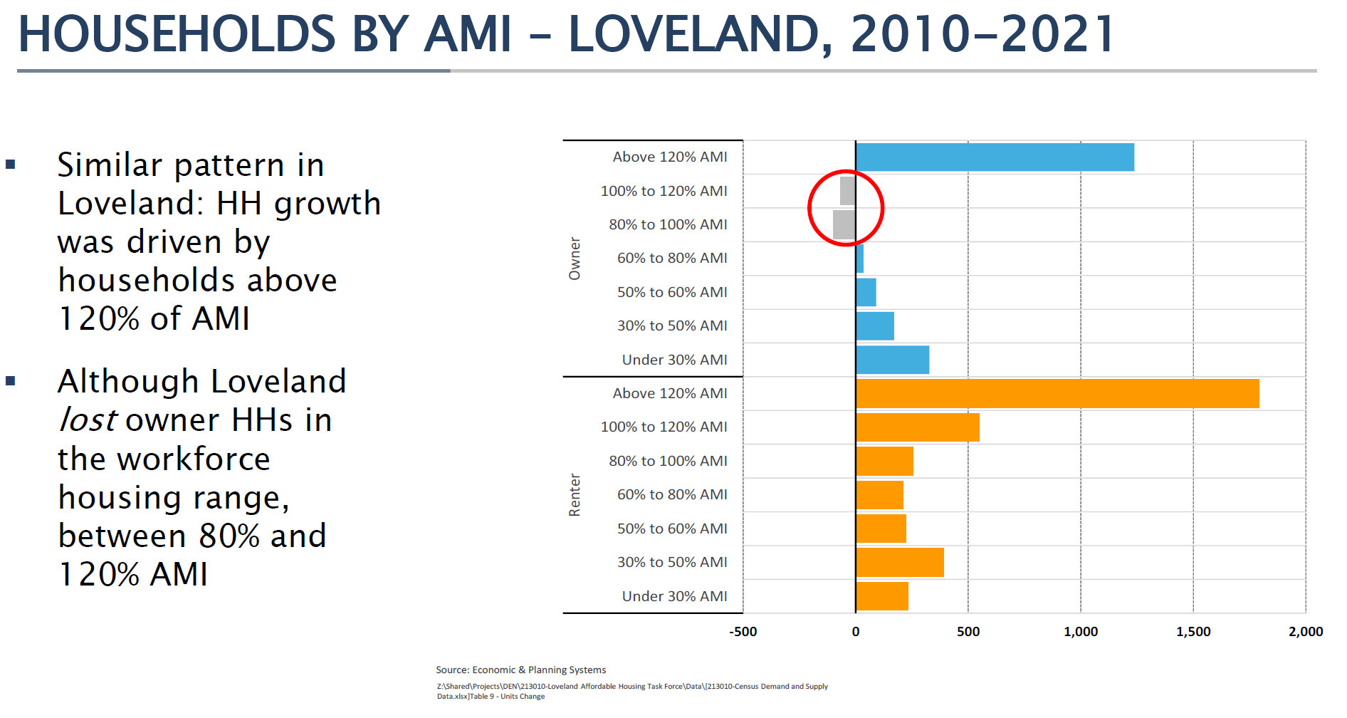

Slide 16
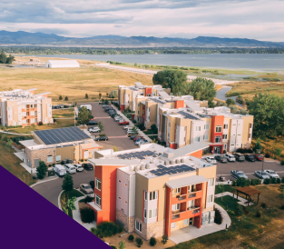
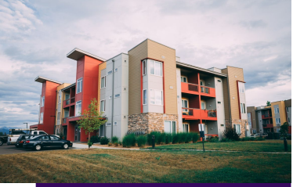
McWhinney – Loveland Housing Authority
Affordable Units on 4.4 Acres Donated to LHA:
80 – 85 units
Affordable Units sold to LHA at a Discount:
205 units

Slide 17

Affordable and Attainable Housing: Housing Diversity and Choice
Boyd Lake Shores.
McWhinney’s Diverse Housing:
Apartments 1255 28%
Condos 1258 28%
TH 300 7%
SFD 1630 37%
Total 4443 100%
For-Sale Homes:
82% of for-sale homes fall in the 60% to 120% AMI
Rental Units:
45% AMI to 110% AMI with an average affordability to 77% AMI
The Lakes.
Study produced by EPS
March 30, 2023
Lost Creek Dr.
Boyd Lake Ave.
Highway 34
17

Slide 18
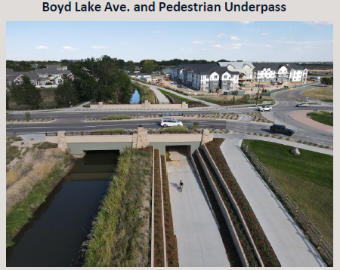
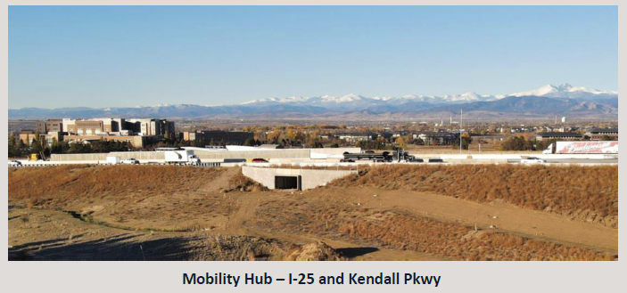
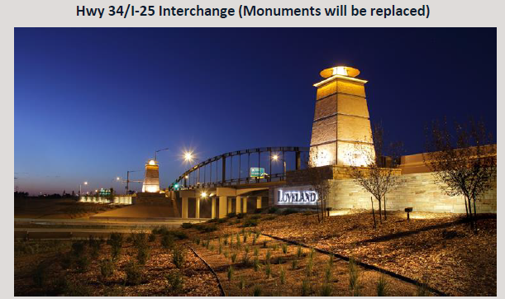
Regional Traffic-Related Improvements Track Record
Highway 34 and I-25 improvements - $14 Million
Crossroads and I-25 improvements - $2.6 Million
Mobility Hub at I-25 and Kendall Parkway - $11.4 Million
Boyd Lake Avenue - $20.4 Million
Kendall Parkway - $14 Million
Centerra Parkway - $13.7 Million
Total - $76.1 Million

Slide 19
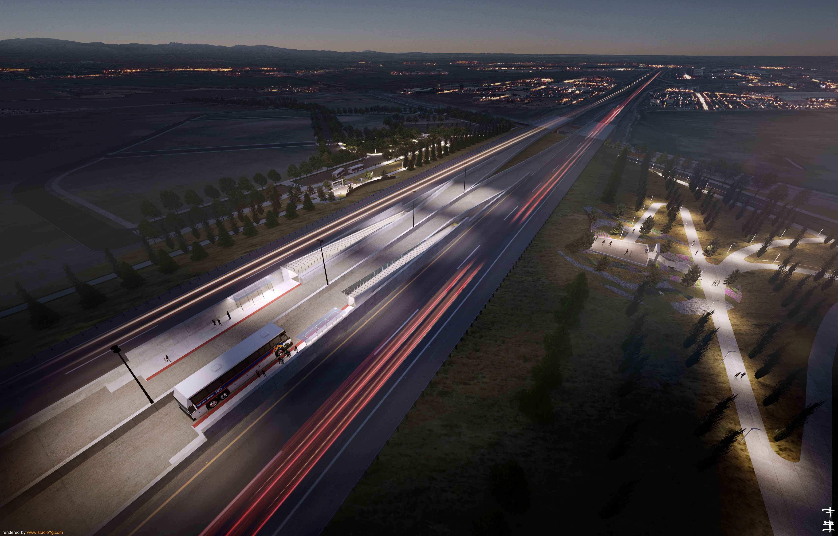
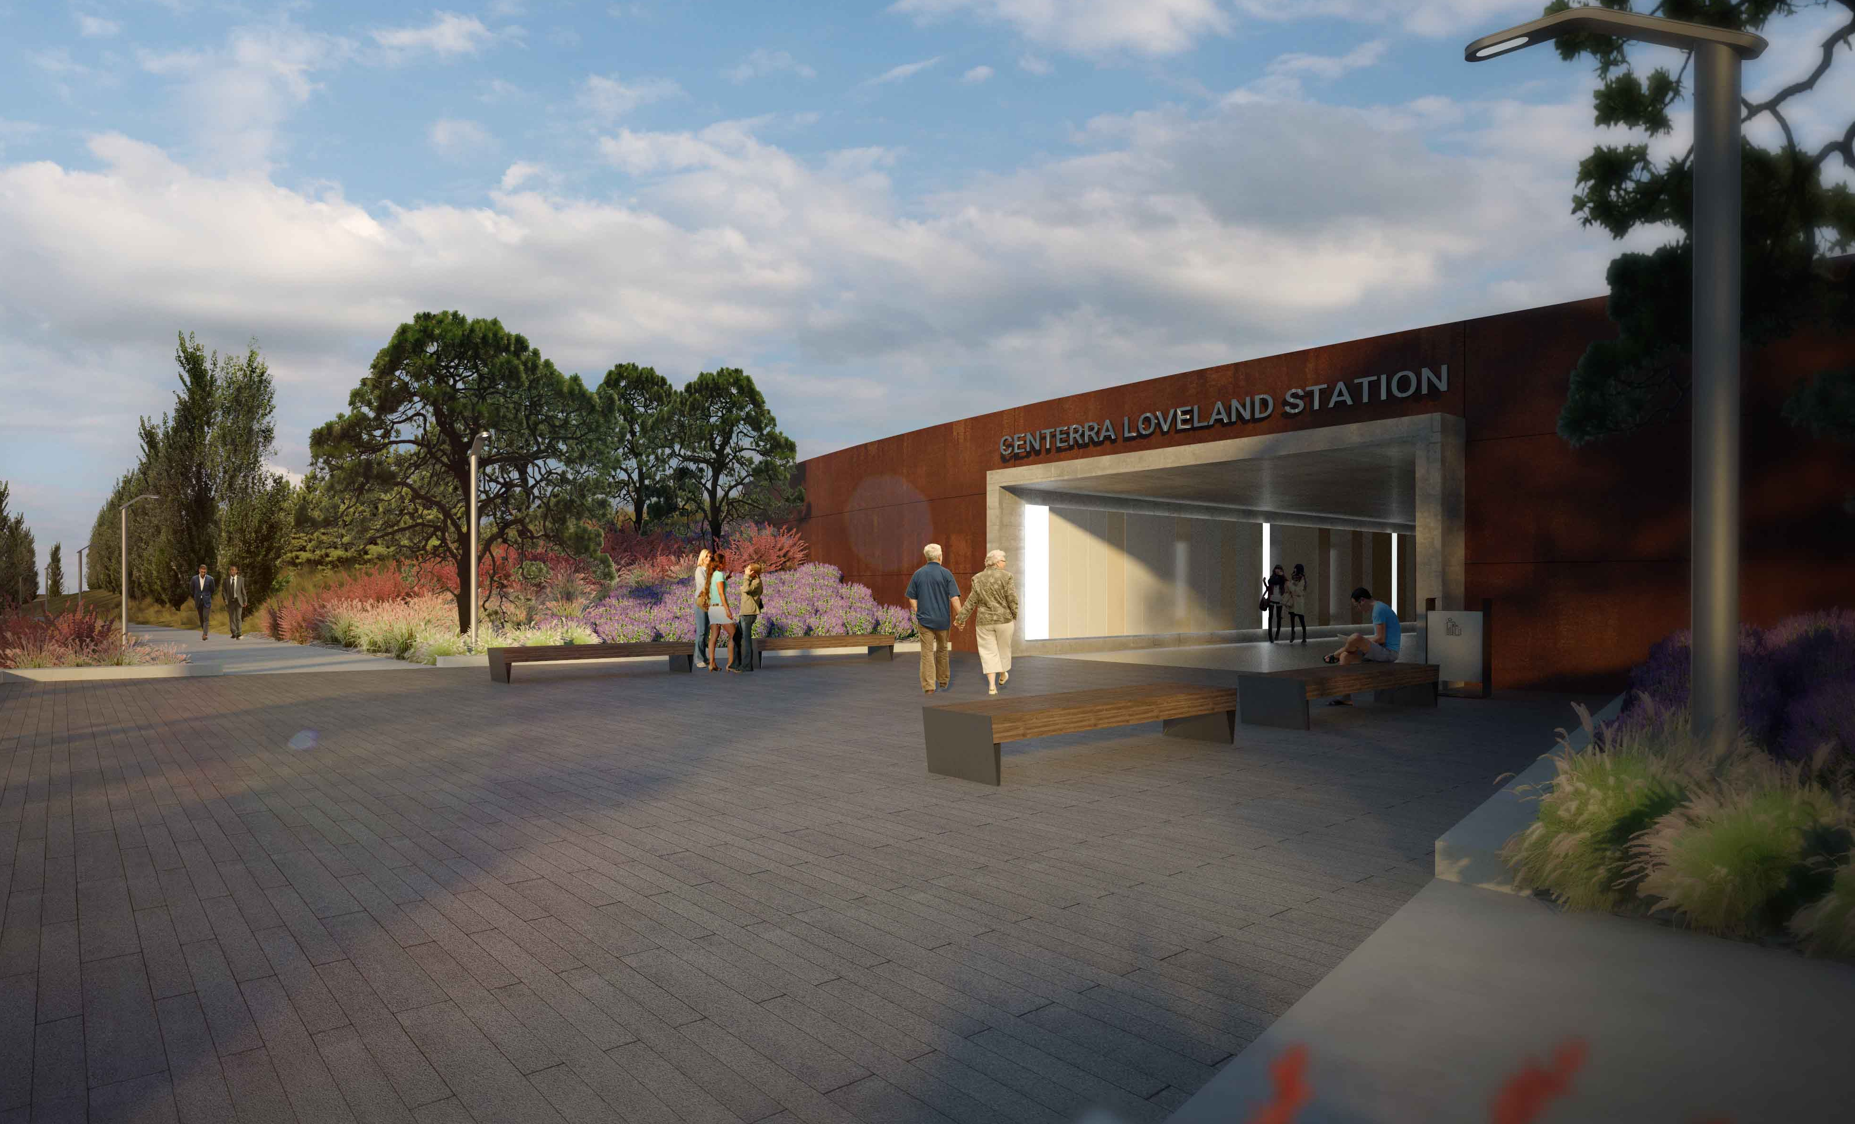
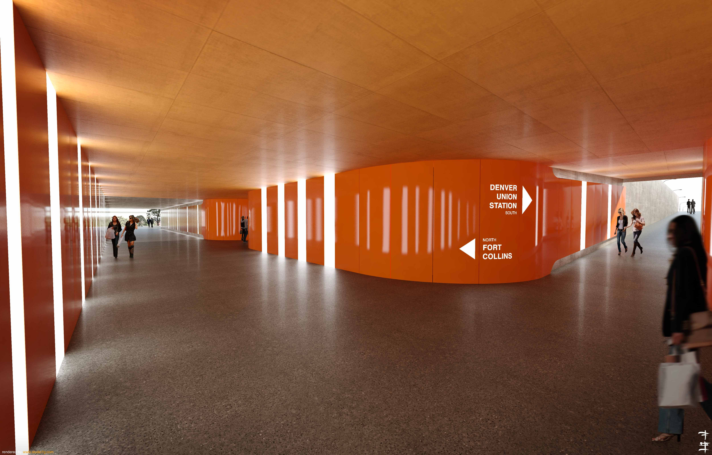
Centerra-Loveland Station – CDOT Mobility Hub (2024)
Boyd Lake Shores.
$11.4 Million to date contributed for the Kendall Parkway underpass, exterior and interior station enhancements.
The Lakes.
New C3
Lost Creek Dr.
Boyd Lake Ave.
Highway 34
19

Slide 20
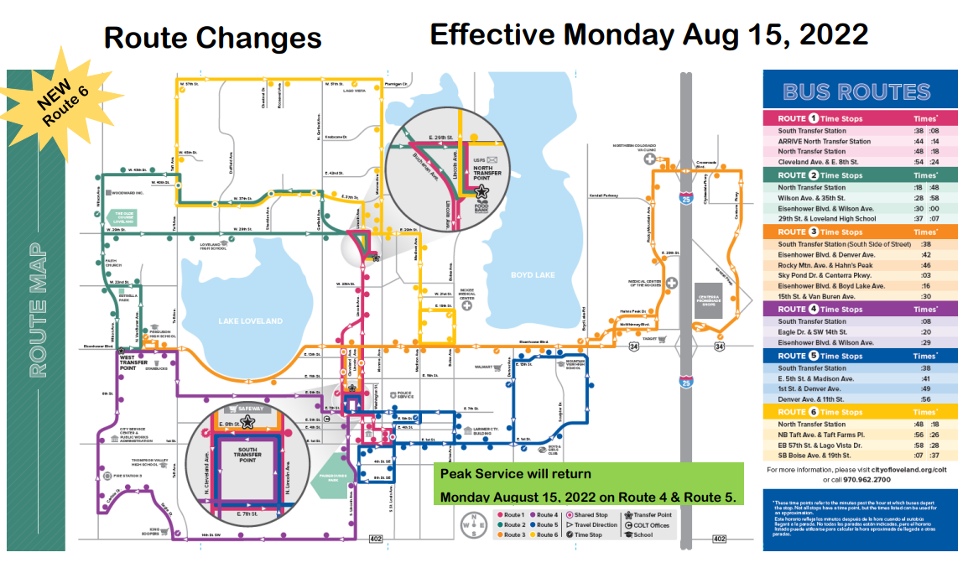
COLT Route Map
Boyd Lake Shores.
The Lakes.
New C3
Lost Creek Dr.
Boyd Lake Ave.
Highway 34
20

Slide 21
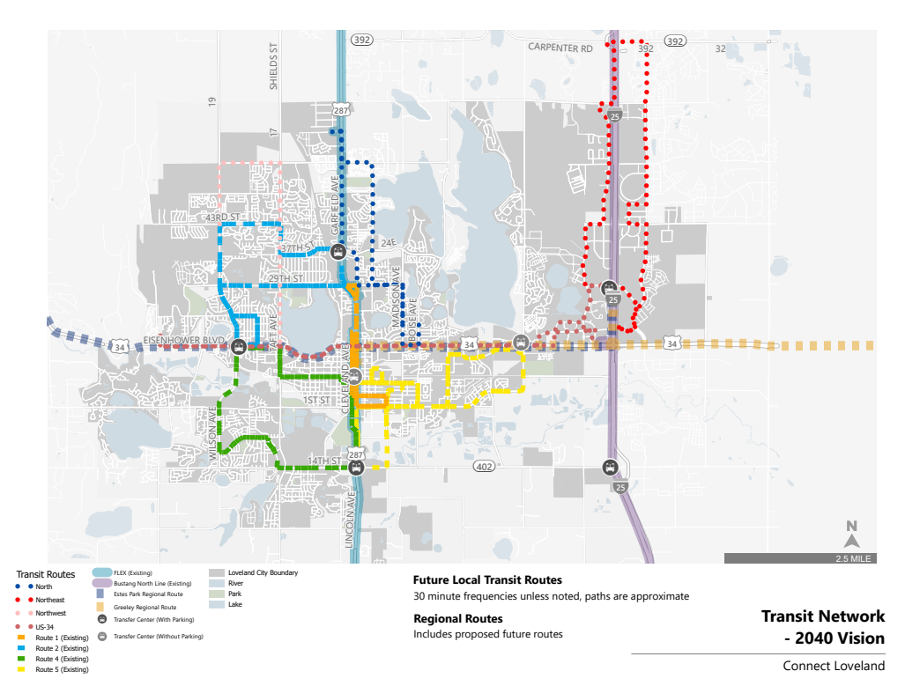
Public Transportation

Slide 22
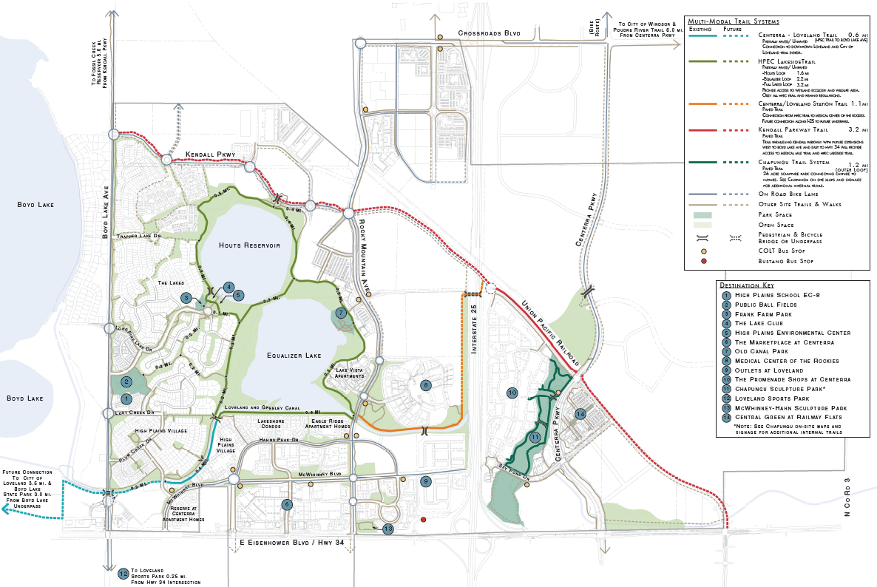
Centerra Trails and On-Road Bike Lanes
Boyd Lake Shores.
The Lakes.
New C3
Lost Creek Dr.
Boyd Lake Ave.
Highway 34
22

Slide 23
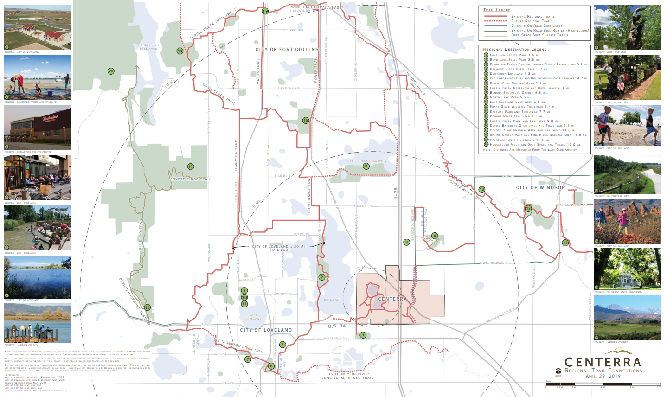
Centerra Trail Connections to the Surrounding Regional Trails
Boyd Lake Shores.
The Lakes.
New C3
Lost Creek Dr.
Boyd Lake Ave.
Highway 34
23

Slide 24
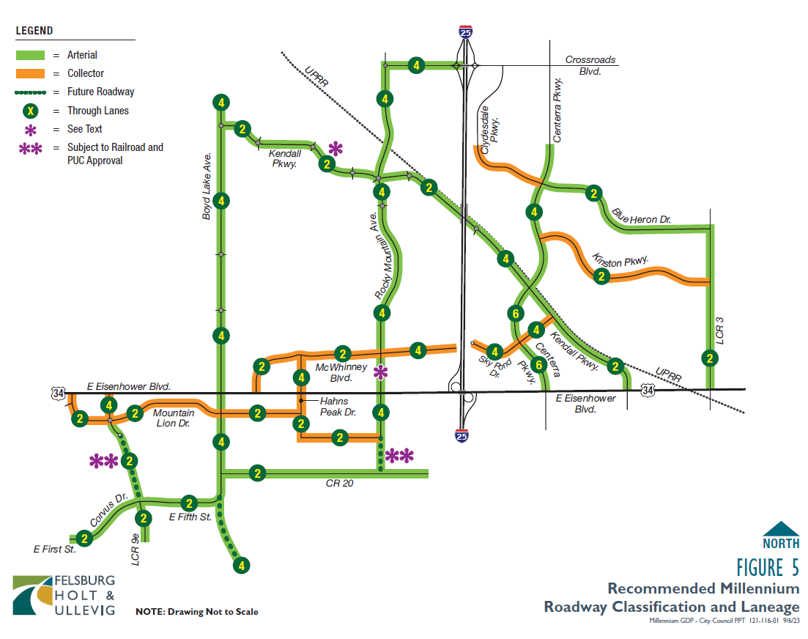
Master Streets Plan
Road Improvements:
Rocky Mountain Avenue
Centerra Parkway
Kendall Parkway
Boyd Lake Avenue
E. First Street
E. Fifth Street
20E
Elk River Drive
McWhinney Boulevard
Sky Pond Drive
Kinston Parkway
Hahn’s Peak Drive
Mountain Lion Drive
Clydesdale Parkway

Slide 25
Millennium GDP Development Agreement Amendment
Boyd Lake Shores.
Revise the Development Agreement to update the vested rights.
The Lakes.
Lost Creek Dr.
Boyd Lake Ave.
Highway 34
25

Slide 26
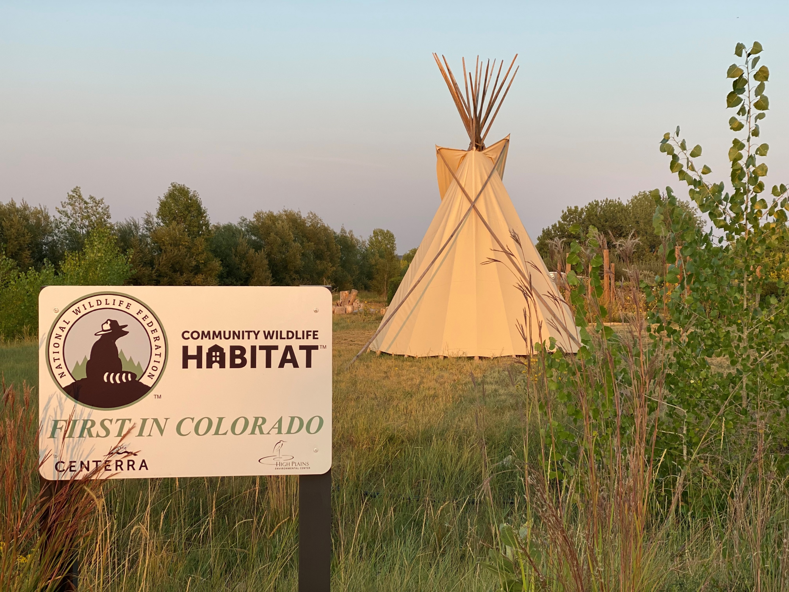
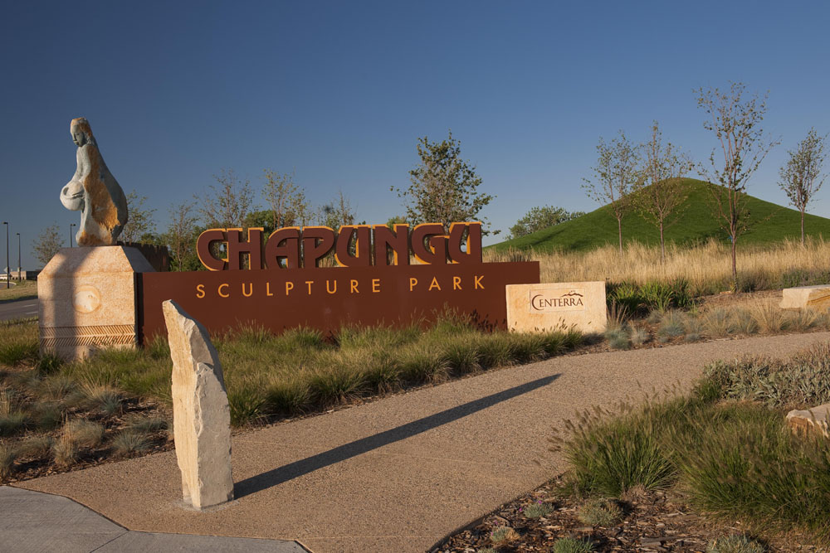
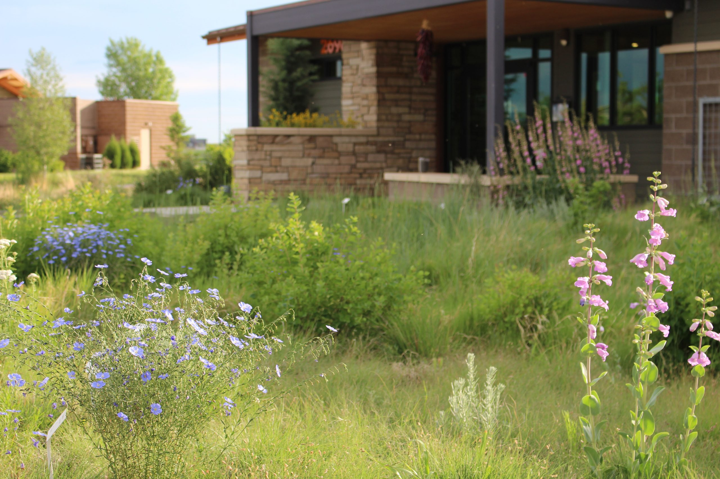
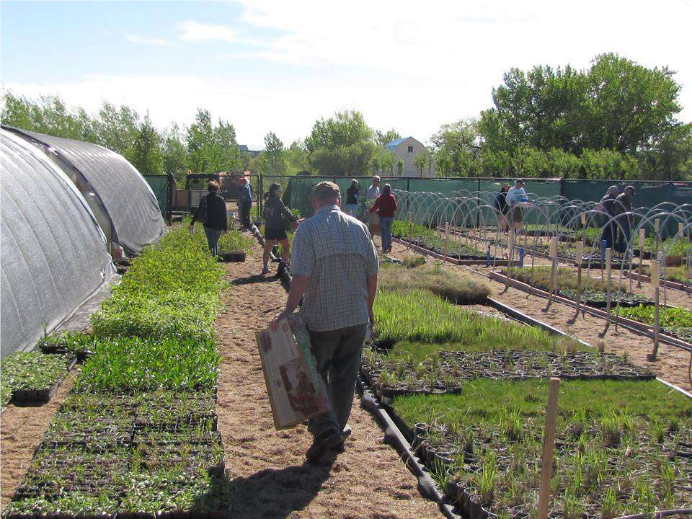
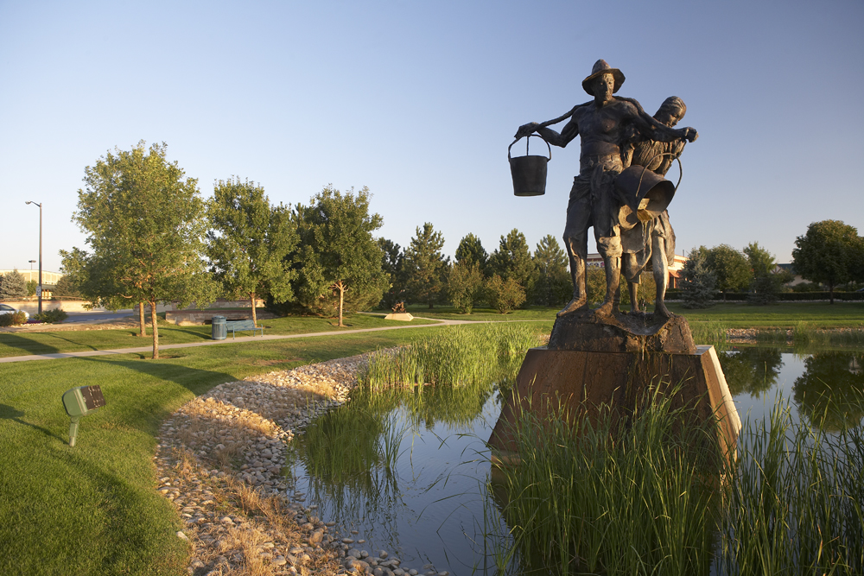
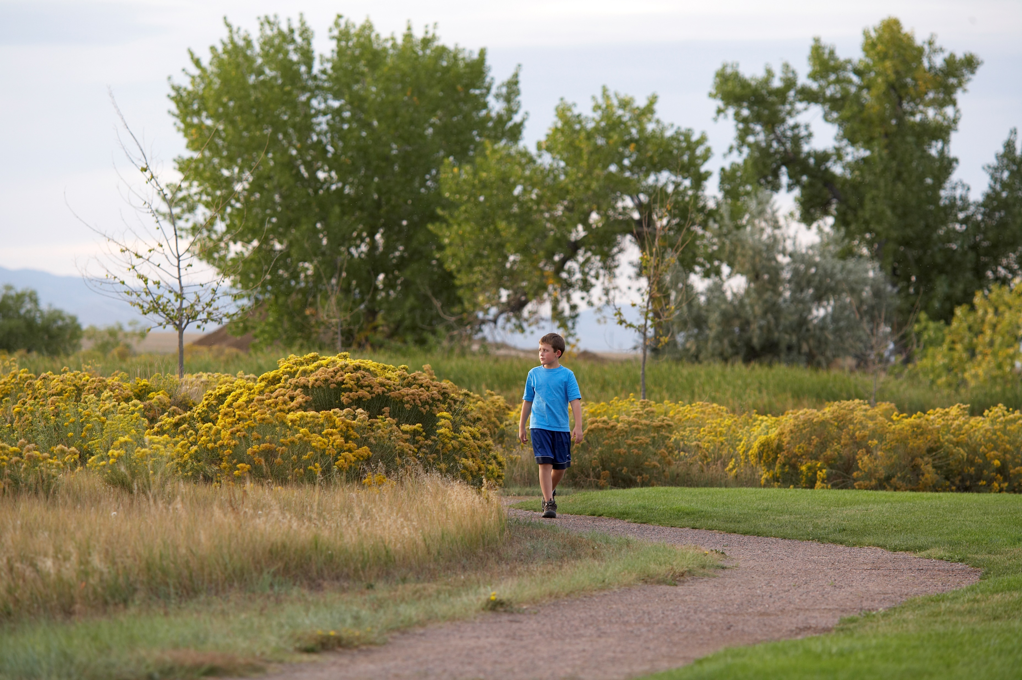
Public Amenities and Benefits

Slide 27


Environmental Fees

Slide 28
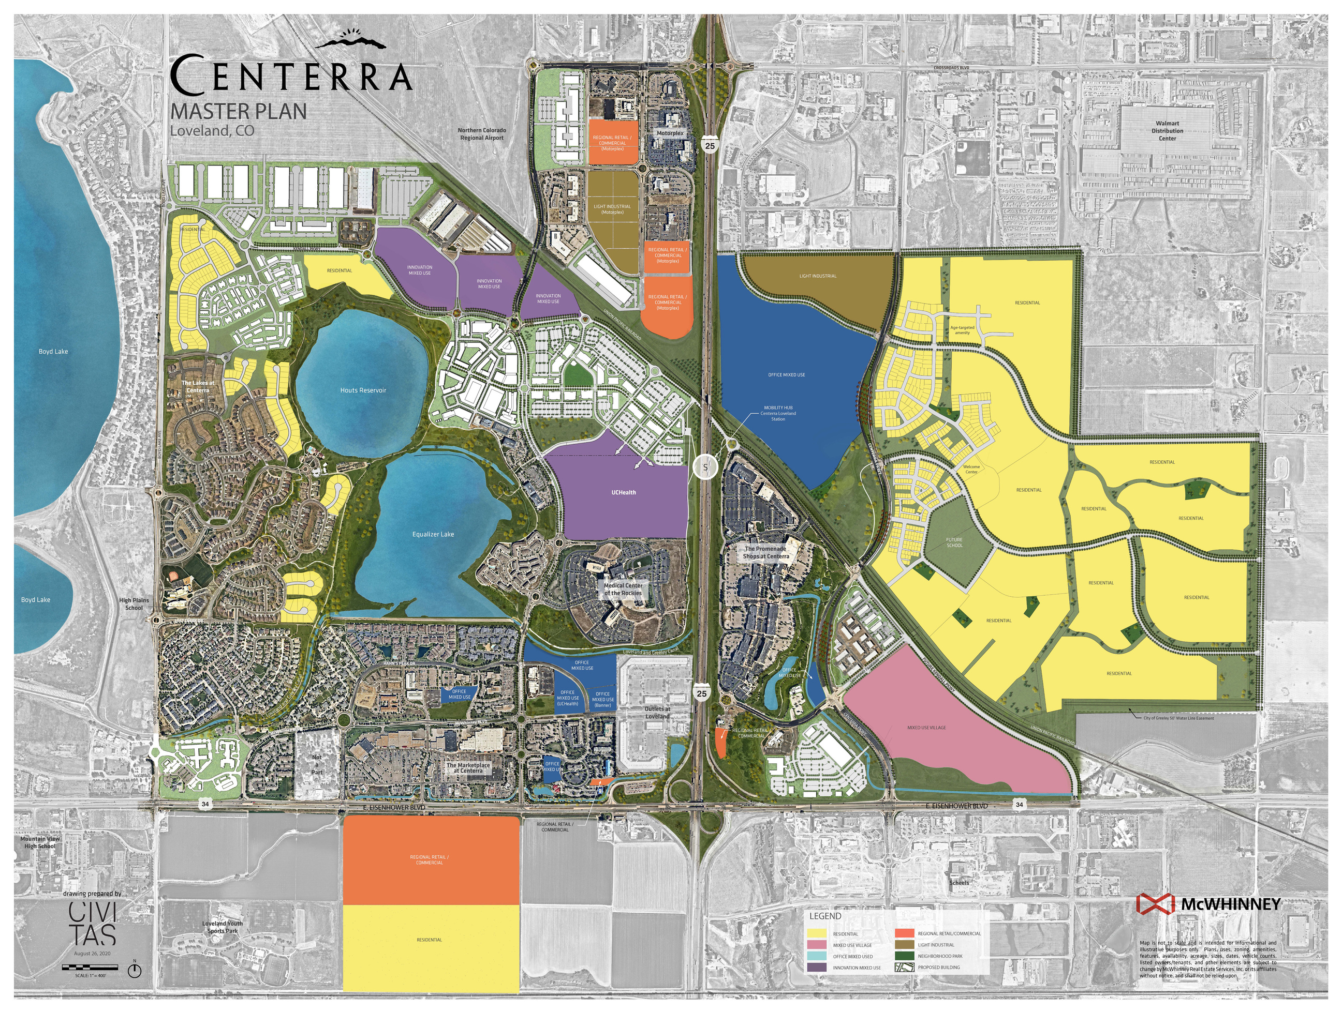

Centerra South: Environmental Fees

Slide 29
Questions?

Slide 30
Traffic Impact Study Differences – Hypothetical Example Only
Master Traffic Study (maximum density of 100 single-family detached homes)
Daily estimate is 1010 trips per day
Assess affected roadway segments
Detailed Traffic Study (only 92 single-family detached homes are proposed)
Daily Estimate is 935 trips per day
Assess affected nearby road segments
AM peak hour estimate is 69 trips per hour, 16 in and 48 out
PM peak hour estimates is 92 trips per hour, 58 in and 34 out
Assess nearby intersections given turning movements increases

Slide 31
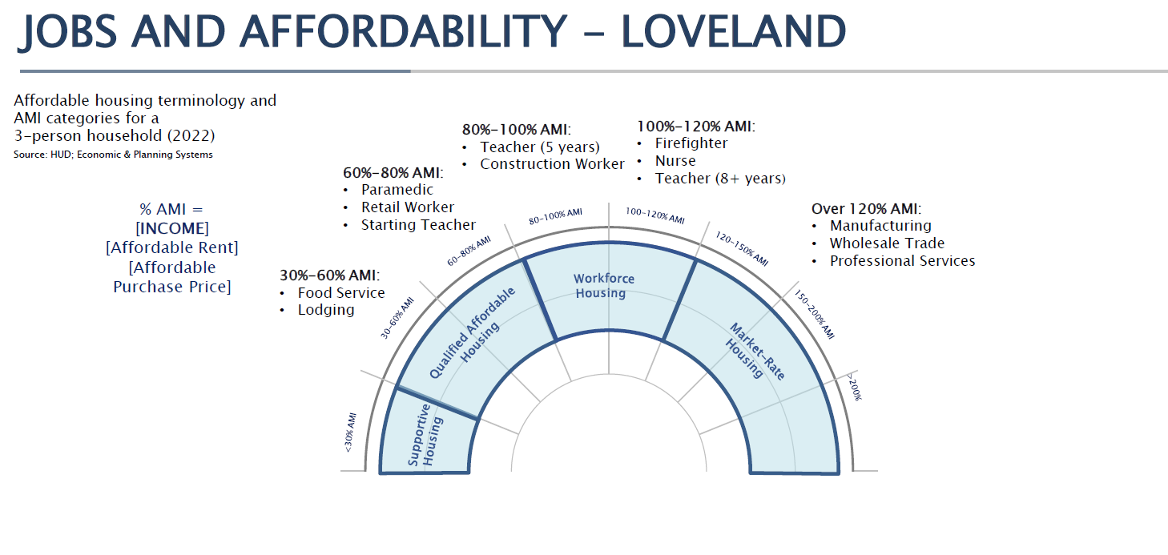
EPS Study: Affordability

Slide 32
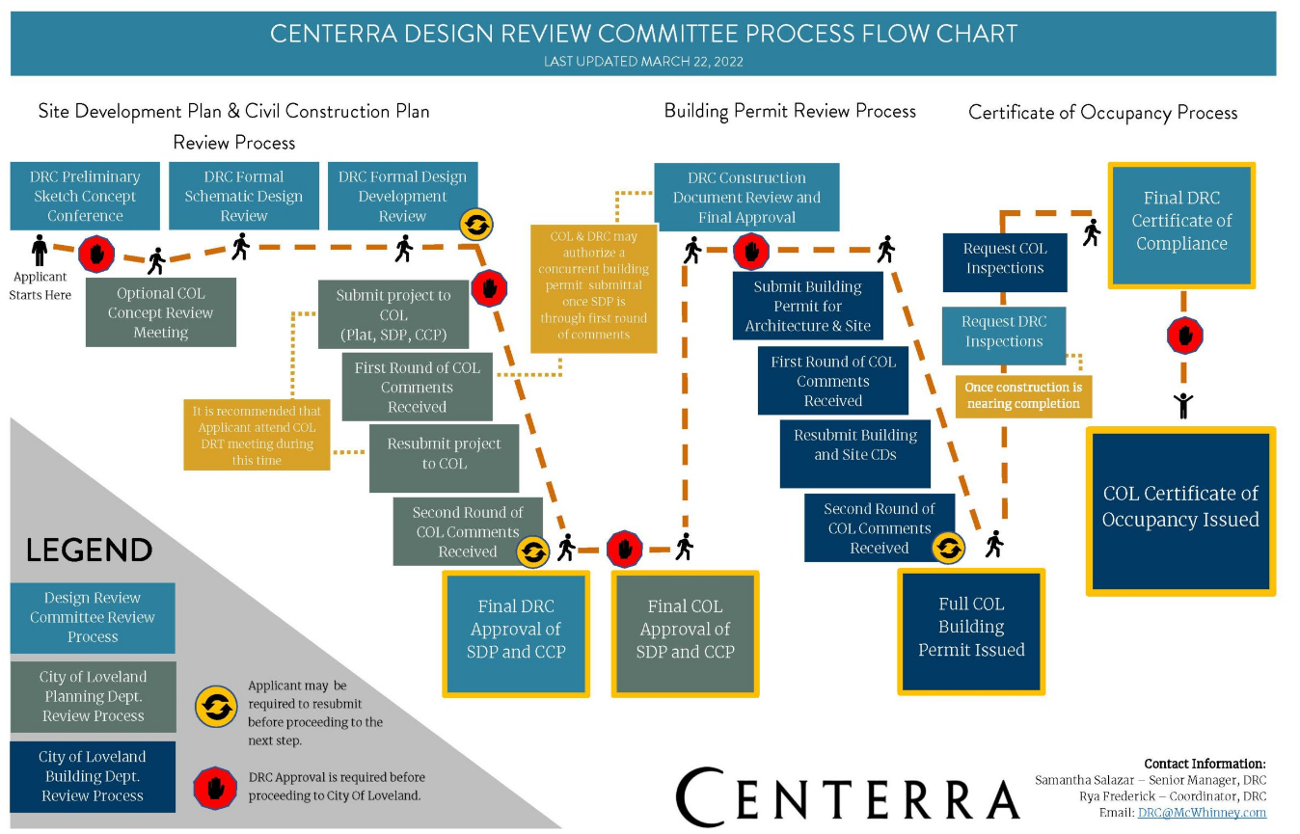
Centerra DRC Review Process

Slide 33
Impact on School Capacity
Information from the School District:
447 students currently attend High Plains School
High Plains School expansion will increase capacity to 750
Future K-8 school site east of I-25

