Slide 1
2022 Community Development Block Grant Process

Slide 2
Agenda
Grant guide and portal access
Funds available
2022 schedule
General & specific information
Federal regulations
Document submission
Ask a commissioner

Slide 3
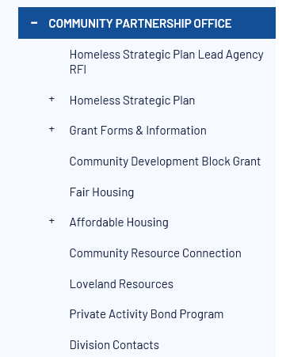
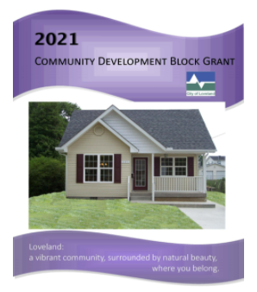
Grant guides
www.cityofloveland.org/communitypartnership

Slide 4


Grant portal
www.cityofloveland.org/communitypartnership

Slide 5

Funds Available for Projects
Estimated amount: $275,000

Slide 6
2022 Schedule
Pre-Application due Thursday, March 17th before midnight (confirmation email indicates success)
Grant Proposal due Thursday, April 14th before midnight (confirmation email)
Presentation Sign-up Genius email Friday, April 15th before noon
Grant presentations: May 4th (or May 5th depending on # of applications).
Allocations: May 12th
City Council: June 7th
Grant year begins October 1st with executed contract

Slide 7
General Information
MUST HAVE: SAMS.gov registration, DUNS number
Presentation: 20 minutes
Contracts
Reports: Due quarterly
Documents available on the website
Grant guide
2022 HUD income guidelines as soon as available
Quarterly report (this year and next year)
Grant funds spent by July 31st or explanation for extension

Slide 8
Grant guide specifics
Questions in pre-application copy to application (p.7)
MINI CONTRACT (p.8). Please read.
One proposal for all types of projects (if housing, if public facility, skip if …)
Technical assistance available
BUDGET – upload from website.
Minimum you need (Q16) … how to answer (p.12)
Operating budget – rarely used (p.14). We will email to you.
Quarterly reports – one question is 4th quarter only (p.21)

Slide 9
Federal regulations
Davis Bacon. Applies if $ > $2,000 or 8 or more units of housing
Uniform Relocation Act
Section 3 if > $200,000
Lead paint
ALL CONSTRUCTION CONTRACTS WILL REQUIRE A PRE-CONTRACT MEETING

Slide 10
Document Submission
Online grant management system for pre-app and proposal
Strongly recommend submitting during business hours
DON’T WAIT UNTIL THE LAST MINUTE!
No spell check in system. Use WORD and cut and paste.
Video and PDF tutorials available on website
Reports and draw downs submitted online
Documents available on website: PDF of grant guide
Notes:
Will merge agency history in new system.

Slide 11
Questions for Affordable housing Commission
Q&A

