Slide 1


May 6, 2021 Town Hall
Economic Development &
Development Services
Kelly Jones, Economic Development Director
Brett Limbaugh, Development Services Director

Slide 2

Question
What is ‘economic development?’

Slide 3
Economic development is…
… a process of deliberate intervention in the dynamics of the local economy by making economic growth easier or more attractive
… the process of influencing private sector investment as the engine for community economic growth

Slide 4
Question
So what? Why does it matter?

Slide 5
Why Focus on Job Creation
In natural course of things, communities lose jobs
  10-15 percent of jobs disappear annually thru innovation
  meaning that communities must work hard to stay even
Competition for a City’s employers is very intense
One community’s companies are another community’s prospects

Slide 6
Business Climate
Another important economic development term: ‘business climate’
Business climate = extent to which the political and policy environments of a particular locale, compared with other jurisdictions, are seen to be supportive or burdensome to businesses.
Source: Corporation for Enterprise Development (CFED)

Slide 7
What Affects Business Climate
Major cost factors (land, labor, taxes, regulations)
Non-cost factors (quality of life, attitudes toward business)

Slide 8
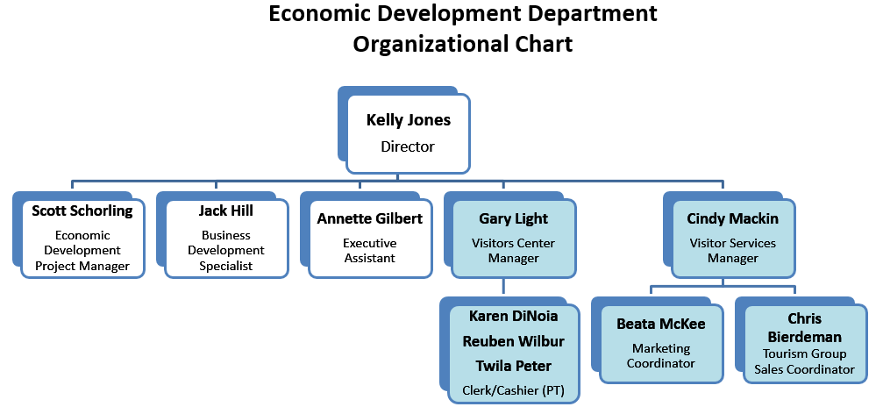
Department Overview

Slide 10
Business Development Division
Economic Development leads and focuses on growing employment and business opportunities to sustain the economic health of Loveland and the Northern Colorado region.
Activities and Projects
Business site visits and outreach activities
Downtown development consulting
Concierge role for startups and businesses expanding or relocating to Loveland
Support and coordination with local agencies (LBDC, Warehouse)
Regional Economic Dev (REDI) Team leadership and coordination
Site selector contact point for large developments
Research and coordination in response to inquiries from large search firms
Guiding Principles and Documents
Economic Development Strategic Plan 2018-2022
Incentive Policy 2017
Workforce 2.0
REDI Memorandum of Understanding
Partners / Local Agencies
Regional Economic Development Initiative
Loveland Business Development Center
The Warehouse
Larimer SBDC
Chamber of Commerce

Slide 11
Five-year Strategy: Back to Basics
T – TRACE Core Principles
      Tourism
      Talent
      Retention
      Attraction
      Creation
      Expansion
        Lodging tax
        Conference bookings
        Thompson Career Campus
        Northern Colorado Talent Website
        Quarterly Executive Level Breakfasts
        Surveys
        Business Visits
        Regional Economic Development Initiative (REDI)
        Local Partner Agencies
        Performance Dashboard

Slide 12
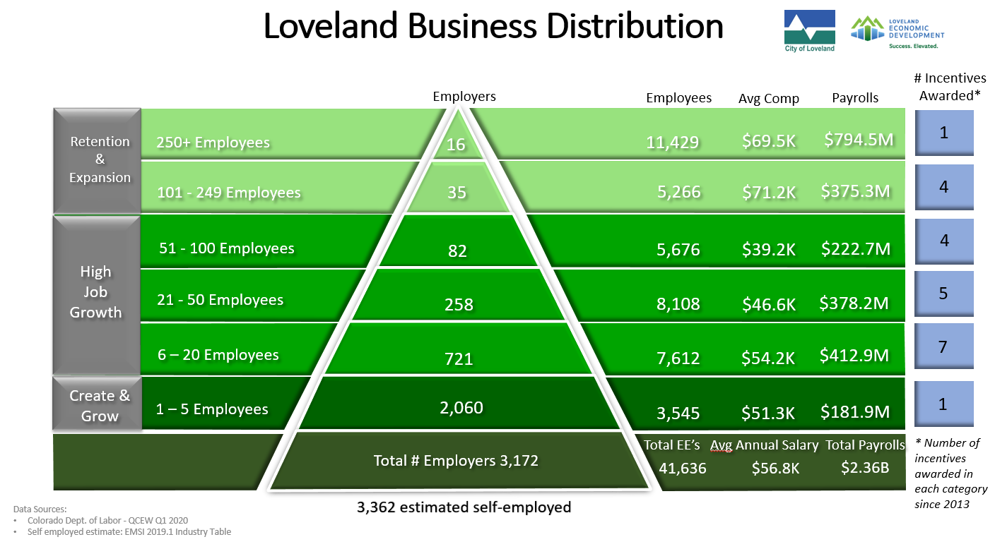

Slide 13
Pyramid Talking Points
High Level Overview – 3 Year Trends
Total Number of Employers: UP 4.4%
Average Wage Compensation: UP 30%
Wage Growth was the highest in Employers with 250+ (51%) and 6-20 Employees (42%)
Notable Employers Out/Downsizing
Madwire: 321 employees
  Moved to FoCo
US Engineering: 557 Employees
  Moved to Berthoud
LPR Construction: 385 employees in 2017 → 135 in 2020
Woodward: 202 Employees
  Consolidation to FoCo
Notable Employers In/Expanding
Nutrien: Added 200+ employees in the past 3 years
Mears Group: 150+ employees
Amazon: Added roughly 200+ employees
Lightning e-motors: Adding 50+ employees

Slide 14

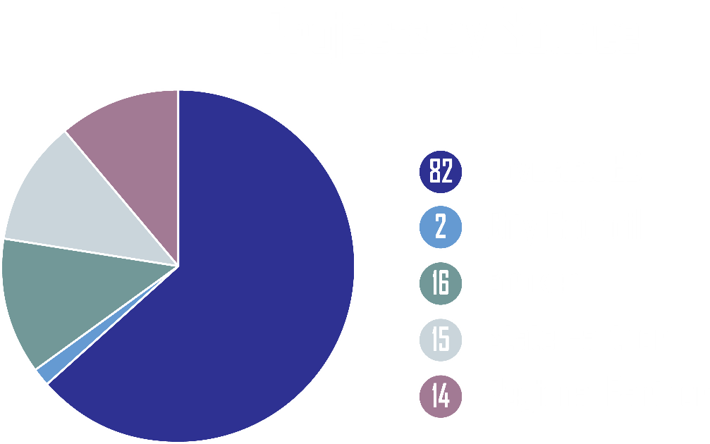
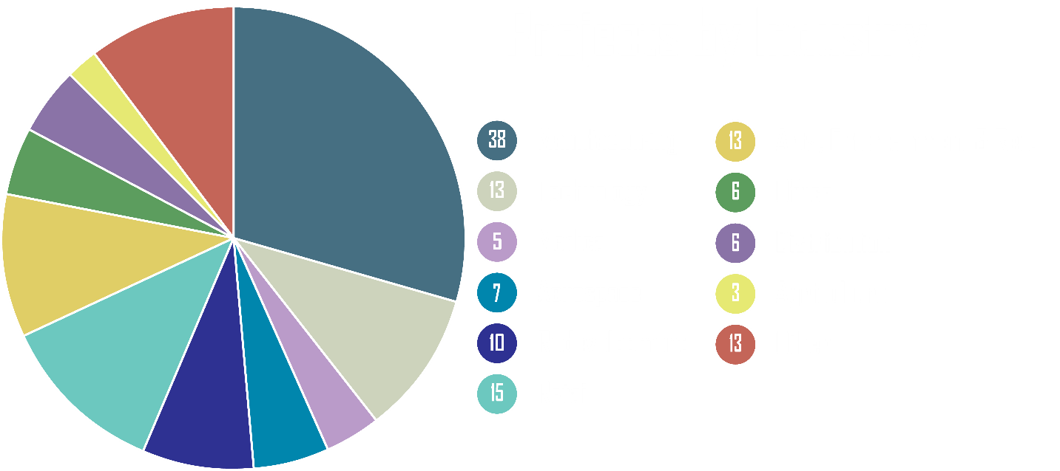
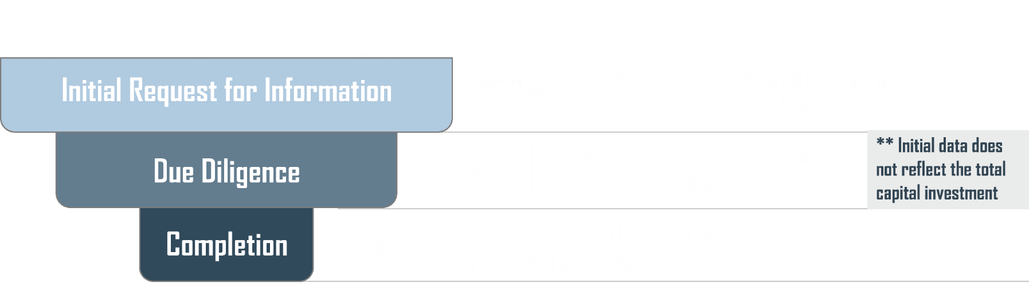
Prospect Report

Slide 15
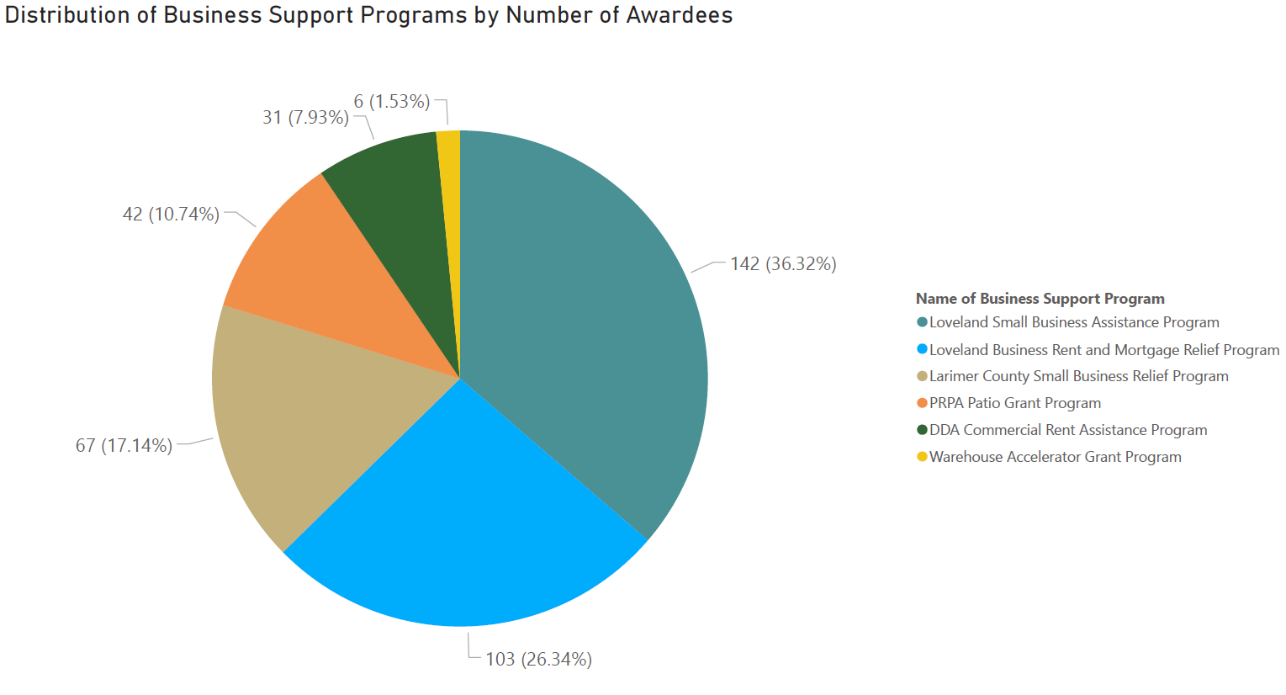
Business Relief Efforts During COVID-19 Pandemic

Slide 16
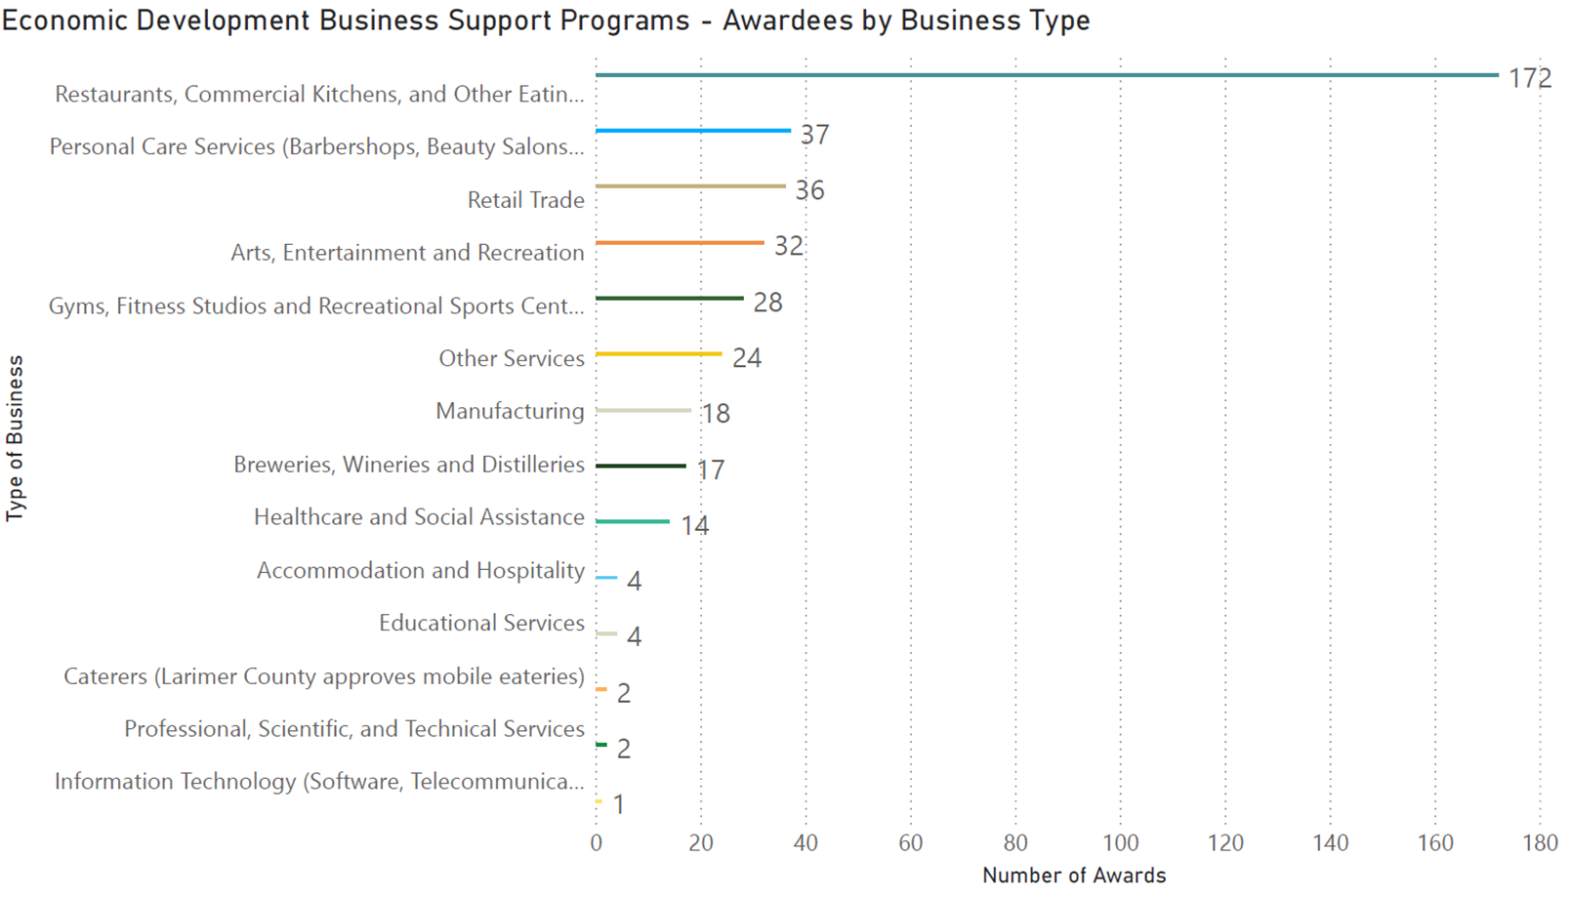
Business Relief Efforts During COVID-19 Pandemic

Slide 17
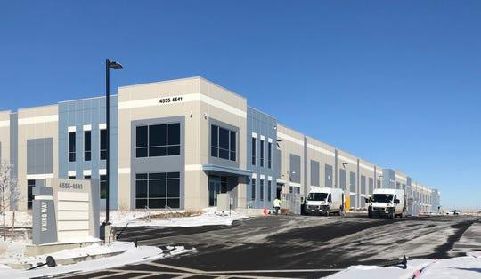
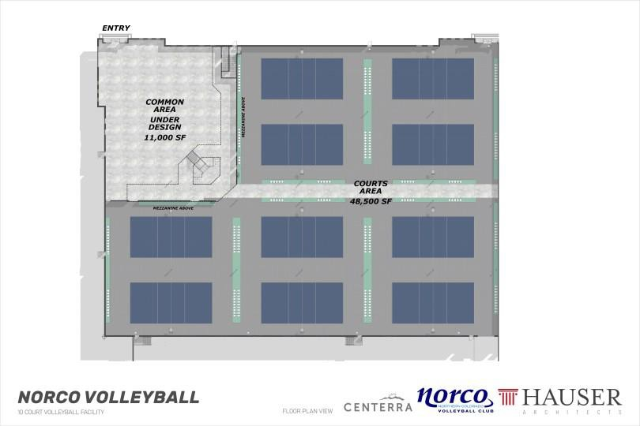
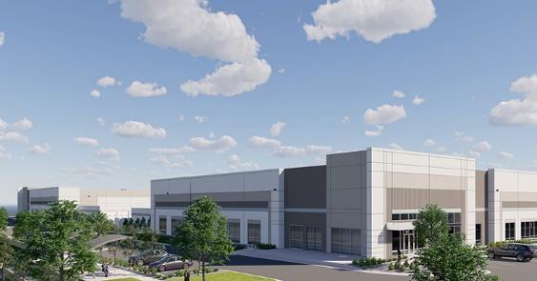
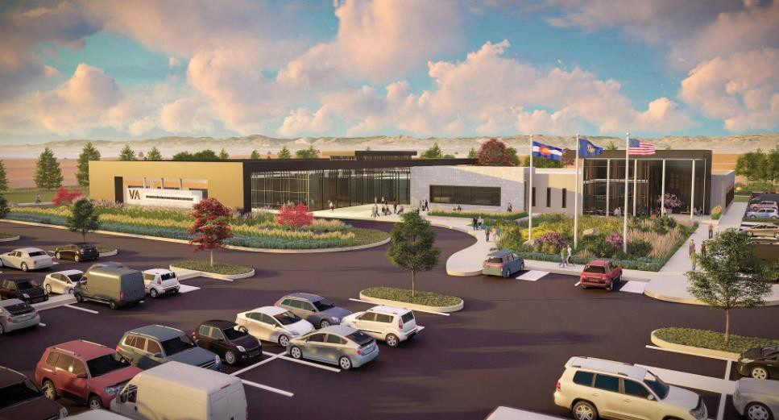
City Projects and Programs
The Forge – 811,000 SF
VA Outpatient Facility – 75,645 SF
Amazon Delivery Center – 123,000 SF
NorCo Volleyball Facility – 60,000 SF
Etkins Johnson: Axis 25 Spec – 100,722 SF & 95,256 SF
JAX: Kmart Redevelopment 90,000 SF
Intellivation – 20,000 SF
Imax / Metrolux – 7,000 SF

Slide 18

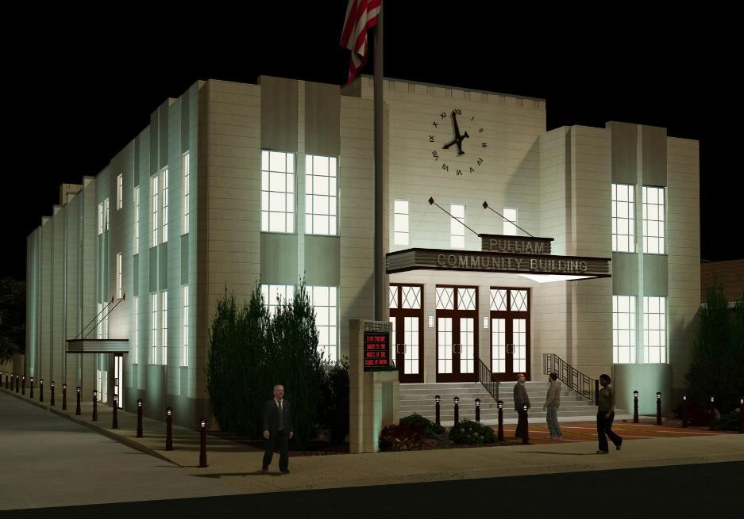







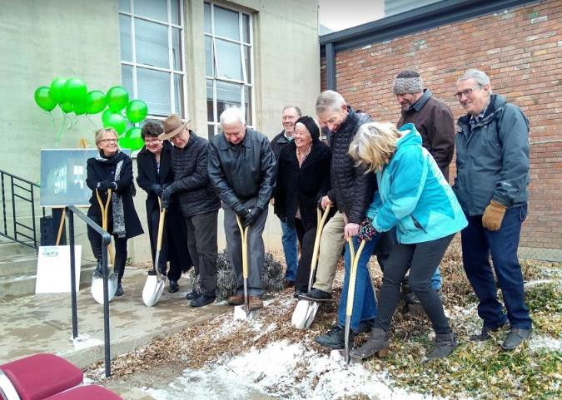
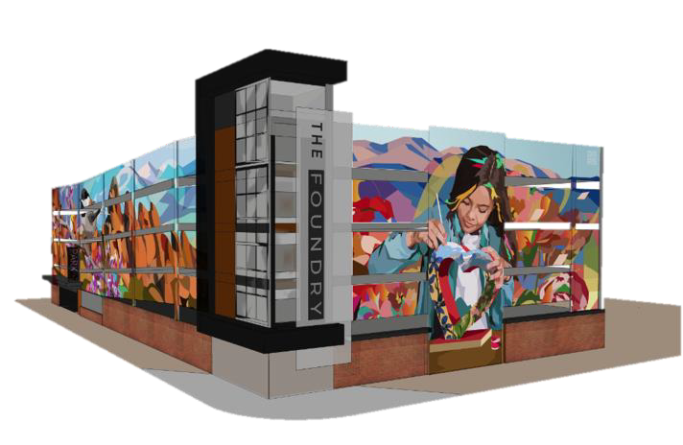
City Projects & Programs
DOWNTOWN:
Pulliam Community Building Rehabilitation
County Building Redevelopment
Mercury Plaza
Cleveland Station
Foundry Completion
LDP/DDA Downtown Programs

Slide 19
Pathways of a Business Development Project
  Business development projects may originate in Development Services or Economic Development which necessitates tight coordination between the departments to ensure project success.

Slide 20
AGENDA
Department Overview
Community & Strategic Planning Division
Current Planning Division
Development Permitting System
Building Division
Changes & Challenges during COVID-19

Slide 21

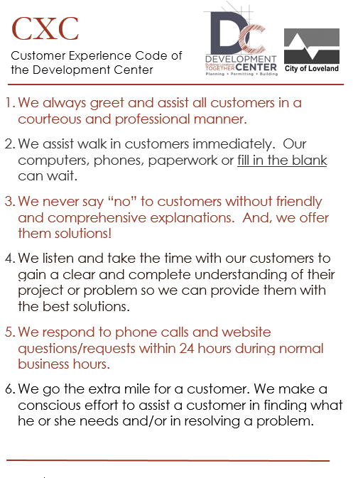
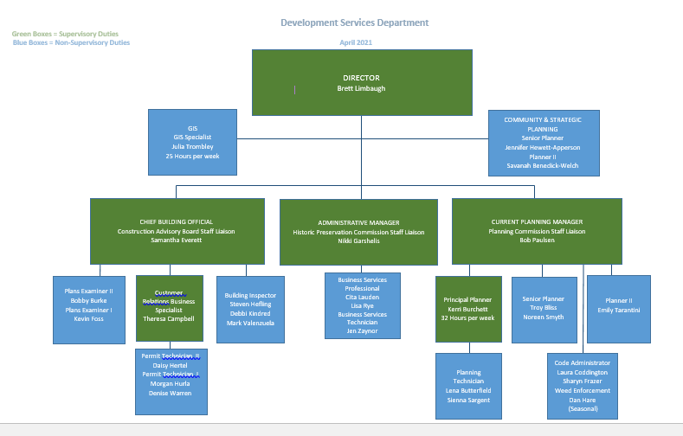
Department Overview

Slide 22
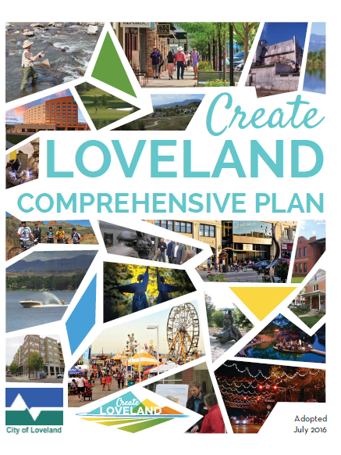
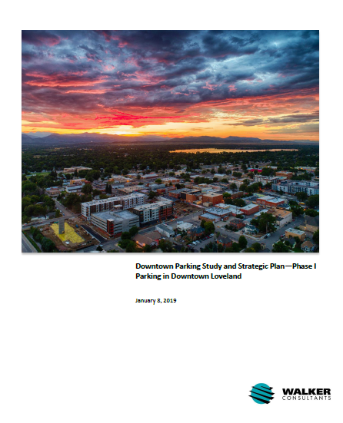
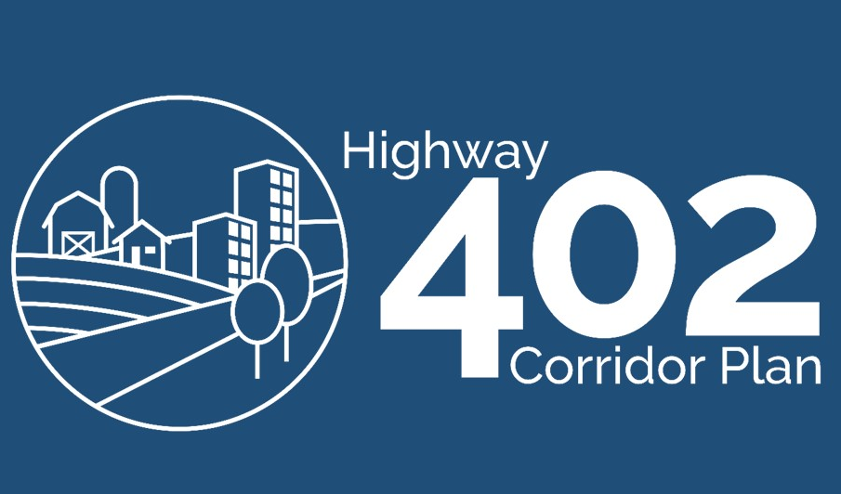
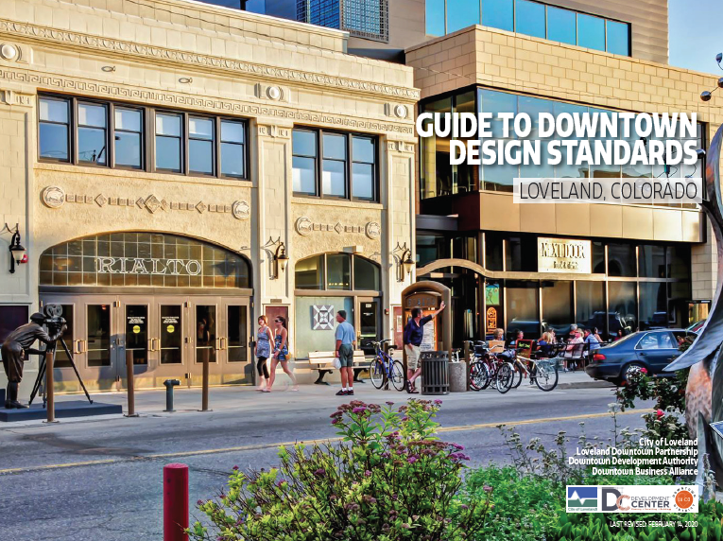
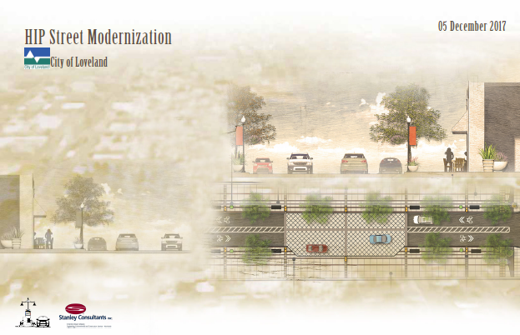

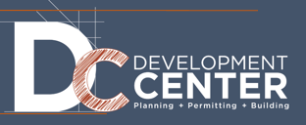
Community & Strategic Planning Division
The Community & Strategic Planning Division works on large and often long-range projects and plans. Projects and programs are often initiated by City Council and include significant public outreach and engagement. The Division manages the Historic Preservation Program and HPC.
Projects, Programs & Studies
Comp Plan Amendments
Annual Data & Assumptions Report
Reinvestment Program for West HWY 34 Corridor
Downtown Parking Study
HWY 402 Corridor Plan
HIP Streets Infrastructure Plan
Downtown Design Standards
Historic Preservation program management

Slide 23
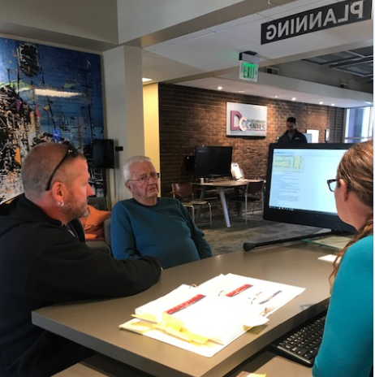
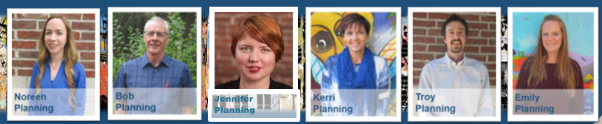
Current Planning Division
Development Review Team leadership and coordination Planning Commission support Building Permit review and inspections for planning requirements Sign permits, home occupation assistance, zoning verifications, customer research, map requests, etc. Community outreach on development applications Code Enforcement

Slide 24

Current Planning Division
The Development Review Process includes the following:
  Annexation and Zoning
  Subdivision of Land
  Site Design
  Exterior Building Design
  Infrastructure Design
  Business Signage
  Services Provided:
  Consultations
  Concept Review Meetings
  Project Meetings

Slide 25


Slide 26

Development Permitting System Process
PHASE 1
Development Review
PHASE 2
Public Infrastructure Installation and Inspection
(associated with development projects)
PHASE 3
Building Permit
Review and Inspection
There are 3 basic phases of the overall system:
Not all projects need to go through all 3 phases

Slide 27
Development Permitting System Goals
Designed to facilitate development and construction within Loveland
Goals:
  Ensure public safety
  Uphold City policies
  Provide clear, consistent standards and processes
  Facilitate efficient review
  Guide applicants to approval
  Promote quality development

Slide 28

Development Permitting System Team
Planning
Power
Trans-portation
Parks & Recreation
Economic Development
Storm-
water
Fire
Building
Water /
Waste-
Water
Addressing
&
Plat Review
Ongoing, Collaborative Interdepartmental Team
9 Participating City Offices - 20+/- staff
Weekly Collaborative Review Meetings
Collaboration Between Private and Public Sector Development Teams
Review Development Applications: Safety, Functionality, Infrastructure Services, Landscaping & Aesthetic Quality
DEVELOPMENT REVIEW
TEAM

Slide 31

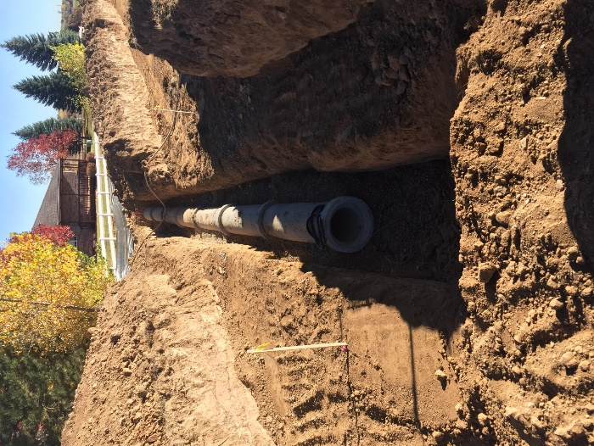
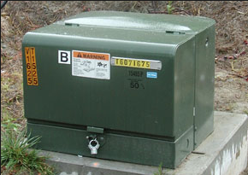
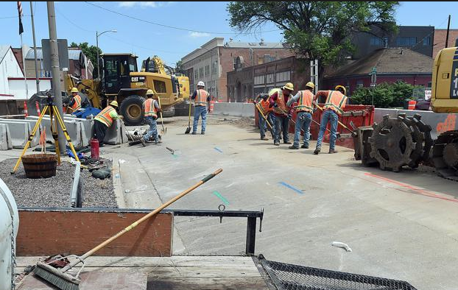
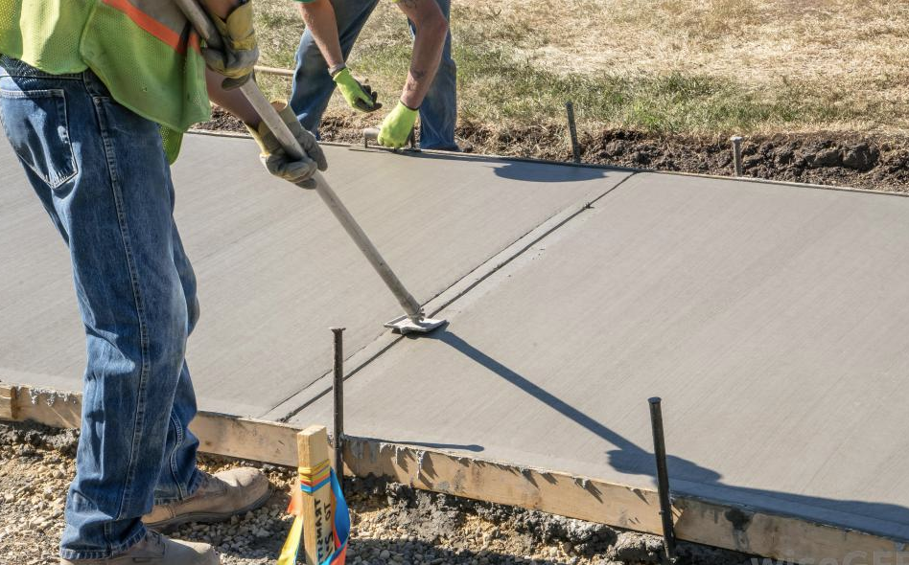
Development Permitting System
Infrastructure
Many projects require infrastructure upgrades
  Street improvements, sidewalks, utilities and storm water provision
  Developers design and install public improvements associated with their projects
  Design review & inspection processes ensure that new development is integrated into the city systems
  Public Works and Water & Power inspectors oversee this process.

Slide 32

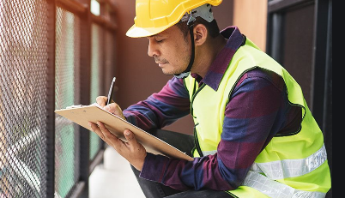
Building Permit
Building Division
Loveland adopted the 2018 International Building Code
Plans are reviewed for compliance under adopted codes
Inspections are completed during various construction phases
Building a safer community

Slide 33

Building Permit
Building Division
Building permit submittal
Plan Review
Permit Issued—Construction begins…
Inspections occur at required stages
Certificate of Occupancy
or Letter of Completion

Slide 34
Numbers
Building Division

Slide 35

Numbers
Building Division

Slide 36
DEVELOPMENT SERVICES DEPARTMENT
DURING COVID-19
DEVELOPMENT REVIEW & PERMIT PROCESSING
  REVIEWS are fully electronic
  All services provided through remote work
  Efficiency & cost savings for customers due to reduced travel time
  Success with Zoom meetings
  Bluebeam software implementation improves efficiency
  Customer feedback is good!
BUILDING INSPECTIONS
  Residential video inspections
  COL Building Inspectors following PPE guidelines
  from Risk Department
  All other services provided remotely

Slide 37
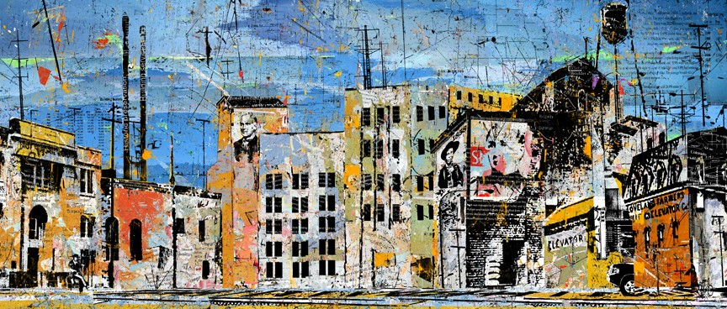
Questions?

