Slide 1
City of Loveland
Affordable Housing

Slide 2

Why We Care
Cost burdened families have difficulty affording necessities such as food and transportation.
One full-time worker earning minimum wage cannot afford the local fair-market rent for a two-bedroom apartment anywhere in the US.

Slide 3
A Brief History
1971 – Loveland Housing Authority formed.
1994 – Adopted an Affordable Housing Policy.
1999 – Affordable housing deed restricted.
2000 – CEF’s and water locked in as of application date.
2002 – Use tax credit added as an incentive.
2009 – Code amended to make fee waivers predictable.
2011 – Five-year rolling lock. Participation of City Council in designation process.
2017 – Re-wrote Affordable Housing Code to make it harder to sell at market rate.

Slide 4
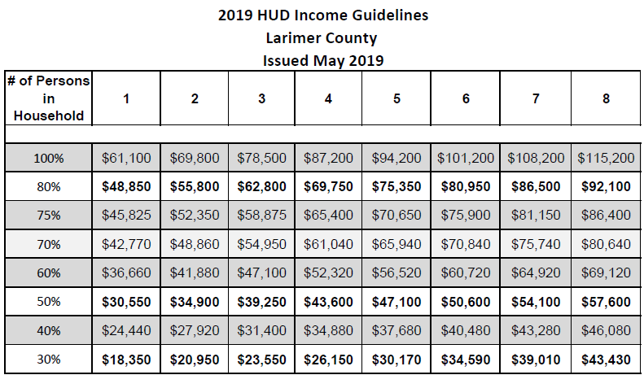
Qualifying
Total gross household income adjusted for household size.

Slide 5

Required Documents
Qualified Affordable Housing application
Income verification
Loan application and qualification letter

Slide 6

Qualifying
All adults in household must meet income limits.
Do not have to be a first time home buyer.
Must be able to qualify for a mortgage through traditional process.
Income verification is valid for six months unless purchase contract has been signed. Applicant must notify the City of Loveland immediately if income changes and prior to purchase.

Slide 7
Deed Restriction: City Code
(18.16.05.08) The builder received fee waivers that City would ordinarily charge on new developments. Deed restriction is required.
When does the promise to sell to a qualified household end?
20 years from the date the house was first purchased
If house is foreclosed on and the bank now owns the property

Slide 8

Deed Restriction
Covenants, or promise, that runs with the land
Binding on each subsequent owner
Automatically expires after 20 years

Slide 9
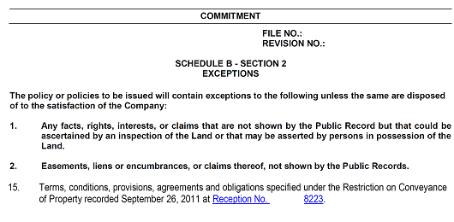
Real Estate Documents

Slide 10
Your Responsibility
What you can do to help promote affordable housing:
Highlight Deed Restrictions in Title Work –
Do not bury in boilerplate
Educate buyers/sellers on deed restrictions
Transparency

Slide 11
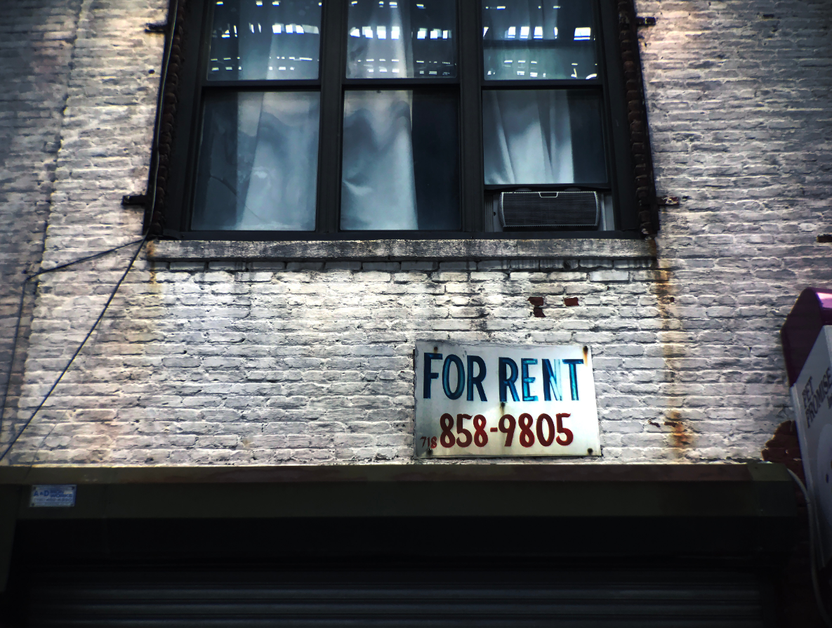
Rules for Sales and Rentals
You must sell your affordable home to another income qualified buyer.
Who determines income qualification: Community Partnerships Office
Renting is NOT allowed
(18.16.05.09) When does the promise to sell to a qualified household end?
Exceptions: A): Hardship waiver issued by Affordable Housing Commission AND repayment of penalty amount. A ‘NO’ from the AHC can be appealed to City Council.

Slide 12
Payoff Table
Number of years from original sale (if a “for sale” unit), or number of years from the issuance of the first certificate of occupancy (if a “for rent” unit) | Amount owed to City
1 | 95% of net proceeds
2 | 90% of net proceeds
3 | 85% of net proceeds
4 | 80% of net proceeds
5 | 75% of net proceeds
6 | 70% of net proceeds
7 | 65% of net proceeds
8 | 60% of net proceeds
9 | 55% of net proceeds
10 | 50% of net proceeds
11 | 45% of net proceeds
12 | 40% of net proceeds
13 | 35% of net proceeds
14 | 30% of net proceeds
15 | 25% of net proceeds
16 | 20% of net proceeds
17 | 15% of net proceeds
18 | 10% of net proceeds
19 | 5% of net proceeds
20 | $0

Slide 13
Enchantment Ridge & Wilson Commons
Applicants wishing to sell before the expiration of the deed restriction should call the Community Partnership Office.
Penalty payments are described in real estate documents.

Slide 14

QUESTIONS &
DISCUSSION

