Slide 1


2018—2019 Grantee Review: ADA, Grievance and Title VI Policies
AlL—Agency Meeting
January 22, 2019
Caryn Capriccioso, MNM
Rick Zwetsch

Slide 2

Today’s Discussion
1. Welcome and Purpose of the Meeting: Alison Hade
2. Grant Review Process Overview: interSector Partners, L3C
3. ADA, Grievance and Title VI Policies: interSector Partners, L3C
4. Grant Review and Policy Q & A
5. Agency Feedback on the Grantmaking Process
6. Next Steps for the Coming Year: Alison Hade
Notes:
Review the agenda
Introduce interSector
Longmont-based
Mission
Work with nonprofits across many sectors including many human service organizations
Strategic planning, business planning, social enterprise development
Work with local governments on community strategy, needs assessment, mostly in human services

Slide 3
Review and Audit Process
City of Loveland Human Services Grantmaking Review
Policies and Practices Review with Grantees
Agency Grantmaking Input and Recommendations for the Commission
Notes:
We’ve had three phases of the project so far:
Rick and I reviewed the grantmaking process, grants made and generally got a sense of Human Services processes and services
We conducted policy and practices reviews with three Human Services grant recipients
Asked all of you for input into the grantmaking process

Slide 4



Policy & Practice Review 2018
Notes:
To get started with the process, in 2018, three organizations were selected to participate in the pilot grantee review for ADA, Grievance and Title VI Policies
We met with Glorie and Cheryl at House of Neighborly Service
Robert at Voices Carry
Kari, Steve and Stephanie at Alternatives to Violence
If you’re curious about the process and/or want to check-in about how it went, I’m sure they’d be happy to share their experiences

Slide 5

Policy & Practice Review: Overview
Document and information review
Title VI, ADA and Grievance policies and practices
Other organizational documents, policies filings and practices
Meetings / interviews
Meeting follow-up
Reporting
Notes:
The review process included:

Slide 6
2019 Policy Requirements
Title VI
ADA
Grievance Policy
Notes:
Starting in 2019, the City of Loveland will require that you have an ADA plan and a grievance policy.
In addition, it will continue to require a Title VI (non-discrimination policy) for those of you who receive federal funding passed through from the City of Loveland.
One thing we’ve noticed over many years of doing nonprofit practices review is that organizations tend to have a version of these policies in place for employees, but generally don’t have external-facing or client-centered written policies for ADA or Title VI.
We’re going to run through each of these today and share some highlights of what should be included.
You should have all received a copy of the City of Loveland’s Non-discrimination (or Title VI) policy, as well as a copy of its ADA Policy and ADA grievance policy as examples of how these policies can look.

Slide 7

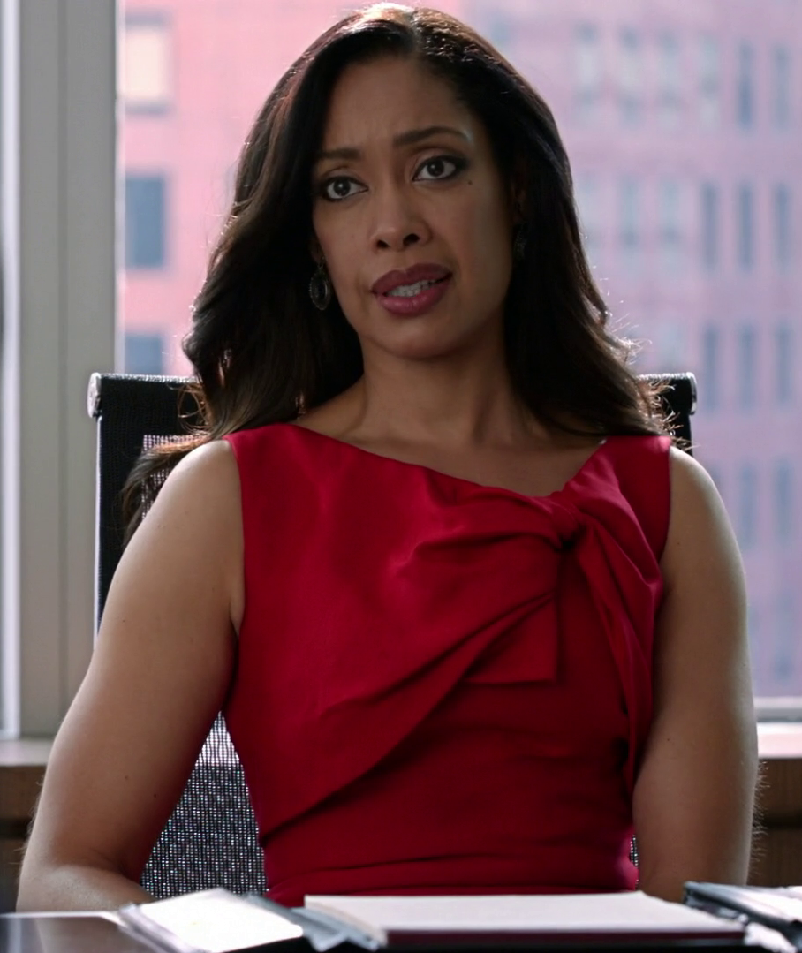

Legal
Notes:
As we talk with you about the various policies and practices required by the City of Loveland, we want to reiterate that neither Rick or I are attorneys and we don’t play them on tv
The information we’ll discuss is based on the City of Loveland’s Policy Checklists and information provided by other City of Loveland consultants as to what should be included in the various policies
You should consult with your own attorney to develop policies that are pertinent to your organization.

Slide 8
Title VI Policy: Civil Rights Requirement
Prohibits discrimination on the basis of race, color, or national origin in any program or activity that receives Federal funds
Cannot distinguish in types, quantity, quality or timeliness of program services, aids or benefits provided
Notes:
Required if you receive federal funding passed through from the City of Loveland or any other entity or if you receive direct federal funding

Slide 9

Title VI Policy: Key Points
Signed policy statement: prohibit discrimination
Include Language Access/Limited English Proficiency plan
Complaint procedure
Public notification process
Notes:
Language Access Plan / Limited English Proficiency Plan – provides equal and meaningful access based on race, color, and national origin. Meaningful access will generally involve some combination of oral interpretation services and written translation of vital documents – Web site, etc.
Signed policy statement assuring compliance with Title VI of the Civil Rights Act of 1964
Public notification process clearly stating the organization’s non-discrimination policy towards those protected under Title VI, and a summary of public outreach/involvement to ensure that minority people have meaningful access

Slide 10
ADA Policy: Public accommodation
Must provide goods and services to customers with disabilities in the most integrated setting possible
Must make reasonable modifications to policies, practices, and procedures to allow equal opportunity to goods and services and access to information
Notes:
Required of Title II entities (state and local governments) and title III entities (businesses and nonprofit organizations that serve the public.)

Slide 11

ADA Policy: Key Points
Signed policy statement: Americans with Disabilities
Effective communication / auxiliary aids and services
Qualified, certified interpreters
Staff training
Notes:
Effective communication: The ADA requires that title II entities (State and local governments) and title III entities (businesses and nonprofit organizations that serve the public) communicate effectively with people who have communication disabilities. The goal is to ensure that communication with people with these disabilities is equally effective as communication with people without disabilities.
Effective communication: must provide auxiliary aids and services when needed to communicate effectively with people who have communication disabilities such as people who are blind, have vision loss or are deaf/have hearing loss, or have speech disabilities
Covered entities should teach staff about the ADA's requirements for communicating effectively with people who have communication disabilities

Slide 12

Grievance Policy: Handling Complaints
Outlines guidelines for receipt, documentation, evaluation, resolution and response to client grievances
Notes:
Not required, but strongly recommended by the City of Loveland

Slide 13
Grievance Policy: Key Points
Complaints can begin as informal or formal
Include stages or levels of escalation
Include timeframes
Posted in accessible areas
Available in English and Spanish
Notes:
Complaints / grievances can begin as either formal or informal; Complaints / grievances should be in writing if not resolved informally
Process should include stages or levels of escalation that include positions within the agency and outside of the agency to hear the complaint / grievance if the resolution has not been reached
At each stage or level, timeframes, procedures and roles of responsibility should be clearly identified
Policies and forms should be posted in a directly accessible area to clients / customers at all times complete with contact information for all defined roles of responsibility at each stage/level of the procedure
Policies and forms should be available in English and Spanish and should be accessible according to ADA Effective Communication Plan standards

Slide 14

Policy & Practice Q&A

Slide 15

Grantmaking Process: Grantee Input
One-on-one conversations (3 orgs; 5 people)
All-agency survey (29 respondents; 42 email invites)
Notes:
Going to go through a summary of a few of the questions we asked and you answered and then have a chance to do a deeper dive on a few of them.
While Rick and I are contracted by the City, we are also working on your behalf and helping the Commission to reconsider how it does its grantmaking processes in the future. The grant application won’t be changed for this year, but there are some opportunities to look at the process and potentially adjust the application and reporting for the 2020 process.
We’ve

Slide 16
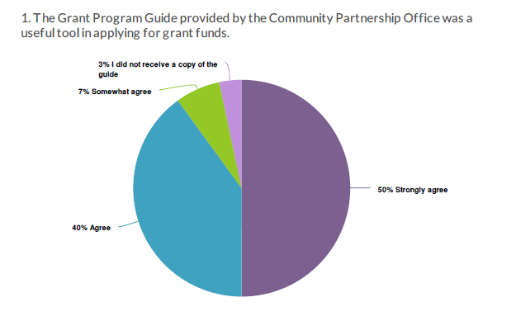
Grantmaking Process: Grantee Input
Notes:
90% of you agree or strongly agree that the grant program guide was a useful tool
And you had some feedback

Slide 17

Grantmaking Process: Grantee Input
What is most useful about the Grant Program Guide?
Easy to navigate
Explanations / descriptions are good
Step-by-step instructions and template
Lays out deadlines and expectations
Answers most of our questions
How can we make the Guide more useful?
Eliminate repetition
Be more responsive to questions about the guide
Notes:
Discuss

Slide 18
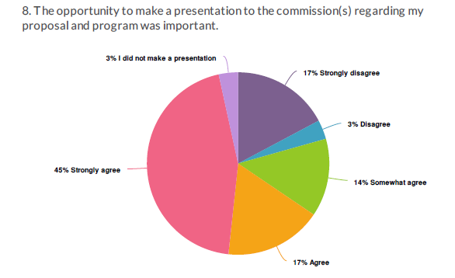
Grantmaking Process: Grantee Input
Notes:
62% of you agree or strongly agree that the opportunity to present to the commission was important.
20% of you disagree or strongly disagree
Again you had some feedback

Slide 19
Grantmaking Process: Grantee Input
Why do you feel this way about making an in-person presentation?
Feel Positively
Great opportunity to share more information
Allows for another medium other than the written word to express the importance of the program and why it should be funded
Allows actual clients to share their stories
Love the process and the feedback it gives us; good it’s blind so decisions aren’t influenced by perceptions of the agencies
Notes:
First the positives

Slide 20
Grantmaking Process: Grantee Input
Why do you feel this way about making an in-person presentation?
Do not like it
Excessive amount of time given the award amounts
No guidance about what the commission wants or what makes a good presentation
Should not be a time for clients to speak for the agency
Should be judged on the proposal, not if 20 people show up to the presentation
Presentations and blind-scoring do not work; the City should align its selection process with the results it is trying to achieve
Notes:
And the negatives
Discuss

Slide 21
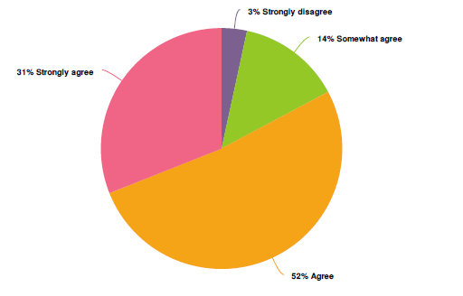
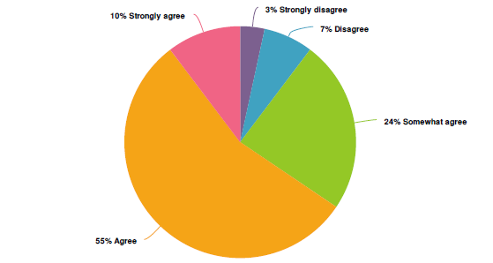
Grantmaking Process: Grantee Input
Pre-Application LOI is easy to complete Grant Proposal (application) is easy to complete
Notes:
For the most part, you feel it’s easy to complete the LOI and the application

Slide 22
Grantmaking Process: Grantee Input
What would make it easier to complete?
It’s time-intensive, takes hours to complete
Too many questions are redundant; suggest fewer long-narrative responses
Add spell check to grant pages
Simplify the budget
Use the common grant application
Greater flexibility in how to answer questions
“Could not answer at least one of the questions... we do not track the exact information they needed.”
“I think the City of Loveland’s process is the best it can be.”
Notes:
We did ask what would make it easier to complete and you had some feedback.
Discuss

Slide 23
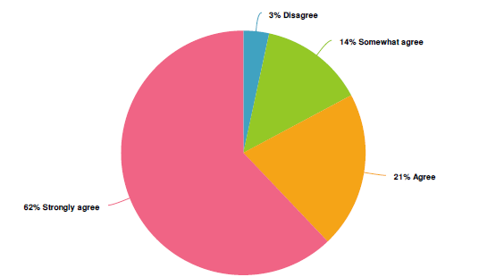
Grantmaking Process: Grantee Input
Notes:
83% of are satisfied or strongly satisfied with the quality of service you receive from the Community Partnership Office.

Slide 24
Grantmaking Process: Grantee Input
What would help you be more satisfied with service received from Community Partnership Office staff?
Objectivity; all should be judged equally
Being more open to feedback about the amount of work required for a small return
Timely responses
What are you satisfied with?
City of Loveland staff responsiveness, availability and helpfulness; caring attitude
Timeliness / very quick to answer questions
Opportunity to provide feedback
Notes:
Discuss

Slide 25

Grantmaking Process: Discussion

Slide 26

Next Steps
interSector Partners
Write final process report
Commission training / support in adapting grantmaking
City of Loveland

