Slide 1


Slide 2


Slide 3

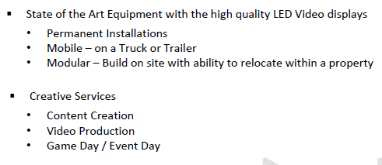

Slide 4



Slide 5


Slide 6
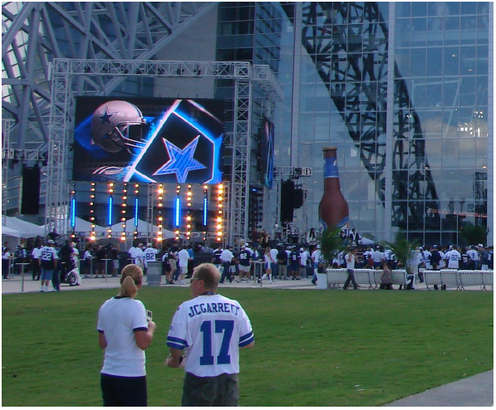


Slide 7



Slide 8
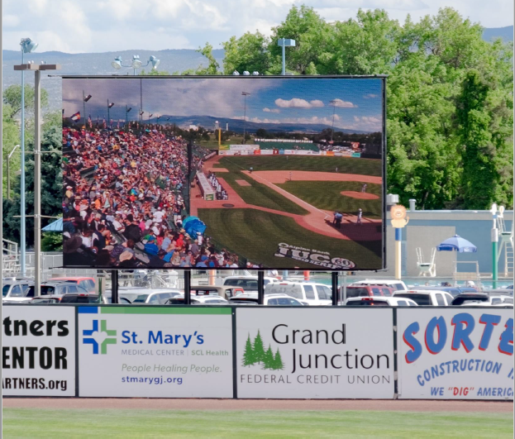



Slide 12
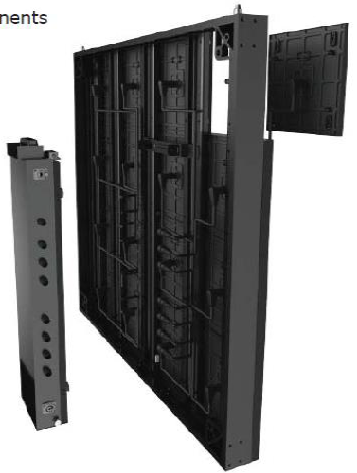
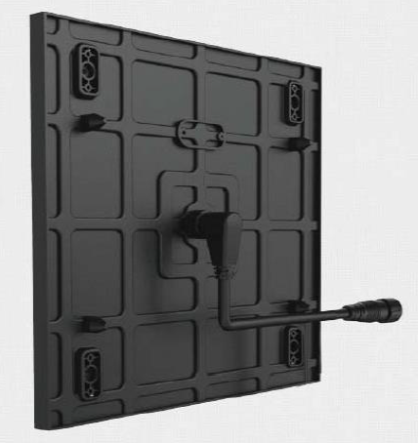
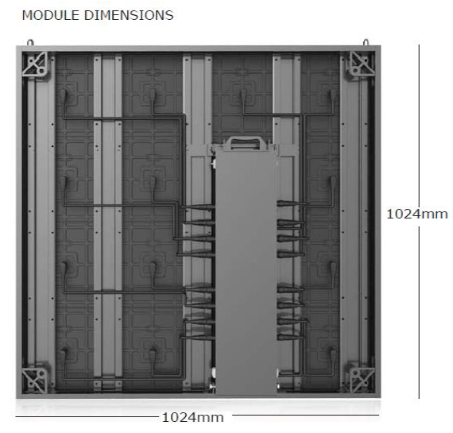
MODULE INFORMATION
All you need for superb performance
Low energy consumption on some models
High brightness with low power consumption for low cost running
Robust engineering
Built to last with precision engineered casing
Real-time monitoring module to module with warning status
On-board real-time feedback system monitoring of vital components and status
Intelligent colour and brightness calibration allowing swapping of modules for continued uniformity and performance
On-board CPU records color and brightness calibration data with working times and dates so that t it can be transferred to any replacement units
IP67 ingress protection
Super high protection against dust and moisture

Slide 13
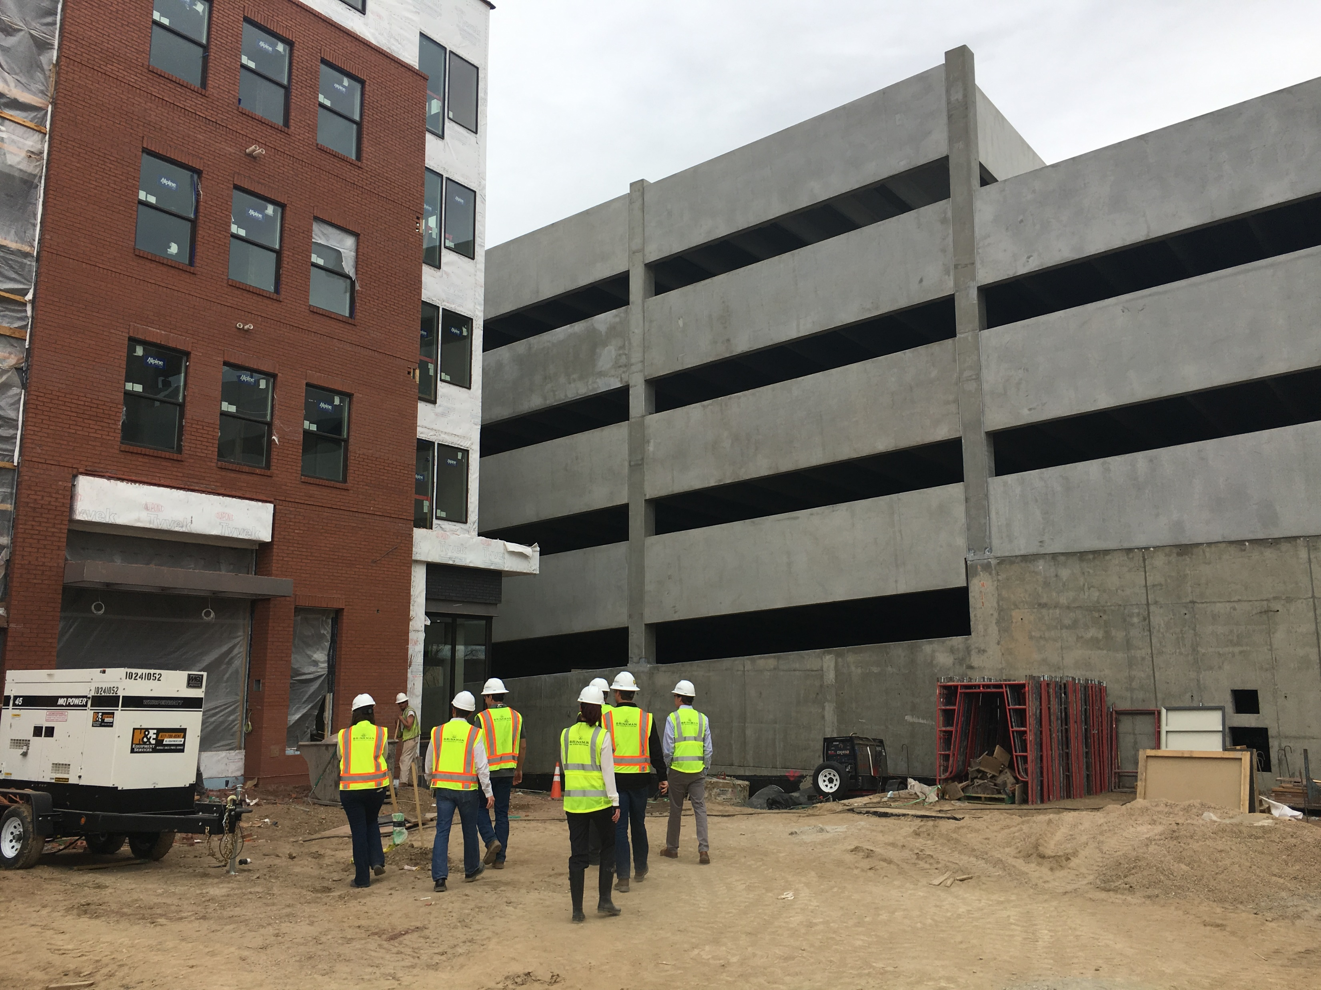

Slide 14
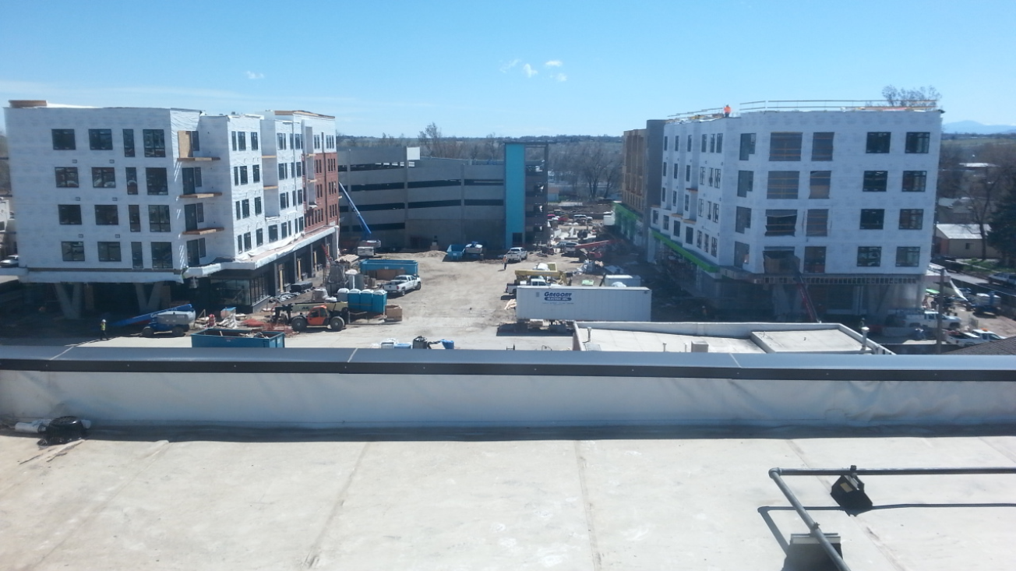

Slide 16
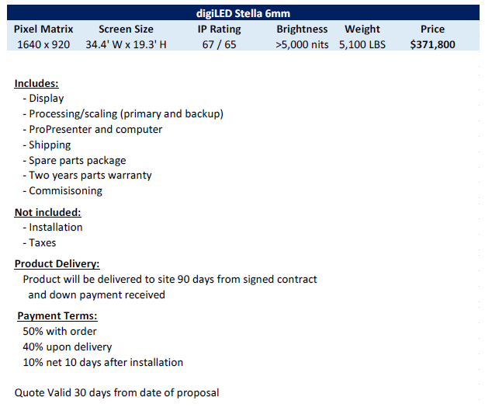

PRICING
-Pricing does not include install or
bracing
-Total expected total costs estimated at $500k
-Request is for CMC consideration
to participate at 50%, financed over 5-7 years

