Slide 1
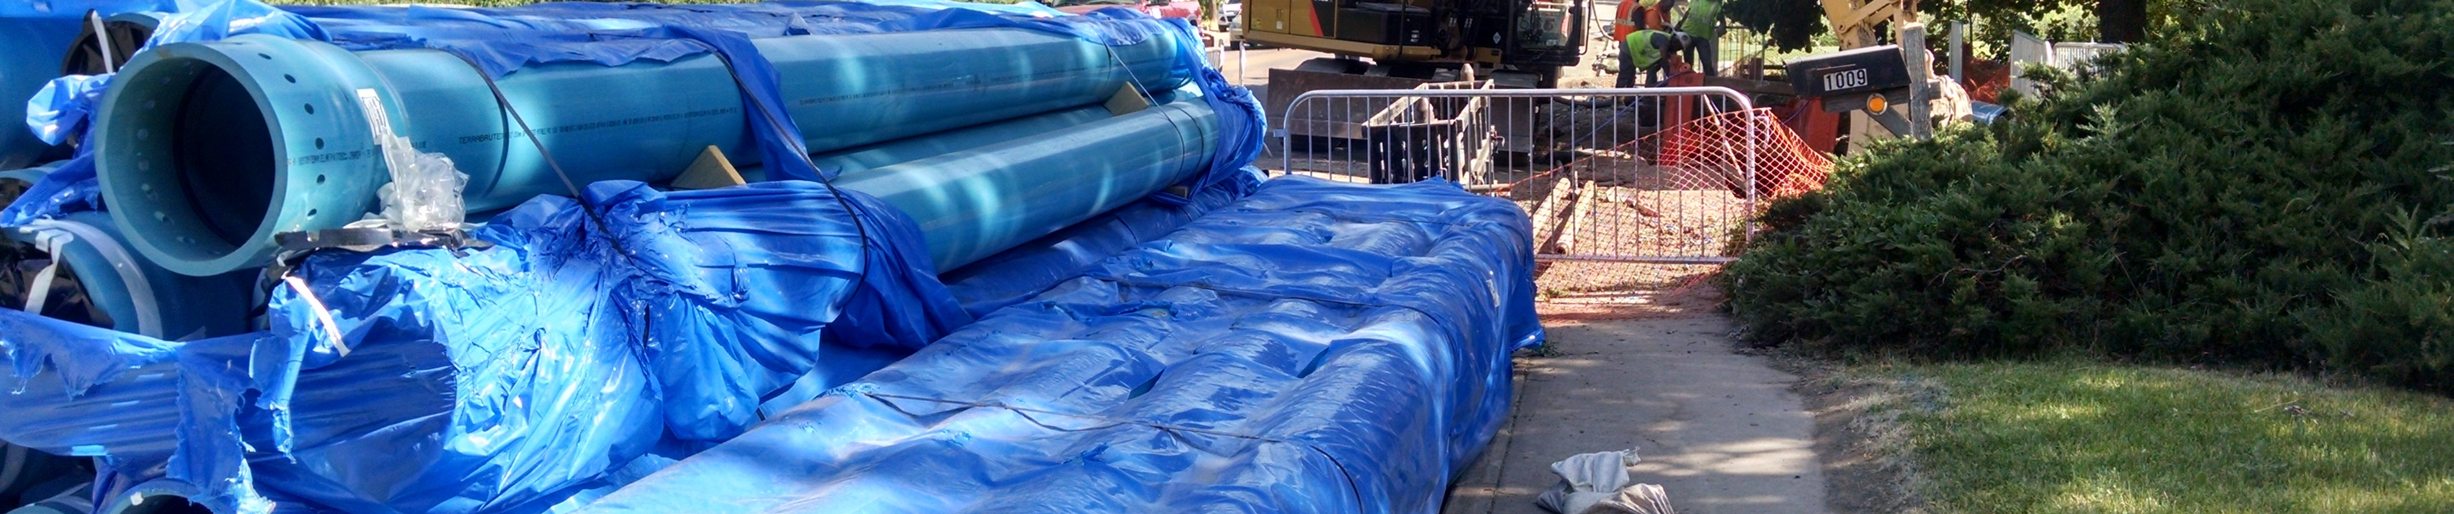
Boyd Parallel Interceptor (Phase 1) Project Construction Contract Award
Tanner Randall, PE - Senior Civil Engineer
January 17, 2018

Slide 2
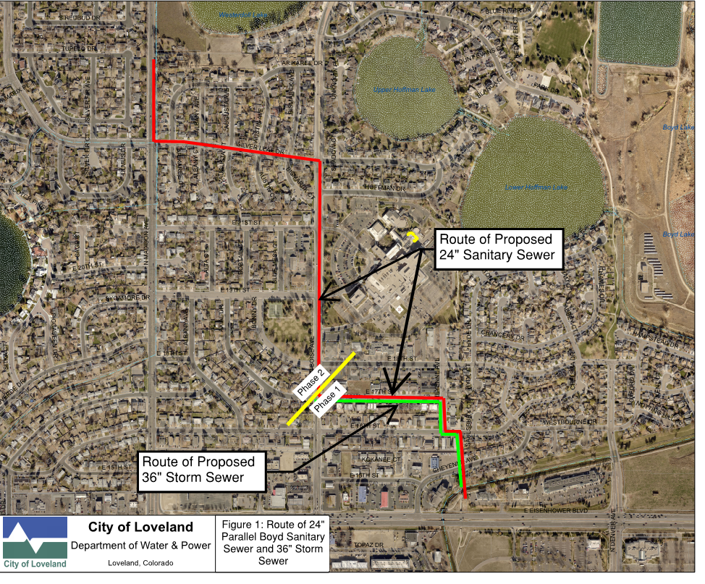
Phase 1 Scope
  ~2,100’ of 24” Sanitary Sewer
  ~2,500’ of Storm Sewer
  ~2,100’ of Duct Bank
  ~2,900’ of Curb, Gutter, & Sidewalk
  Complete Rebuild of Cheyenne Ave. and E. 17th St.
Phase 2
  Design at 60%
  LUC in April 2018
  Construction Begins in May 2018

Slide 3
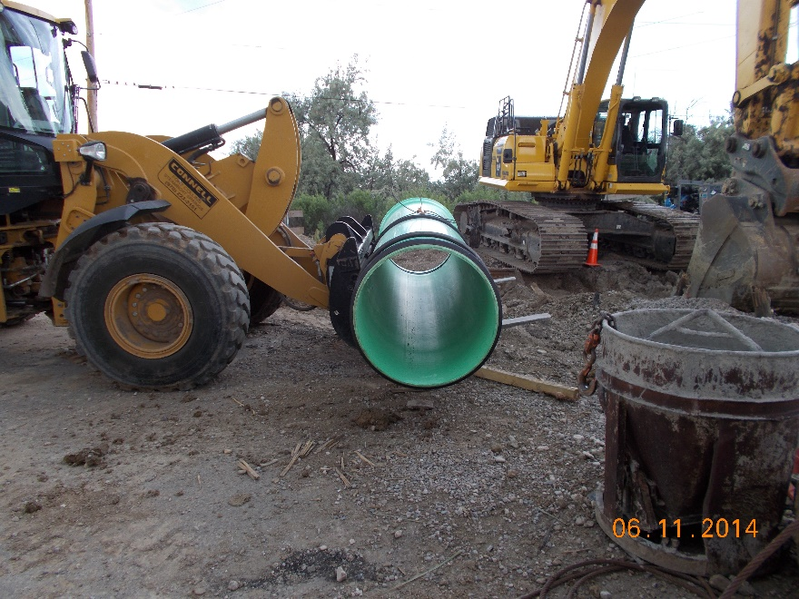
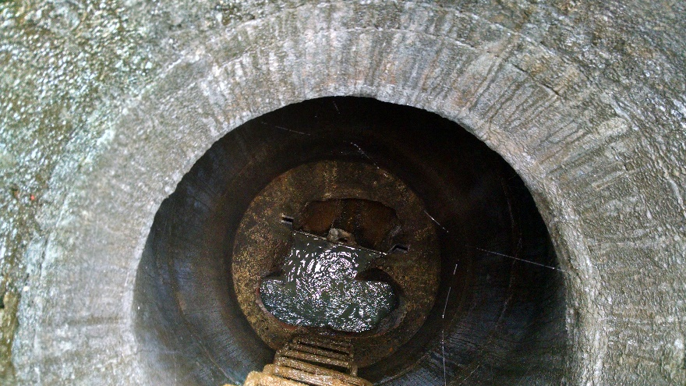
Phase 1 Contract
  Connell Resources of Fort Collins, CO
  Delivered via Construction Manager at Risk (CMaR) Delivery Model
  Contractor Involved During Design
  Independent Cost Estimate 0.3% Higher
  There are Sufficient Funds to Sign the Contract
Contract Details
  The Total Phase 1 GMP for the project is $3,550,202
Breakdown of the work between Departments is:
  Wastewater: $1,760,725.20
  Storm Sewer: $1,123,641.20
  Electric Duct Bank: $434,164.80
  PW Curb & Gutter: $189,932.30
  PW Asphalt: $41,738.50

