Slide 1
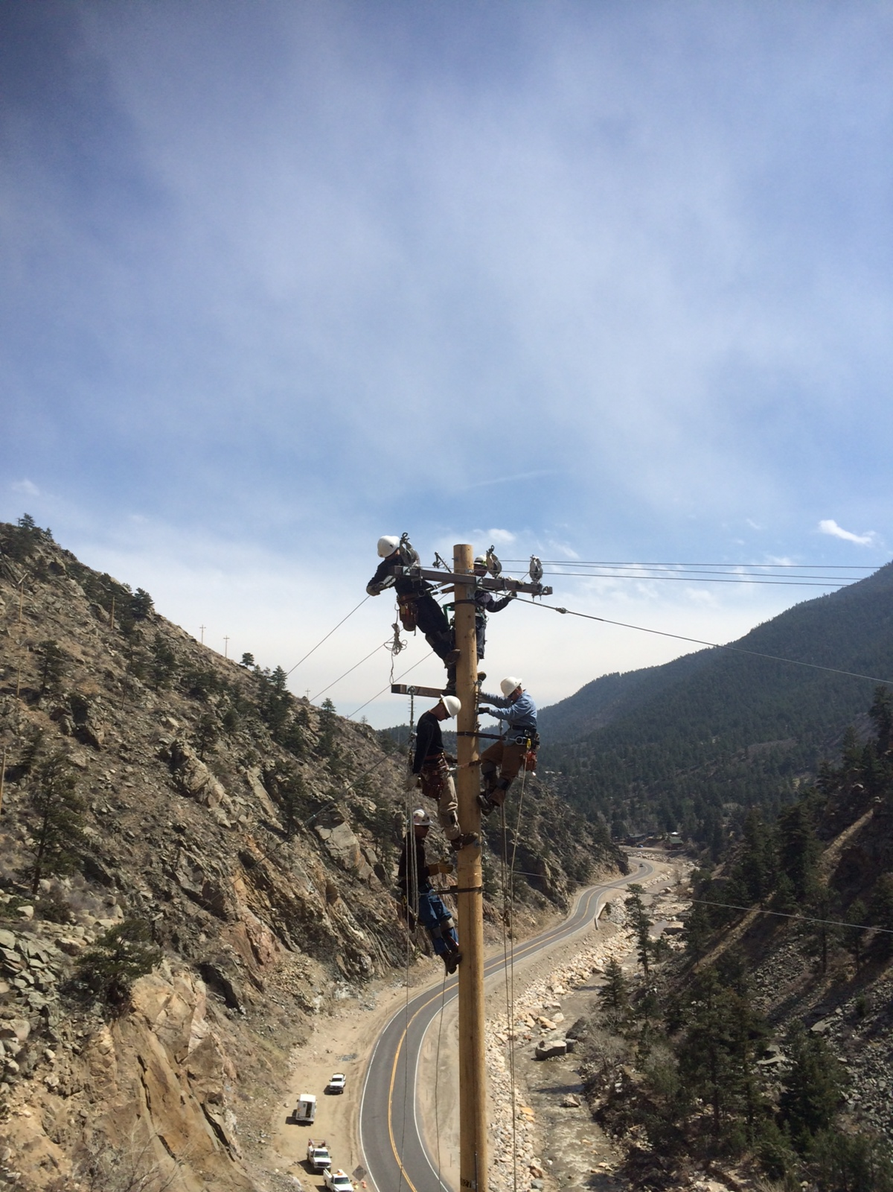
Big Thompson Canyon Voltage Conversion Construction Update
January 17, 2018

Slide 2
Agenda
Construction Overview & Timeline
Reliability Improvements
Construction Pictures
Questions

Slide 3
Canyon Construction Overview Map

Slide 4
Phase 2 Detail Map

Slide 5
Construction Timeline
PHASE 1
PHASE 2
PHASE 3
Expected completion - Jan. 31, 2018
Phase 1A:
West Substation to Glade Rd. & Becker Lane (COMPLETE)
Phase 1B:
Glade Rd./Becker Lane to City of Loveland Water Treatment Plant.
(UNDER CONSTRUCTION)
Feb. 1, 2018 – September, 2018
Phase 2A:
Water Treatment Plant to Sylvandale Ranch
(ISSUED FOR CONSTRUCTION)
Phase 2B:
Sylvandale Ranch to Colorado Cherry Company Store
(ISSUED FOR REVIEW)
October, 2018 – March, 2019
Cherry Store to end of line in Drake & Waltonia.
(IN DESIGN)

Slide 6
Improving Reliability
Rebuilding shorter sections of overhead line to minimize area under construction
Adding auto-recloser devices to reduce number of customers exposed to outage at one time
  Increases segmentation of line to reduce number of customers exposed to outage at one time
  Devices de-energize line briefly to allow temporary fault to clear itself before re-energizing. Operate up to 3 times before locking open
Eliminating steel poles
  Reduces opportunity for electrical ‘flashover’

Slide 7
Improving Reliability
Relocation of poles to reduce likelihood of car/pole incidents
Implementing aggressive tree trimming operations
  Will require cooperation of landowners
  Once permission is granted, encroaching trees will be trimmed / removed at City expense
Establishing single point of contact for customers to direct questions / express concerns
  Tracey Hewson 970.962.3710 tracey.hewson@cityofloveland.org

Slide 8
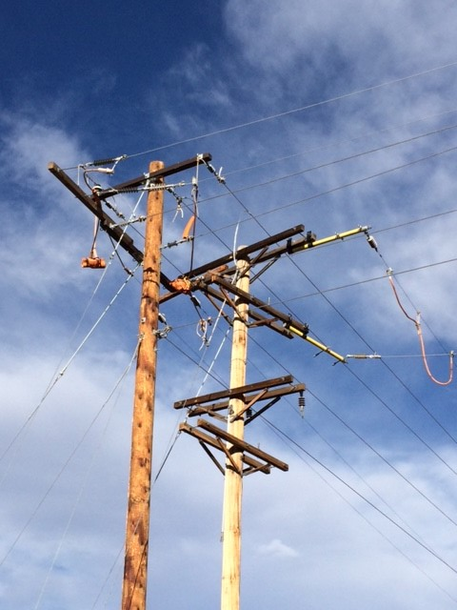
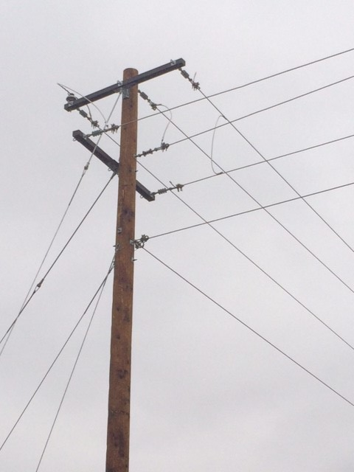
More Straightforward Construction
Photos of corner pole south of W. County Road 24 during construction and after rebuild.
During
After

Slide 9
QUESTIONS?

