Slide 1

Self Generation Solar Rates
John Beckstrom, Utility Financial/Rate Analyst
May 17, 2017

Slide 2
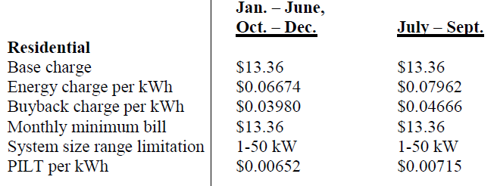

2016 Self-Gen Rates/Methodology
Customer will be billed for net consumption during the month.
If the net consumption is negative in a month, the excess kWh will be carried forward to the following month and credited against the customer’s energy consumption in kWh.
If the customer has a kWh credit at the end of the 12 months, the City will pay the customer at the Self Generation Buyback Charge Rate.
Residential Base Rate $13.36
2

Slide 3
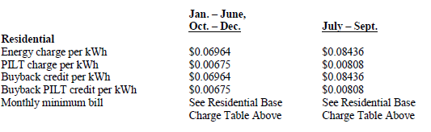
2017 Self-Gen Rates/Methodology
Customer will be charged a Base Charge based on the capacity of the self-generating unit (next slide).
Customer will be billed / credited for consumption & buyback during the month.
Residential Base Rate $14.37
3

Slide 4
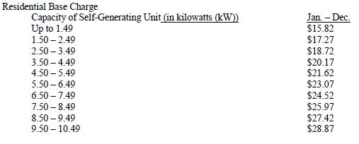
2017 Self-Gen Rates/Methodology (page 2)
4

Slide 5
2017 Base Rate Explained
The Base Rate is a flat charge applied each month regardless of the amount of kWh used.
It includes utility wide and customer specific infrastructure costs such as:
Distribution lines & transformers, metering, meter reading, and utility billing.
O&M of the distribution system.
The capacity to provide energy to all customers on the grid as needed.
These are fixed costs & do not vary based on the amount of energy used by each customer.
Because these are fixed costs the base rate is charged even if the customer has had no usage for the month.
Some of the fixed costs are included in the base rate and some are included in the energy rate (kWh).
For the Self-Generation Rate, the reason the base charge increases as the capacity output of the self-generating unit increases is because as the customer generates more and therefore purchases less energy, the utilities fixed costs must still be recovered to prevent other customers from subsidizing self-generating customers.
5

Slide 6
Response to Citizen’s Observations
Paragraph 4: “The accounting implementation was the cause of the problem.”
The invoices in question have been reviewed and are correct (2016 & 2017).
Paragraph 6: “The problem was in an erroneous formula for quantifying the transactions.”
Under the old method customer generation was tracked as kWh.
If more kWh were produced than purchased the excess kWh were carried over to the next month.
If at the end of the 12 months there was excess generation, a credit was issued at the buyback rate.
Net energy is not assessed a second time.
Paragraph 7: “The revised rate structure does two things...”
Power produced by the customer has not been double counted.
The Base rate has been previously explained.
The buyback rate has been increased to match the purchase rate.
Excess generators do benefit from the higher buyback rate.
Paragraph 8, Bullet Point 3: “There is insignificant cost difference...”
This has been explained as part of the Base Charge.
6

Slide 7
QUESTIONS?

