Slide 1

FEMA Alternate Project Update
Loveland Utilities Commission
August 20, 2014
Gretchen Stanford, Customer Relations Manager
Brieana Reed-Harmel, Senior Electrical Engineer

Slide 2

FEMA Alternate Project Options
Preferred Options
  Solar at PRPA Rawhide Energy Station
  Solar at a Loveland site
  In-line hydro turbine at the Loveland Water Treatment Plant
Alternate Options
  Battery storage for demand response and reliability
  Grid automation for outage management and better customer service

Slide 3
FEMA Alternate Project Expenditure Timeline
May, 2014 - FEMA Award of $9.1M for Alternate Project
Jun-Nov, 2014 – Coordination and Evaluation of Alternate Project Options
Mar, 2015 – Submit Alternate Project Scope(s) to FEMA
Apr, 2015-Sept, 2017 – Possible 30 month extension from State
Sept, 2017– Deadline to complete construction of Alternate Project

Slide 4
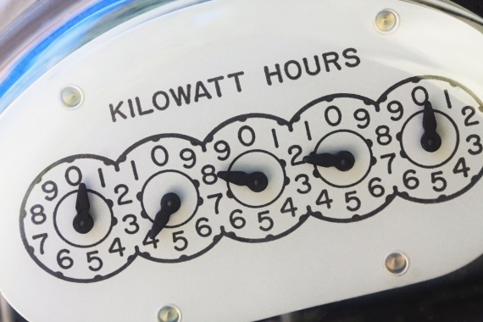
Alternate Project – The Race Is On!!!
Benefits the ENTIRE community
Renewable resource replacing a renewable resource
Larimer County 1041 permit
NEPA process
Loveland ownership
Federal purchasing guidelines
First of it’s kind!

Slide 5
Questions?
Thank you!

