Slide 1
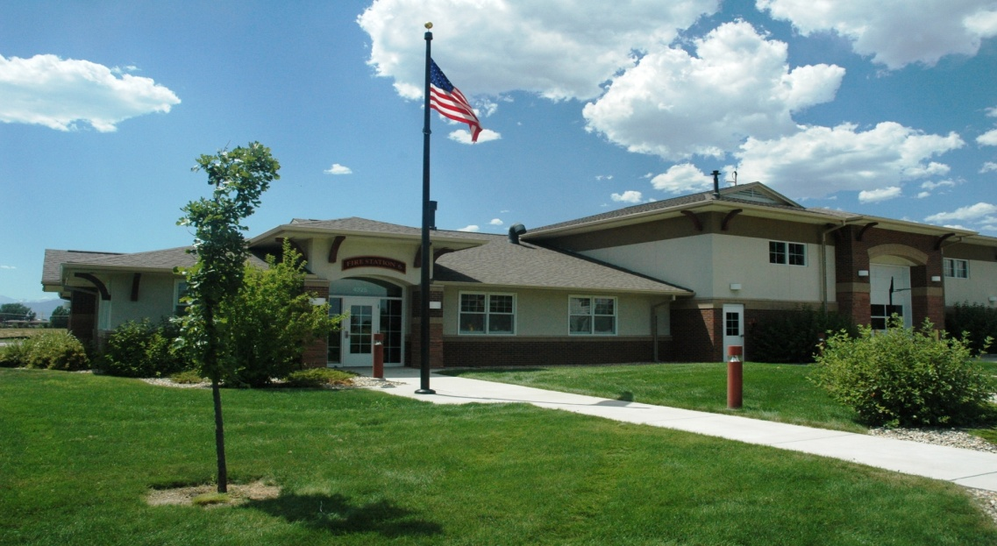
Station Tours 101
A Guide to Effective Fire Station Tour Presentations
Presented by Scott Pringle
Deputy Fire Marshal
Loveland Fire Rescue Authority

Slide 2
Objectives
Provide a “toolbox” of potential fire station tour presentation topics.
Help you to custom tailor your presentations to your audience.
Add pertinent fire and life safety education to your presentations.

Slide 3
Overview
Like it or not, conducting fire station tours will be a common occurrence during your fire service career.
This course will help you to become more effective in the areas of content and delivery of your fire station tour presentations.

Slide 4
About Station Tours
Some tours may be scheduled in advance, while others might be unexpected “drop-ins”.
Tour groups can vary in size, and can include a variety of ages and comprehension levels of the visitors.
Regardless of these variables, having a pre-existing basic plan and system for conducting tours will help.

Slide 5
Be Prepared
For any scheduled station tours, make a good impression by ensuring that the station and apparatus are clean and orderly.
Look professional - wear the appropriate uniform.
Have any handouts that you plan to distribute ready before the tour group arrives.

Slide 6
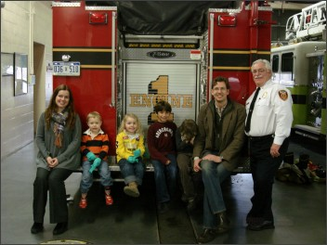
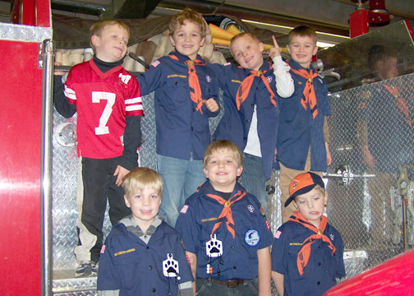
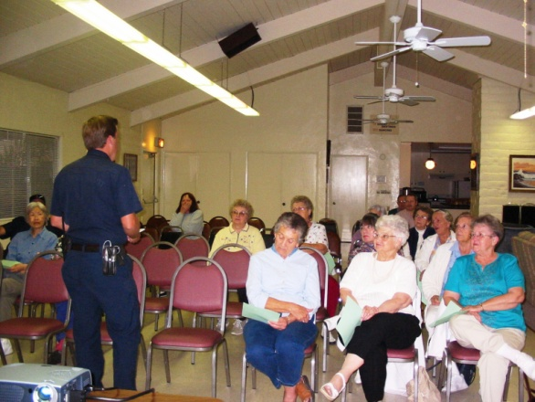
Know Your Audience
Whenever possible, be familiar with the expected age level and general make-up of the tour group that is scheduled to visit.
Base your presentations on the specific audience that you have for each tour.

Slide 7
Have a Plan
Have specific topics ready to discuss with certain age groups, as well as the general topics that you will cover with every tour group.
Have an idea of how much time you plan to spend with each tour group.
Establish a general sequence of events.
Remember that no two tours will be exactly the same, but many will have commonalities.

Slide 8
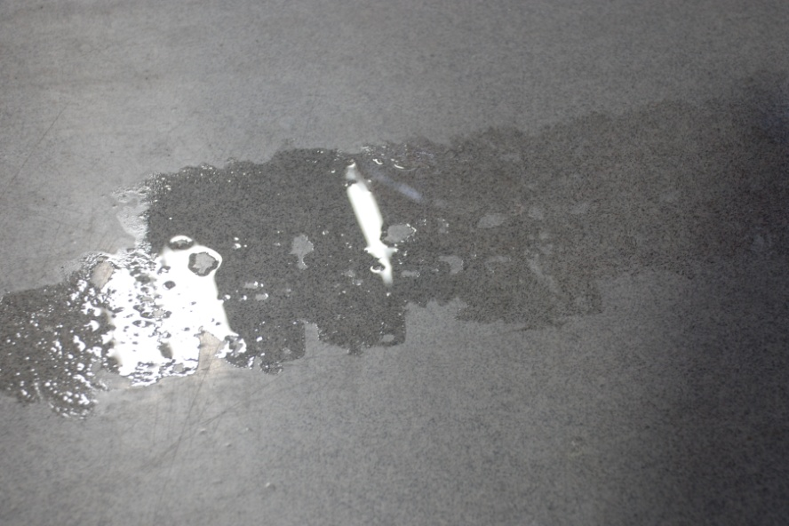
Safety First
Whenever possible, remove any potential hazards before the tour group arrives, such as snow, ice, water puddles, trip hazards, etc.

Slide 9
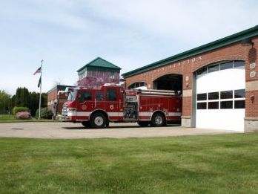
Safety First
Begin each tour with a safety briefing.
Since station crews typically remain “in-service” during tours, explain the procedures for ending the tour early due to an emergency response call.

Slide 10
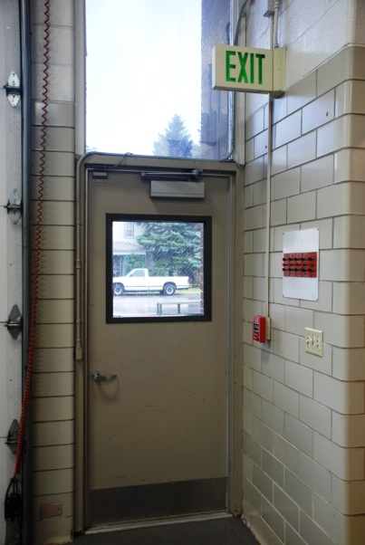
Introductions
Introduce the members of the station crew.
Point out the restrooms and exits that may be used by your visitors.
Set ground rules for the tour:
  Expected tour sequence.
  Opportunities for questions.
  Off limits areas.
  Stay with group / provide an escort.

Slide 11
Where to Start
A great place to start the tour presentation is in the station’s dayroom.
Topics here can include:
  Overview of the fire department - what you do.
  Life of a firefighter - describe a typical 24-hour shift.
  Station duties - cleaning, laundry, etc.

Slide 12
Next Stop – The Kitchen
The fire station’s kitchen can be a great area to teach some valuable life safety topics, including:
  Parents should establish a 3-foot “no kids” zone around cooking appliances.
  Watch what you heat.
  Keep matches and lighters locked up and out of reach of children.
  How to treat a burn injury.
  Fire extinguishers.

Slide 13
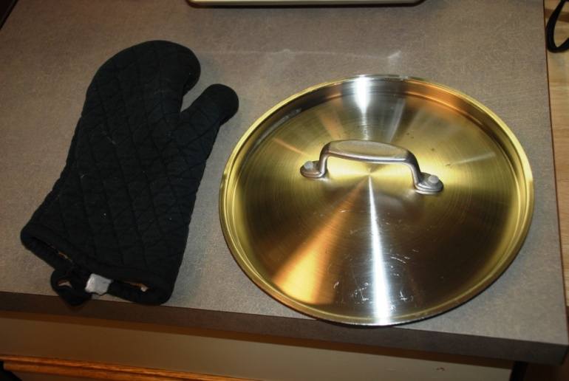
“Put A Lid On It”
Cooking fires are the leading cause of home structure fires and fire-related burn injuries.
  Teach the concept of “put a lid on it”.
  A visual demonstration can be effective.

Slide 14
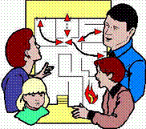
Moving On – The Bunkroom
Topics of discussion here can include…
Home fire safety systems:
  Smoke alarms
  Residential fire sprinklers
Home fire escape planning and drills:
  “Get low and go”
  “Get out and stay out”
  Have an outside “meeting place”
  Call 9-1-1 from outside the home.

Slide 15
The Case for Smoke Alarms
Why is it so important to have working smoke alarms?
Over 80% of all fatal fires occur in residential occupancies.
Most fatal fires occur in the late evening or early morning hours, when most people are asleep.
Most fire fatalities occur in bedrooms.
Smoke alarm sensors get weaker over time and the whole unit should be replaced every 10 years.
89% of all fatal fires occurred in 1- and 2-family residences where working fire alarms were not present!!! Source: FEMA

Slide 16
Know the Beeps!
Smoke alarm activations are repeating sets of three (3) beeps, with a short pause in between sets.
Carbon monoxide activation are repeating sets of four (4) very quick beeps, with a short pause in between sets.
Both types of devices will typically “chirp” once every 30 – 60 seconds to indicate a low battery alert.

Slide 17
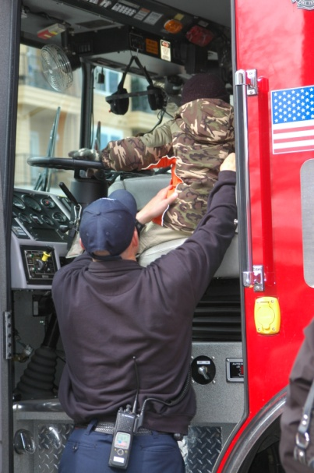
The Apparatus Bay
Keep discussions age appropriate.
Discuss equipment and information that you feel is important.
Keep it safe! Follow your policies.
Allow time for questions and photo opportunities.

Slide 18
More Safety Topics
While showing off the apparatus, you can also discuss…
  Seatbelt use.
  Car seats / booster seats for children.
    Give info on local car seat inspection programs.
  “Pull to the right for sirens and lights”.

Slide 19
Helpful tips
Be creative
  Use interactive demonstrations
  Have dispatch air a welcome message to your group
Be animated
  Speak with character and charisma
  Move around
  Use humor when appropriate
Customize
  Tailor the tour content to fit your audience

Slide 20
The Sky’s the Limit!
Other topics of discussion can include…
  Carbon Monoxide (sources, alarms, etc.)
  Bike helmets, life jackets, and other life safety equipment.
  Other department services (smoke alarms, bike helmets, home safety surveys, car seat techs, etc.)
  Local emergency notification systems.
  Home disaster planning / emergency supply kits.
  City / department budgets.
  Inter-agency relationships.
  Any other pertinent or local programs or issues.

Slide 21
Conclusion
Answer any questions.
Re-enforce safety lessons.
Distribute any handouts.
Thank your audience.
Escort them to the exit.
Log your event if your department tracks public relations contacts.

Slide 22
Summary
Make station tours a “valued added service”.
Use educational components to go beyond the expected entertainment value.
Take every opportunity to gain the support of your community members.
Ensure that they leave with a positive impression of your crew, your station, and your agency.

Slide 23
Any questions or comments?
Thanks for you time!
Contact Information:
scott.pringle@cityofloveland.org
970-962-2614

