Slide 1
Idylwilde Dam, Pipeline and Hydro Station
2013 Flood Assessment Images
City Council Presentation
By Water and Power Department
October 8, 2013

Slide 2
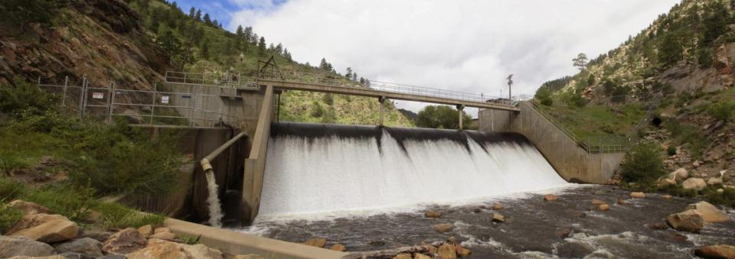
Idylwilde Dam prior to 2013 Flood Circa June 2013

Slide 3
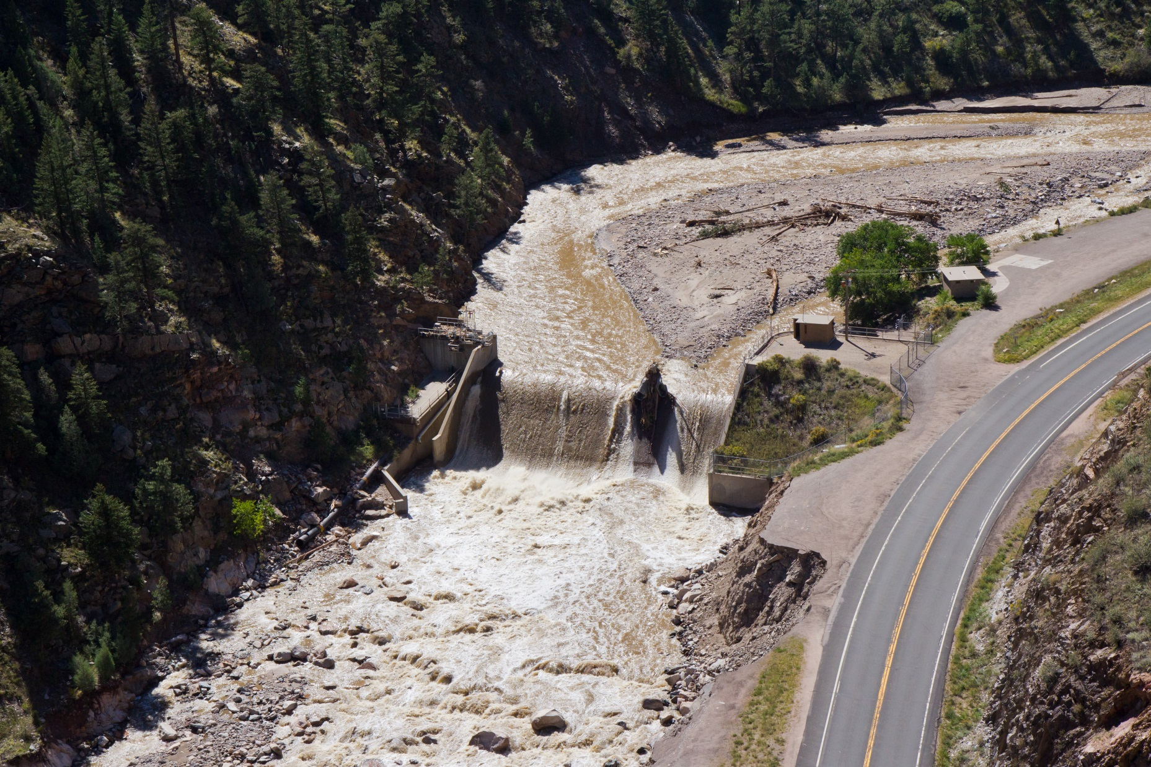
Idylwilde Dam post 2013 Flood Concern about dam stability, reservoir filled with silt, sand, cobble and boulders

Slide 4
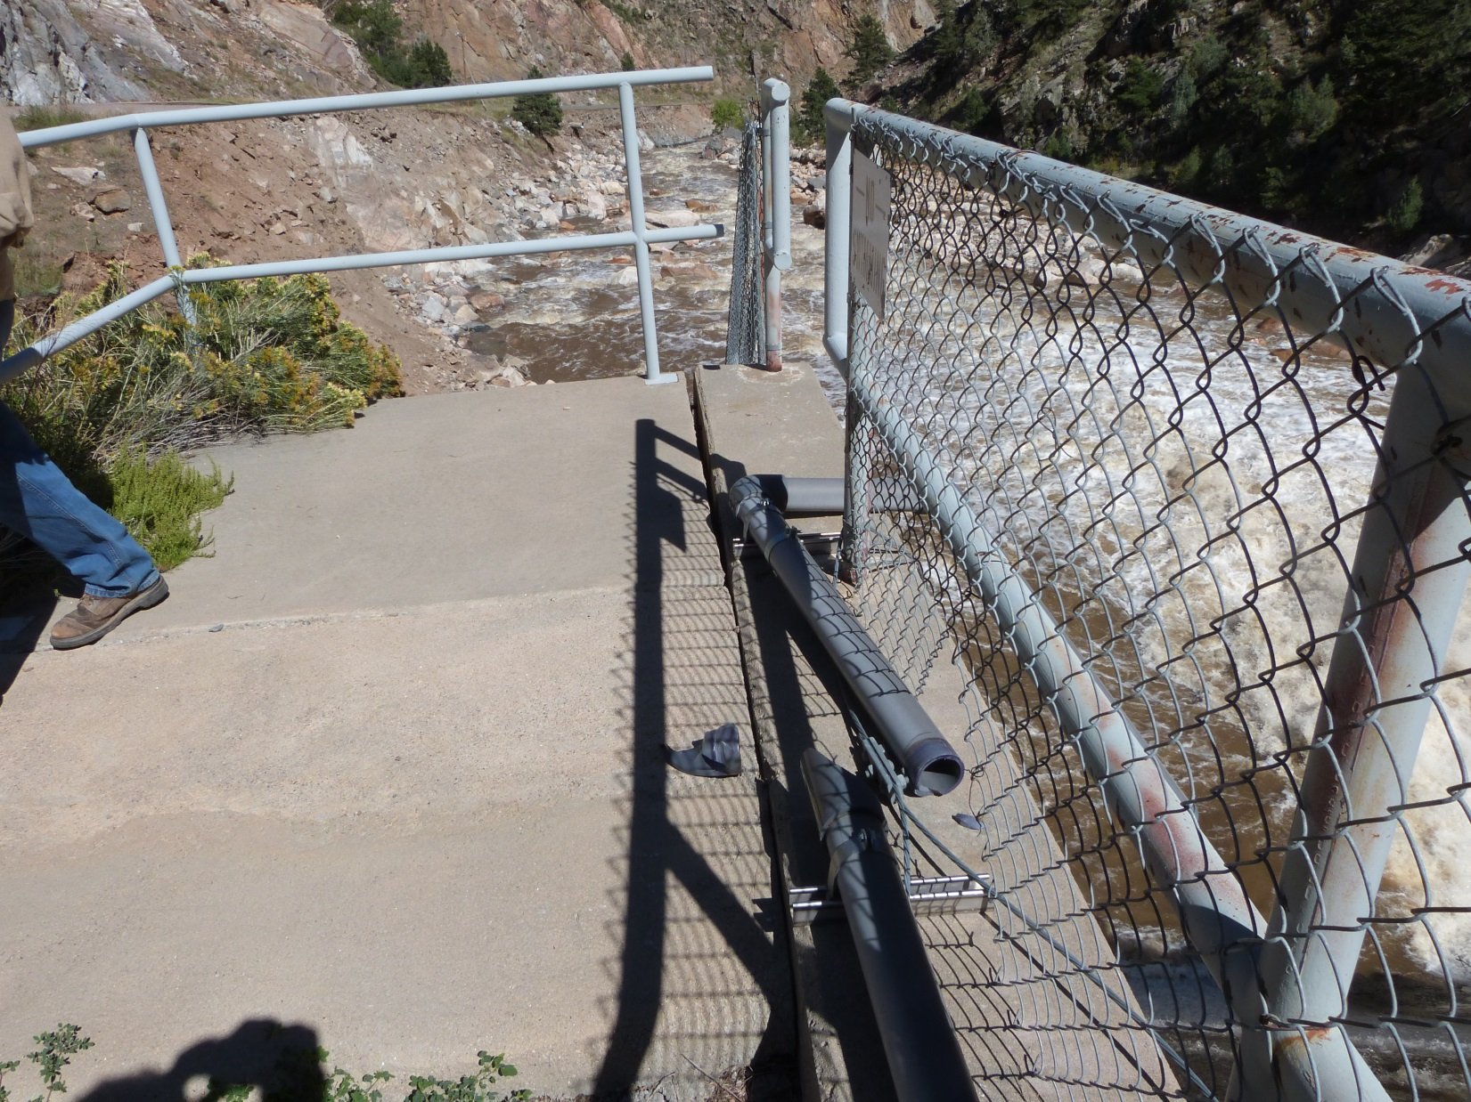
Idylwilde Dam post 2013 Flood Disconnected pipe and concrete separation

Slide 5
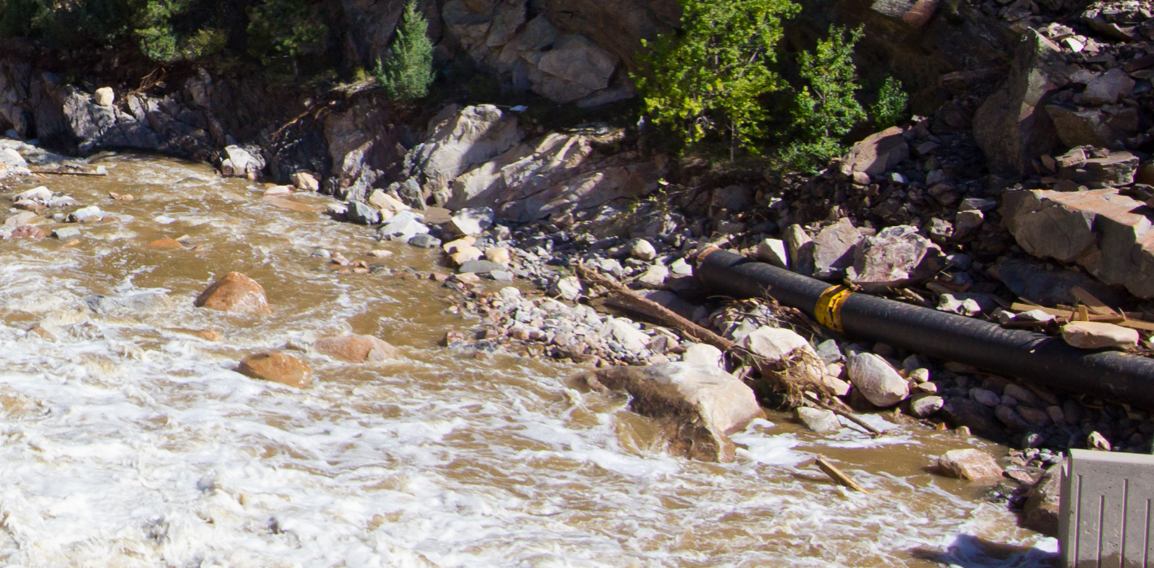
Pipeline post 2013 Flood Downstream from Idylwilde Dam, Exposed pipe with portion missing

Slide 6
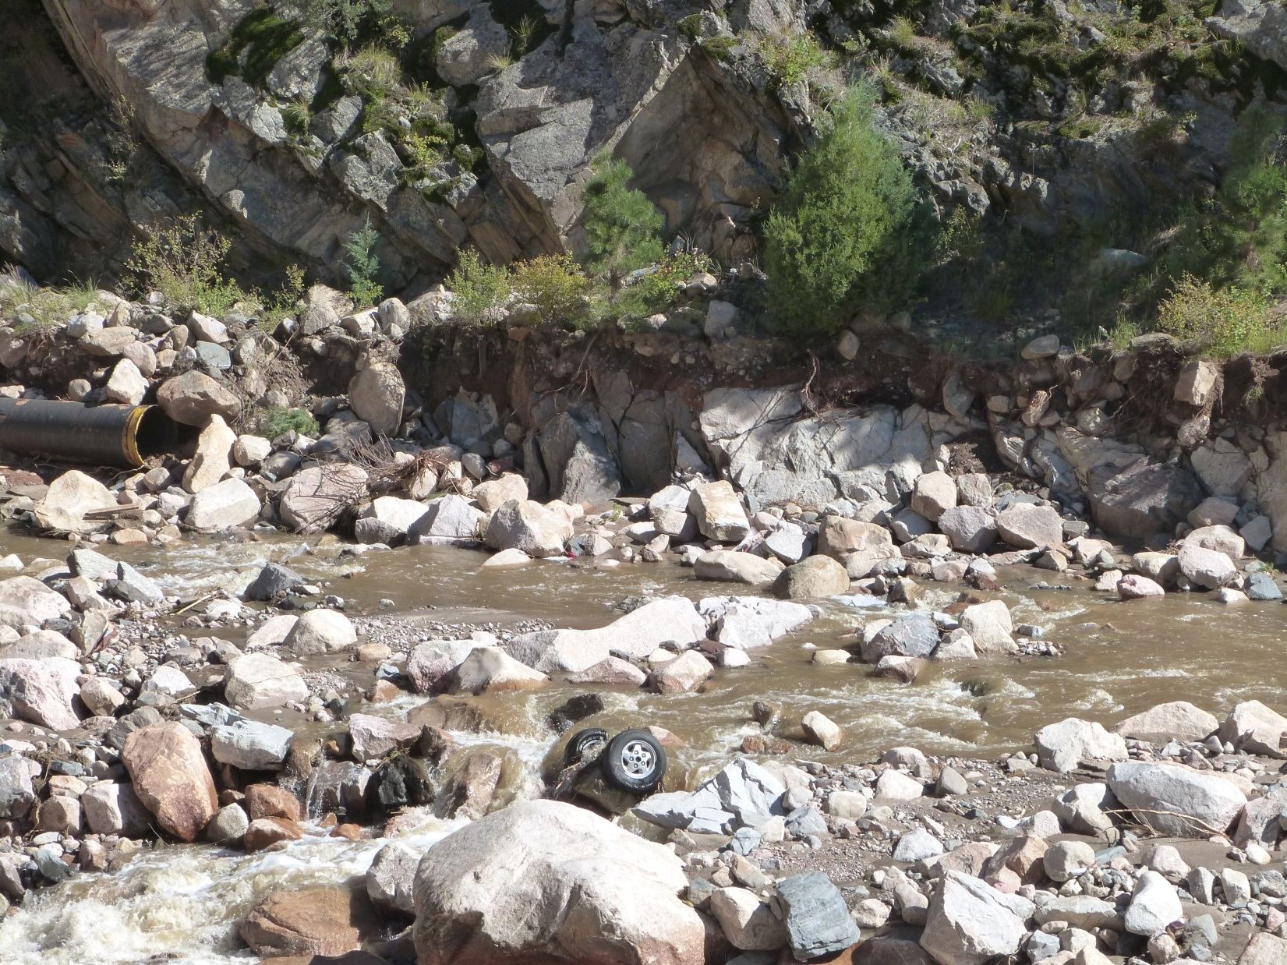
Pipeline post 2013 Flood Downstream from Idylwilde Dam, Exposed pipe with portion missing

Slide 7
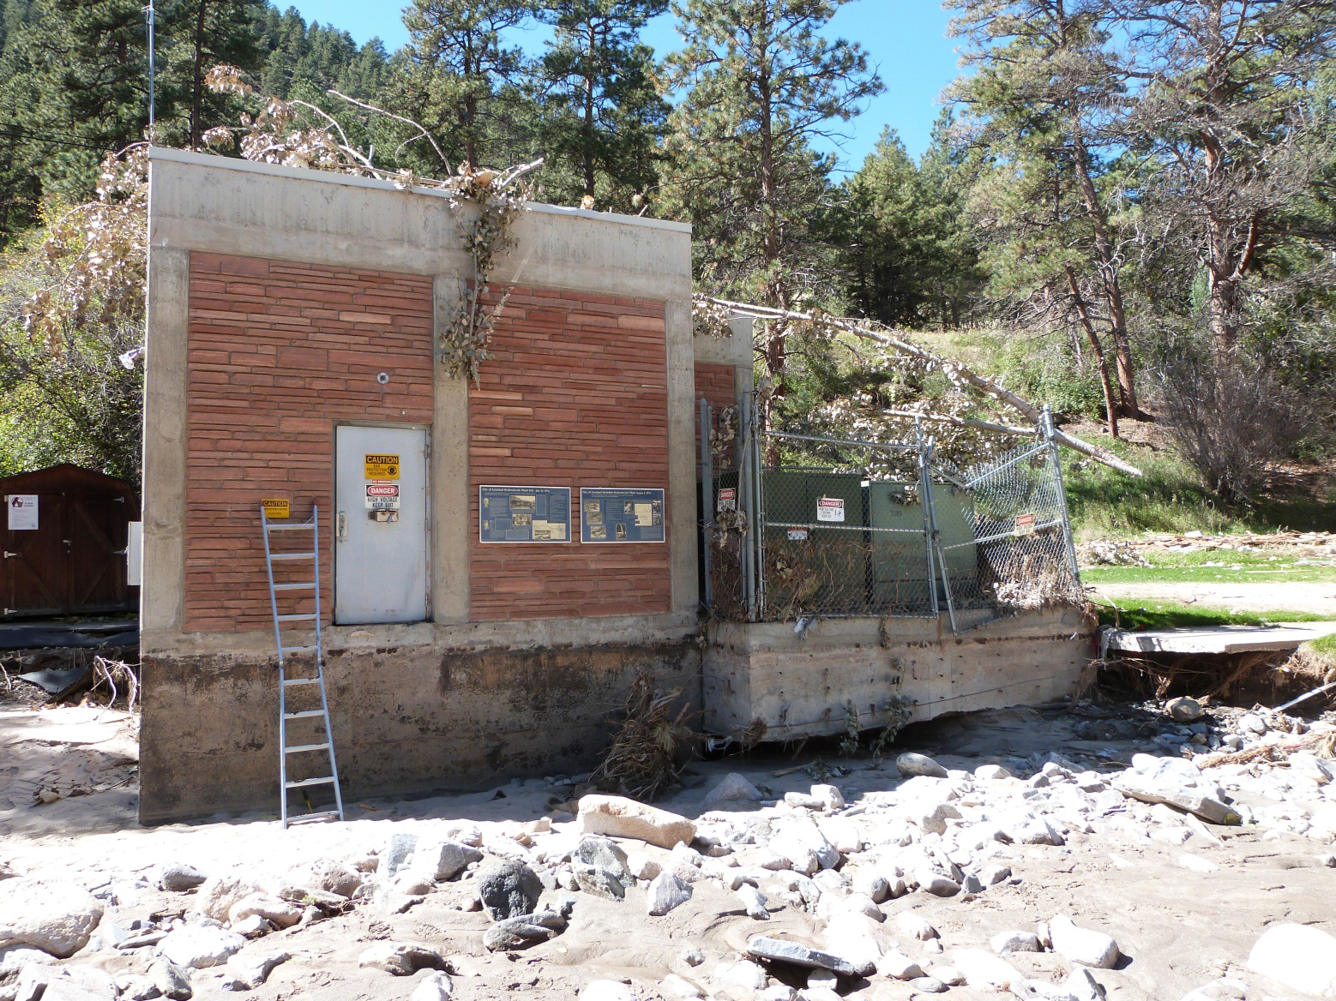
Power Plant post 2013 Flood Erosion around foundation

Slide 8
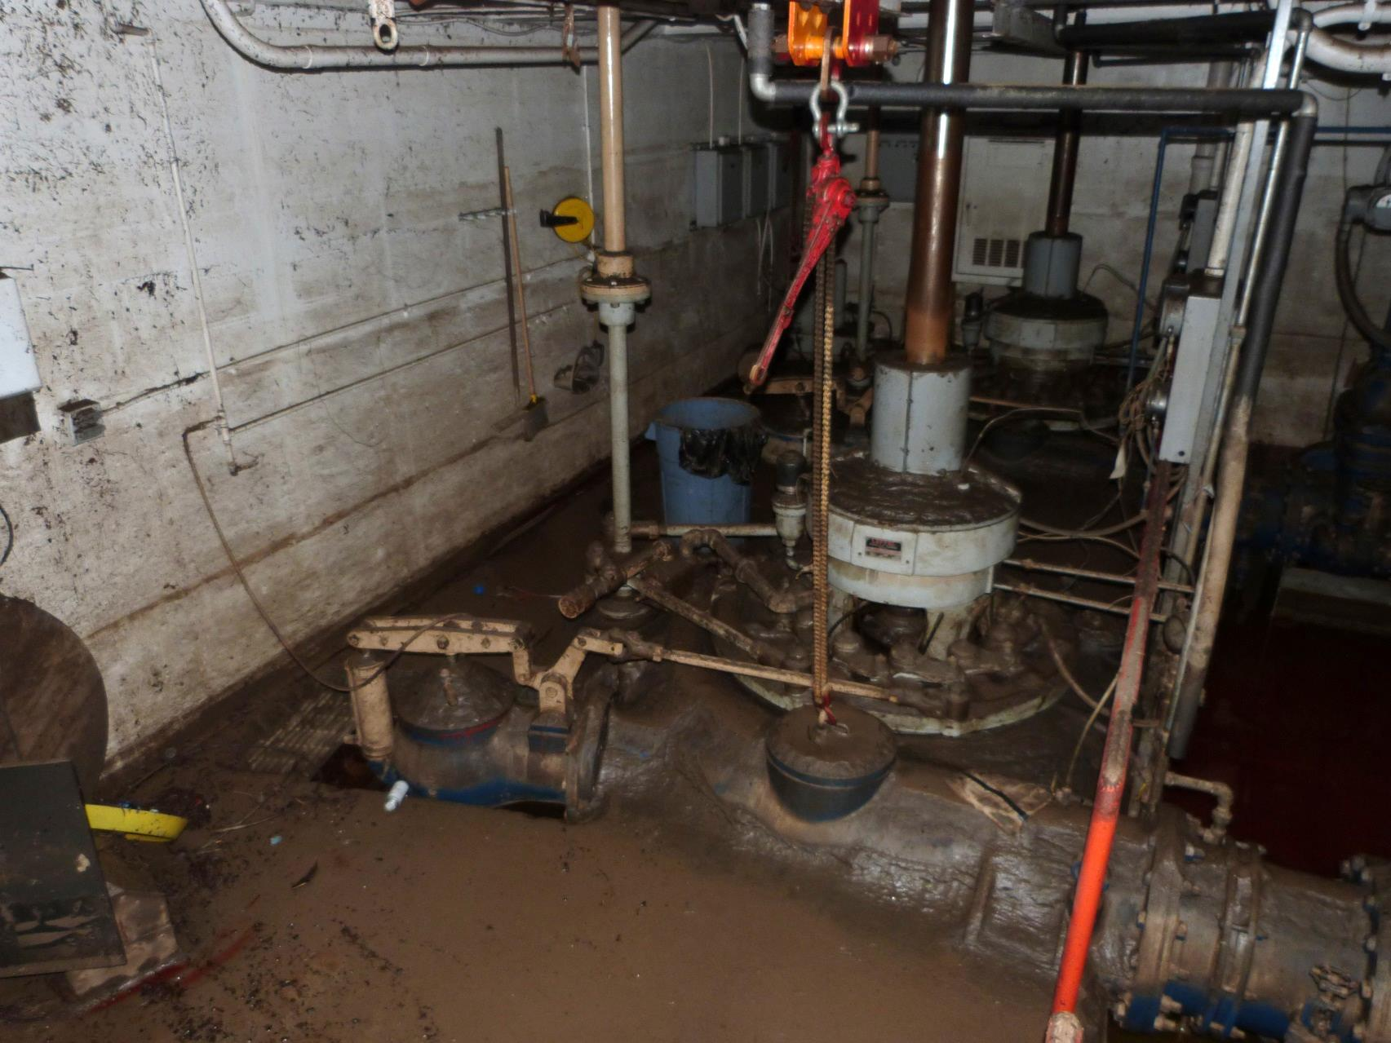
Power Plant post 2013 Flood Inside is filled with muck

Slide 9
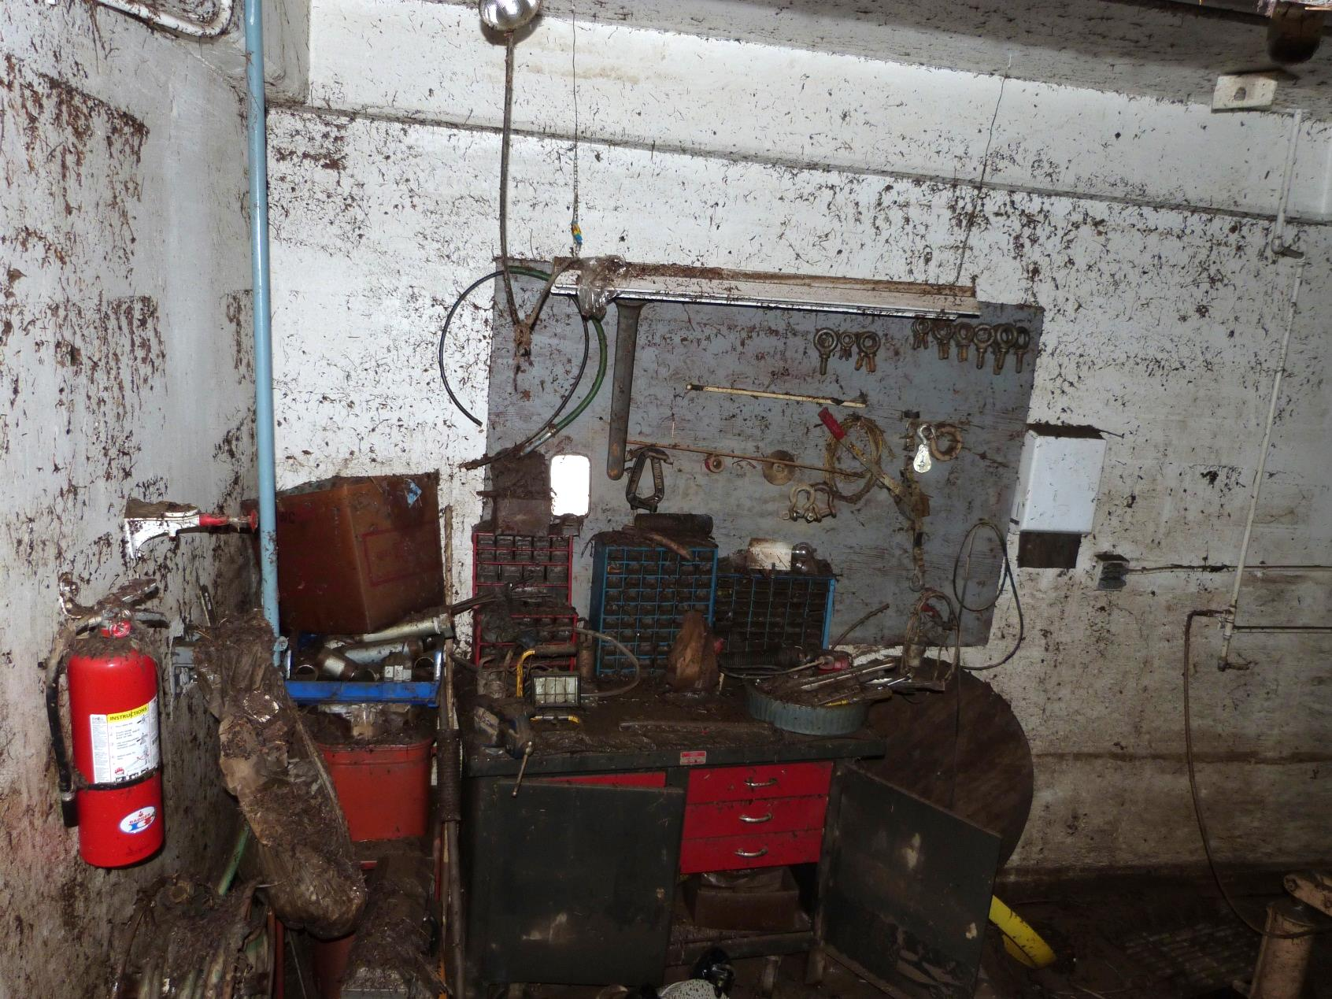
Power Plant post 2013 Flood Inside is filled with muck

