Slide 1

Water & Power
Quarterly Financial Report
Loveland Utilities Commission
October 16, 2013

Slide 2
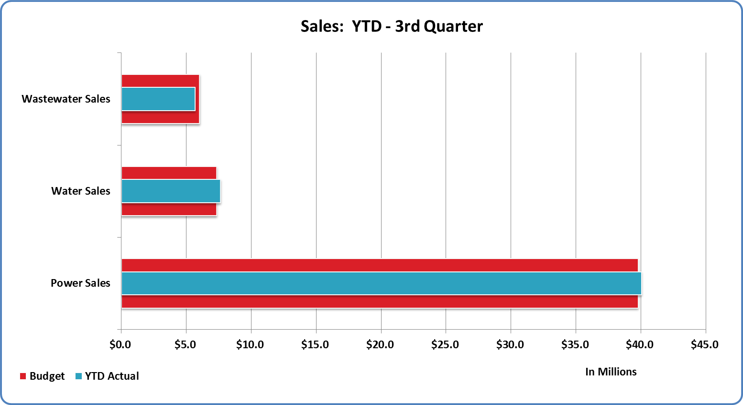

Slide 3
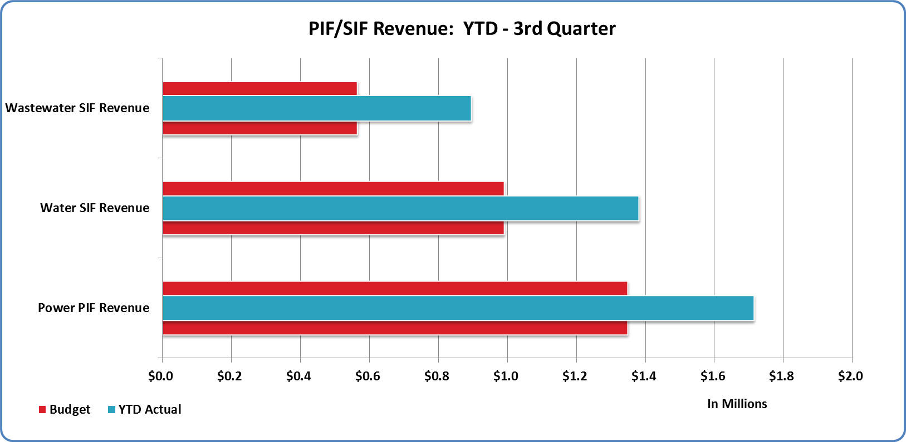

Slide 4
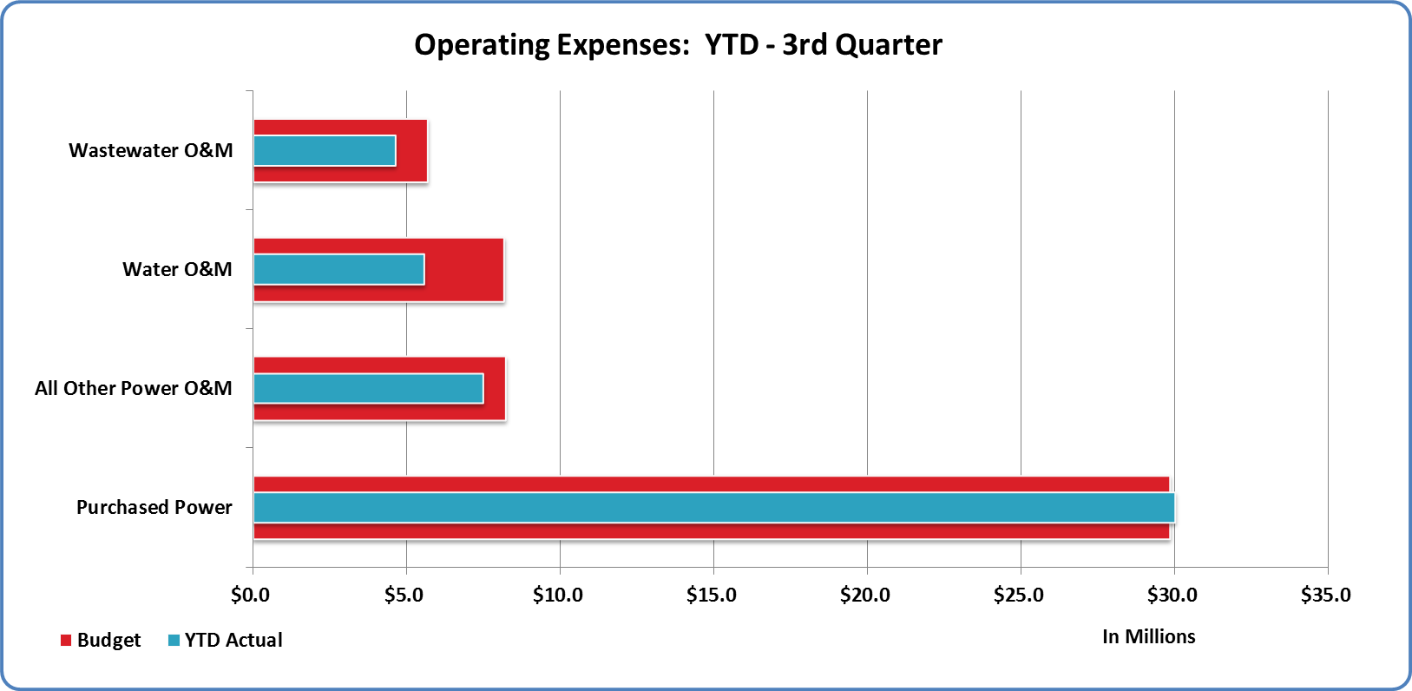

Slide 5
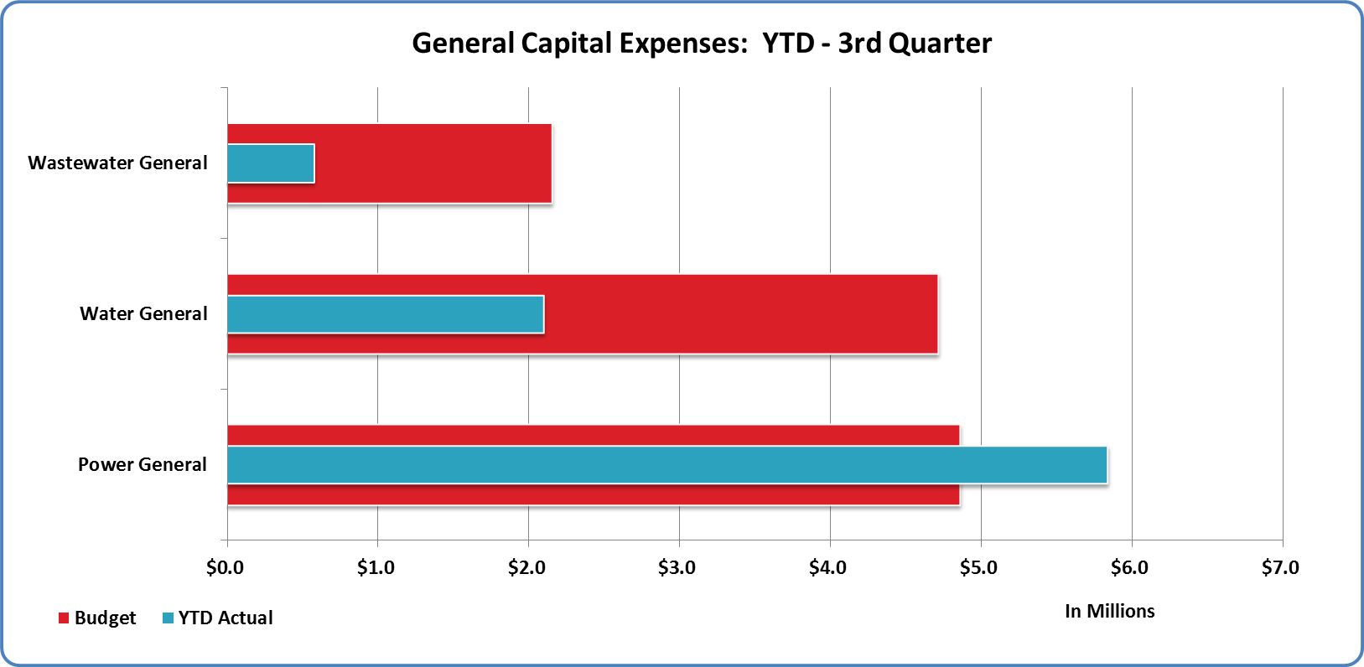

Slide 6
