Slide 1

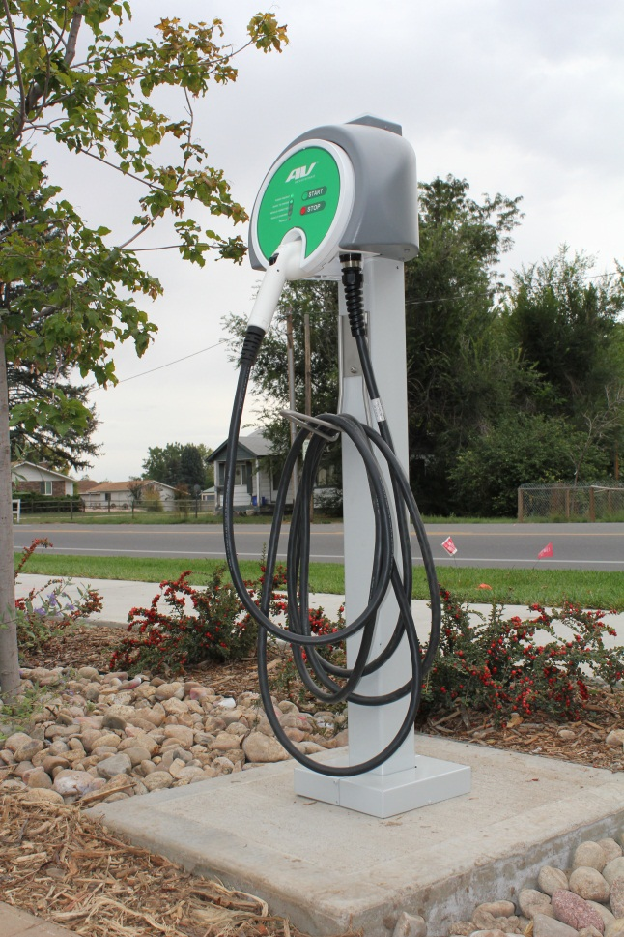

EVSE Grant and DENC Update
October 16, 2013

Slide 2
Colorado Energy Office Grant for EVSE Infrastructure
Electric Vehicle Charging Stations

Slide 3
Deployment Progress
The City of Loveland was awarded a grant from the Colorado Energy Office in February 2013.
Installation on the charging stations was completed in September 2013 at the following locations:
Service Center
Civic Center
Library
McKee Medical Center
Service Center (fleet use only)

Slide 4
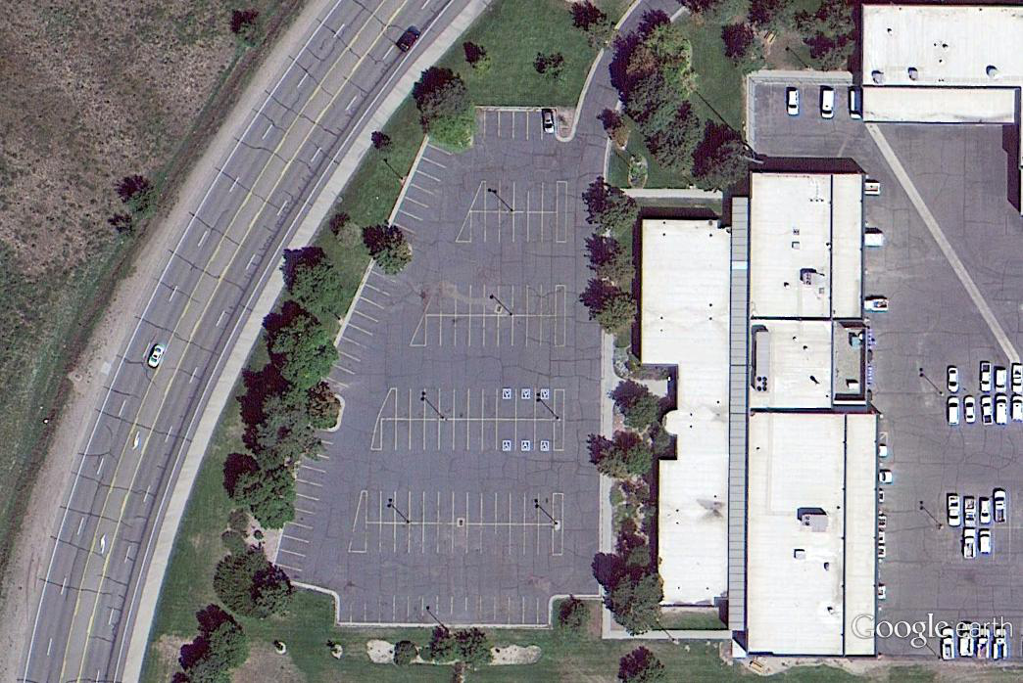
Service Center

Slide 5
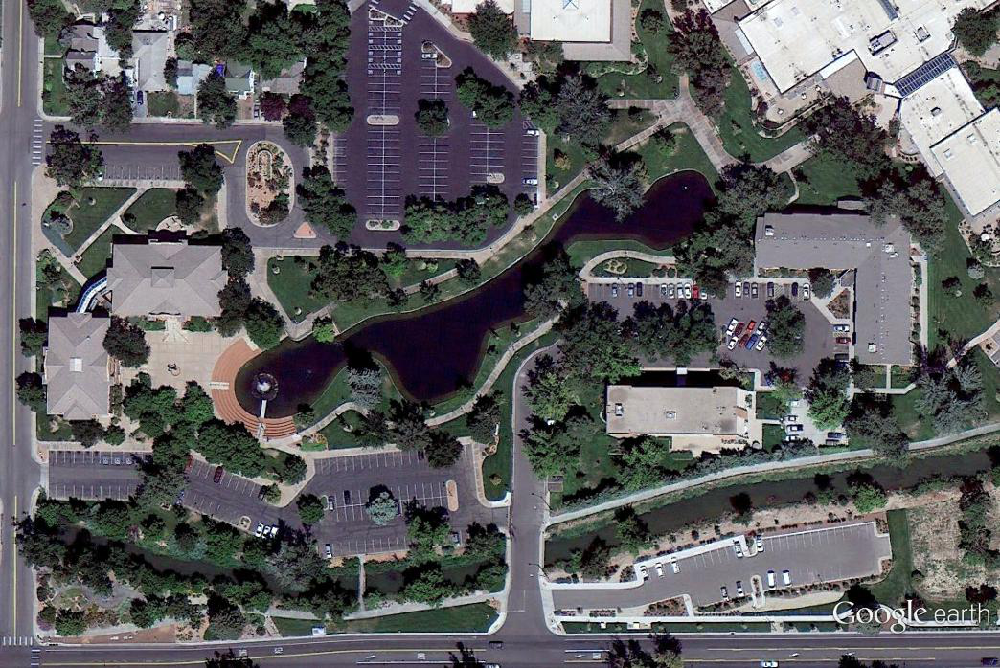
Civic Center

Slide 6
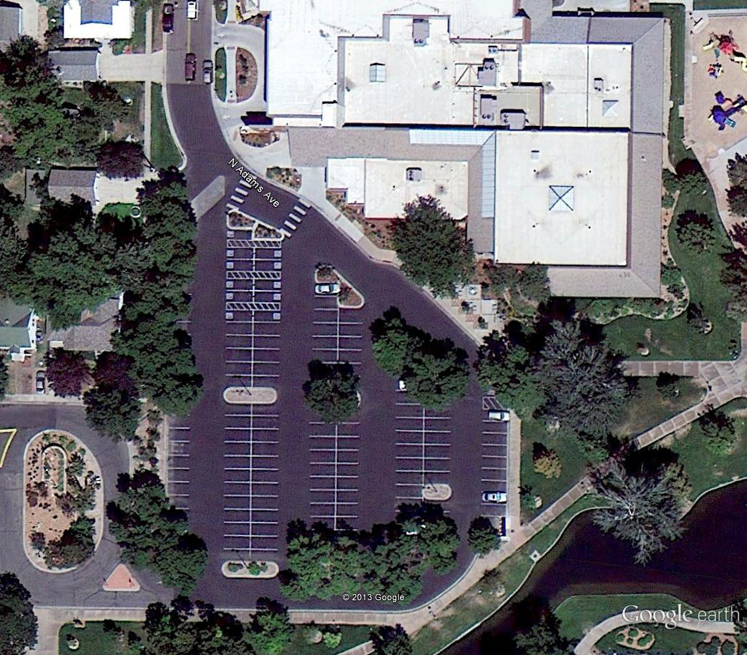
Library

Slide 7
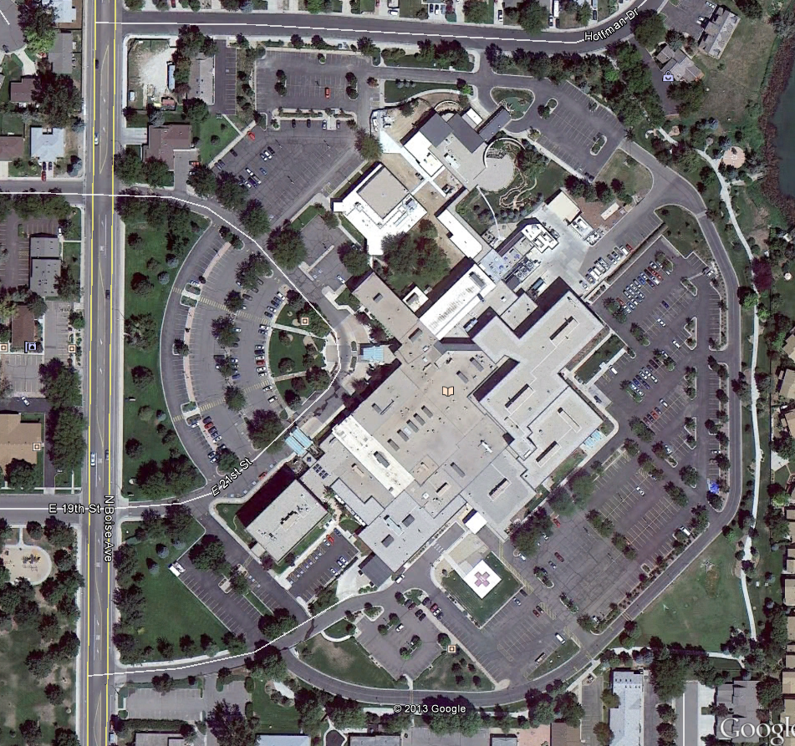
McKee Medical Center

Slide 8
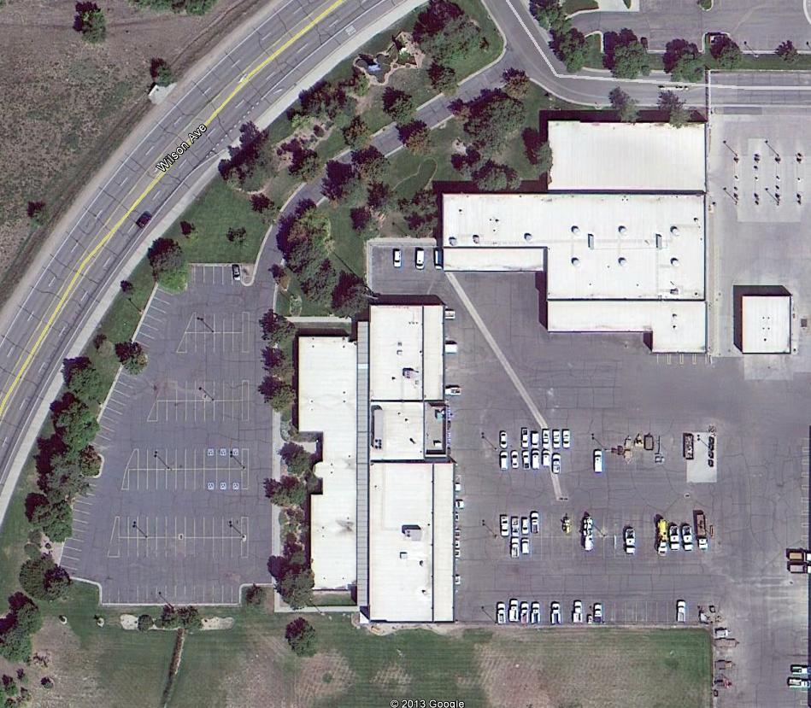
Service Center (fleet use only)

Slide 9
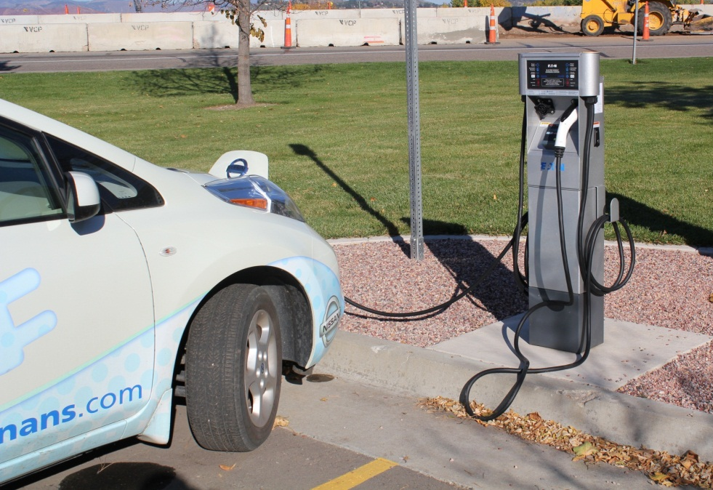
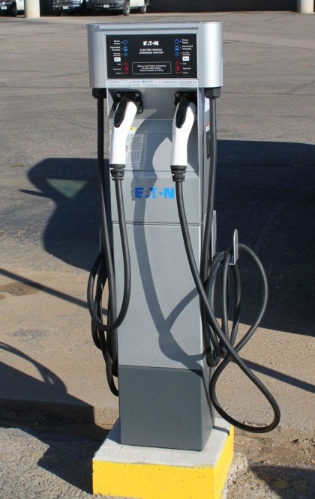
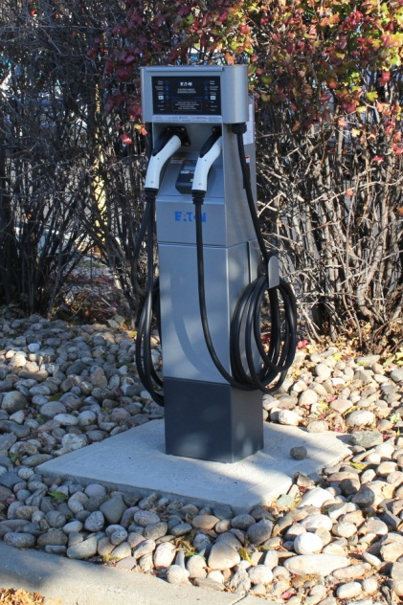
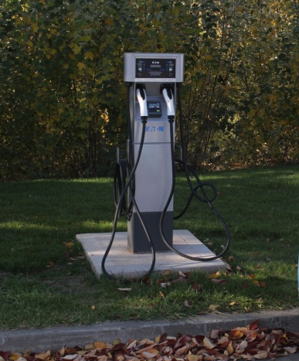
Charging Stations

Slide 11
Financials
Location | McKee Medical Center | Library | Service Center (fleet) | Service Center (public) | Civic Center
Misc. Material &Labor Expense | $3076.73 | $2677.58 | $1764.34
EVSE Expense | $3,804.00 | $3,804.00 | $3,260.00 | $3,804.00 | $3,804.00
Electrician Expense | $3,279.00 | $3,265.00 | $4,886.00 | $4,886.00 | $5,756.00
Total Expense by Location | $10,159.73 | $9,746.58 | $9,910.34 | $8,690.00 | $9,560.00
Grant Funding | $6,260.00 | $6,260.00 | $6,260.00 | $3,600.00 | $6,260.00
City Funding | $3,899.73 | $3,486.58 | $3,650.34 | $5,090.00 | $3,300.00
City % Match | 38% | 36% | 37% | 59% | 35%

Slide 12
DENC Update and Upcoming Events
Drive Electric Northern Colorado

Slide 13

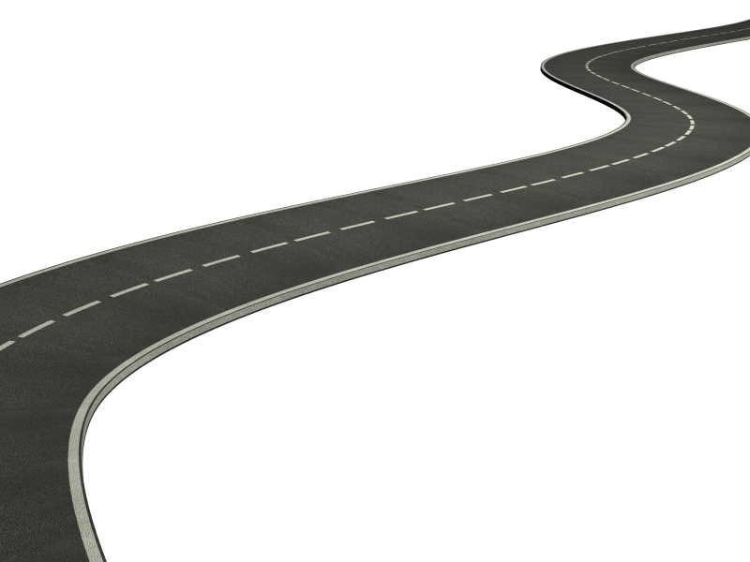
The Deployment Community Concept
Remove Roadblocks to Large Scale Deployment
Broad Stakeholder Cooperation & Engagement
Facilitate Nationwide Plug-in Electric Vehicle Technology
Create a replicable and scalable model as a roadmap for other communities across the nation.
Notes:
To facilitate nationwide commercialization of plug-in electric vehicle (PEV) technology, the engagement and cooperation of a broad group of stakeholders is required. These stakeholders include state and city governments, infrastructure providers, utilities, automakers and other firms, service providers, and regulators. If the necessary ecosystem is not created, commercialization of this technology will proceed far more slowly.

Slide 14
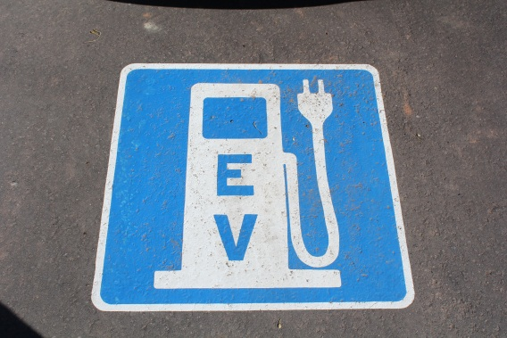
One Month Accomplishments
Recognition
Speaking Opportunities
Grant completion
White paper – Green Fleets Magazine
2013 Outstanding Non-Profit Award by the Sustainable Living Association
“The story of the I” - BMW
Orlando Launch – Orlando, FL
Green Fleets Conference – Phoenix, AZ
Rocky Mt. Utility Exchange – Aspen, CO
Net Zero Cities – Fort Collins, CO

Slide 15
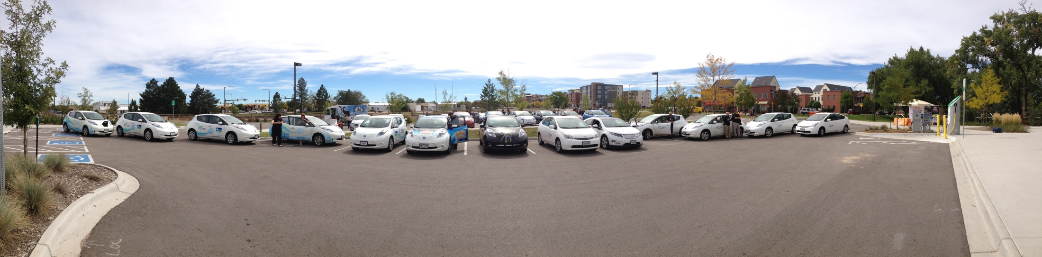
Events
September 30 – National Plug in Day
October 15 - Financial Literacy Class – Loveland Public Library
October 23 & 24 – Net Zero Cities
November 13 – McWhinney Launch – CEO Drive Electric Program
November 16 – Ride and Drive at Verboten and Grimm Brothers
November 20 – Business Innovation Fair
December 12 – Loveland Key Accounts Meeting
TBD – McKee and Library Charging Station Launch

Slide 16
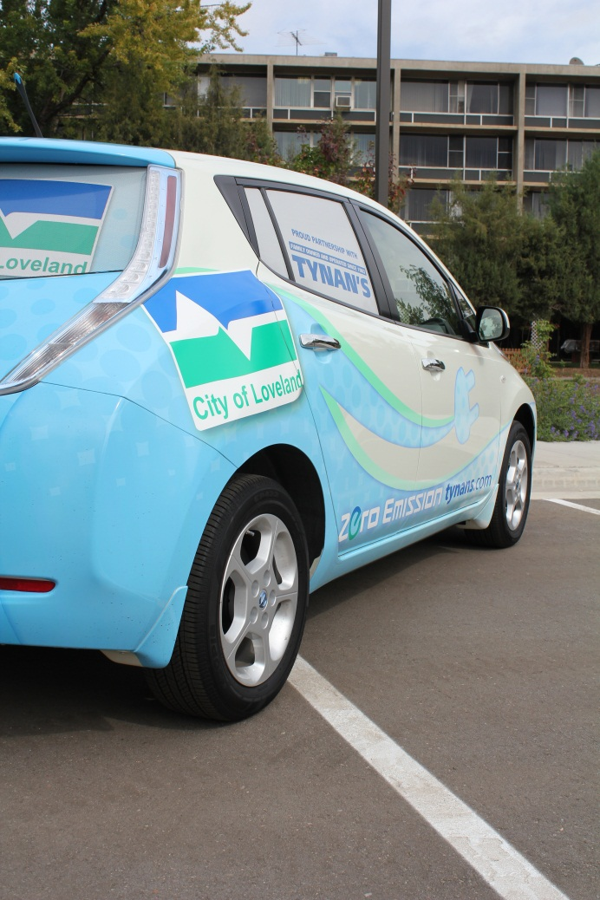
Thank you!
Questions or Comments?

