Slide 1
Customer Relations Role
“I wanted to send out a big “thank you” to the entire city staff for all of the extra work that they have put in to keeping our city safe and running as best as possible this past weekend. Could you please pass that on to everyone at Water and Power for me? Thank you. As I see individual people that I work with on a daily basis, I will let them know of my appreciation, but there are so many others that worked hard this weekend that I don’t know. I want them to know that they are a blessing to the city of Loveland!” – Suzette Schaff, P.E. , CDS Engineering Corporation
Flood 2013
LUC - October 16, 2013

Slide 2
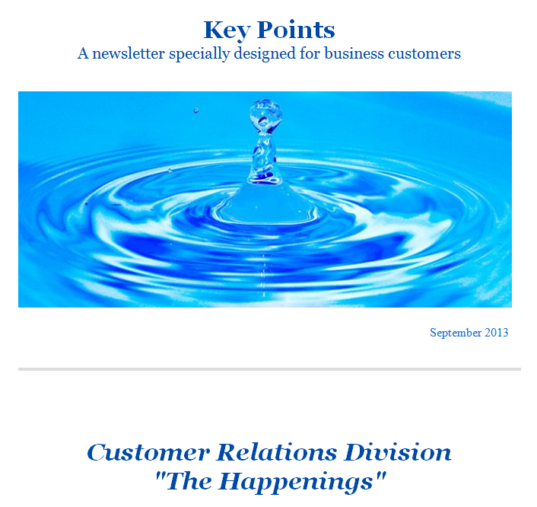
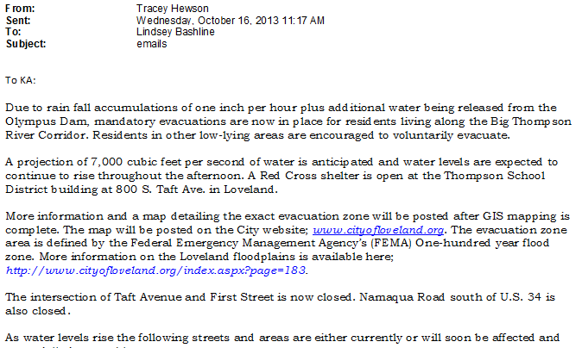
Communications:
Internal
W&P Staff
CSRs/Dispatch
EOC
PIO
External
Key Accounts
Residential
Businesses
Conversation Efforts
“I have family in Loveland and have been following you on Facebook. You have done a superb job keeping your followers updated, I feel well informed and that their utility actually does care. Keep it up!”
– Seattle, Washington
Notes:
Internal
CSRs, Dispatch and LWP Staff
Loveland PIO
External
Key Accounts
Loss of Service Contacts
Fielding Customer Calls
Disaster Assistance Center
News and Print Media
In addition to communications CR provided general support: WTP deliveries, Staffing the EOC

Slide 3
Communications with Loss of Service Customers:
73 customers on the 20 and 36 inch lines:
Helped field crews to identify problem sources
Managed water resources for customers including 1,000 water tank
Approximately 300 customers without power:
Incorporating FEMA recovery questions
Timeline
24/7 Personal Phone Calls
24/7 Website Updates
24/7 Press Releases
Notes:
Point: The 73 water and 300 power. Personal calls, email (deaf individual), constantly updating contact list – All we had to start with was the UB contact and issues around that.

Slide 4
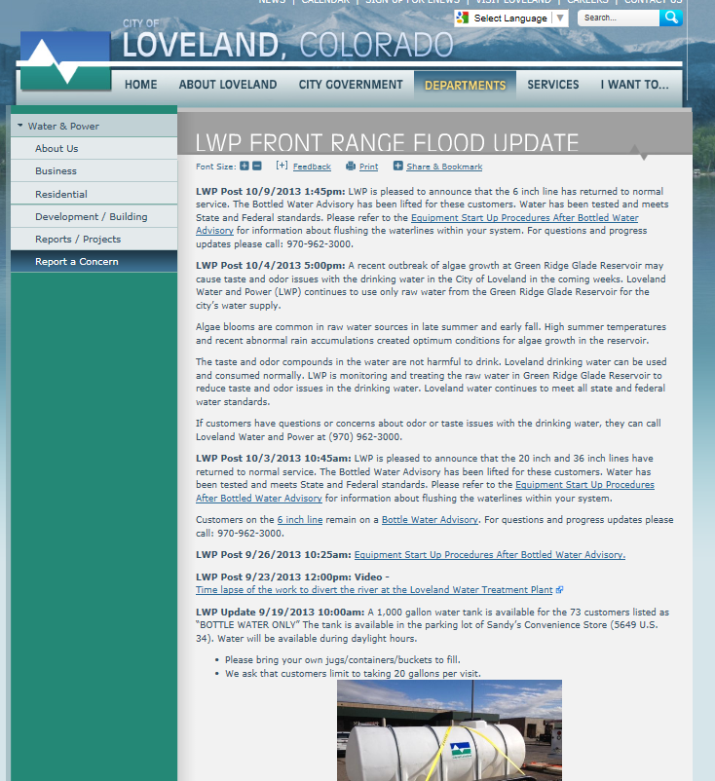
LWP updates online becomes a historical timeline:

Slide 5
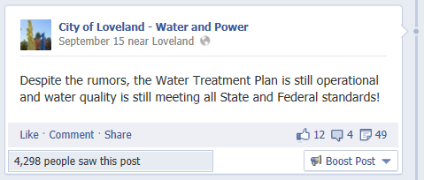

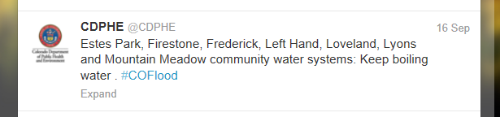
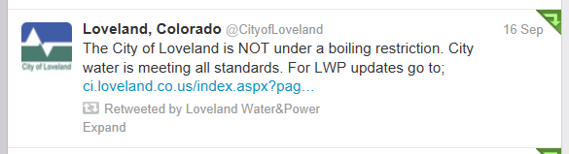
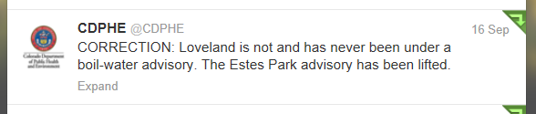
Monitoring Media Reports
Notes:
Point: By monitoring media sites we were able to dispel rumors and monitor the accuracy of media output from other organizations. CDPHE example: Saw post and found Loveland was incorrectly included as a Boil Order community on a CDPHE Flooding Update that was widely distributed. CDPHE issued a correction.

Slide 6
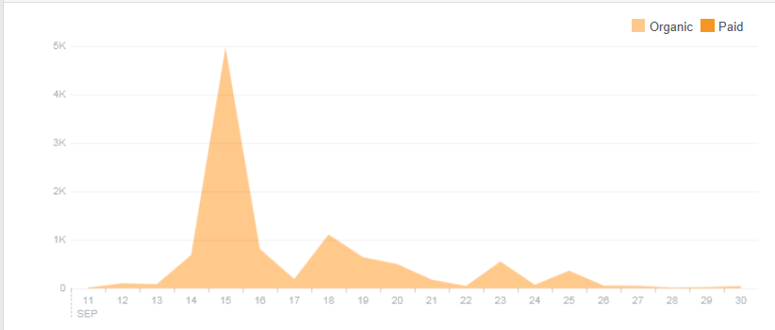
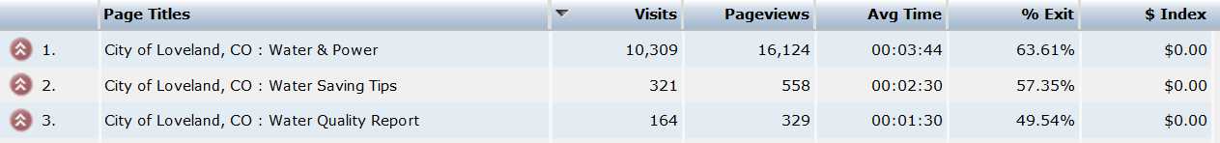
Traffic:
Facebook Post Reach:
Website Hits:
Notes:
Point: Maintain accurate information on our sites as traffic to these sites increased significantly. 5,000 FB in one day, over 10,300 visits to LWP website

Slide 7
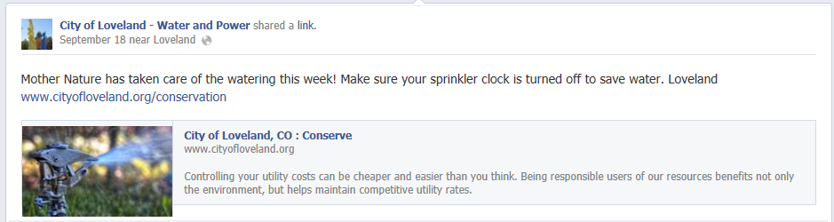
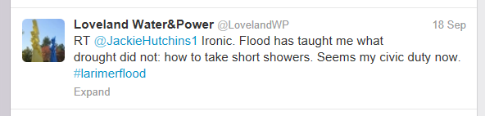
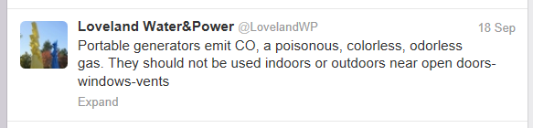
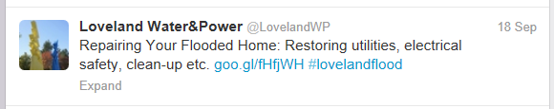
General Messaging During the Flood:
Notes:
Point: Able to remind the community about power outage safety, conservation and utility resources

Slide 8
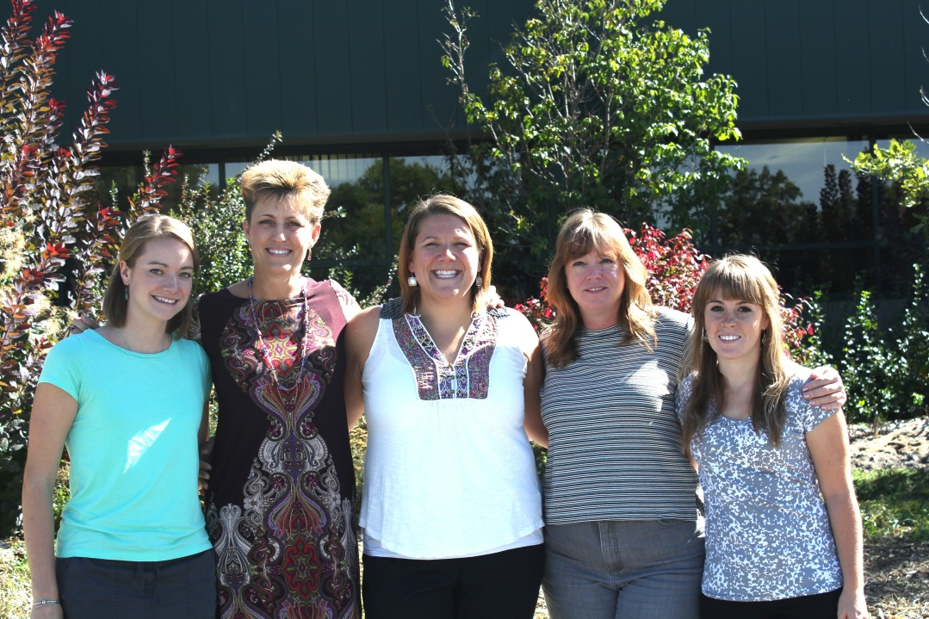
Other Job Duties as Assigned:
EOC shifts, dispatch shifts, deliveries to the WTP
Photo and video coordination
Presentations to City Council and for City Council
Tier 1 Bottled Water Notification
Dirty Water Complaints
Taste and Odor Concerns
Algae Bloom at Green Ridge Glade
Wastewater Treatment Plant Odor Concerns
Do It Right the First Time - Recovery Efforts
Increased Rebates
Energy Advisors
Colorado Energy Office, NREL, Utilities, PRPA

Slide 9
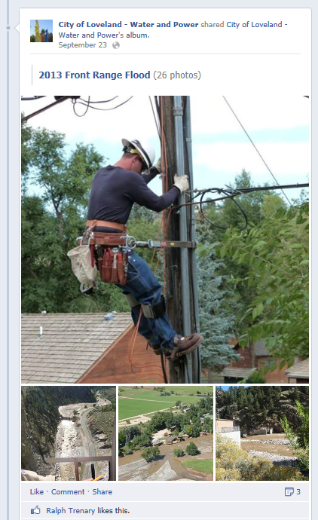
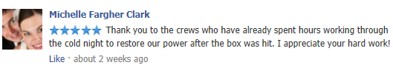
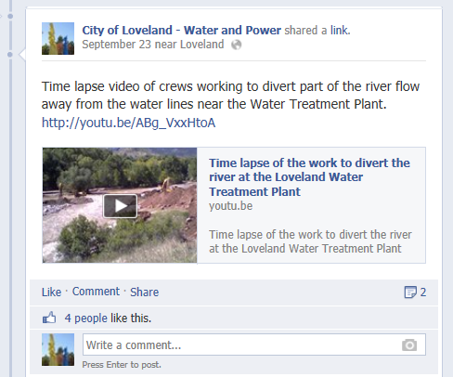
After the Flood:
Notes:
Point: Continue to rally support around recovery, highlight the great work done by staff

Slide 10
Questions?

