Slide 1
Home Supply Diversion Structure
Loveland Utilities Commission
October 16, 2013

Slide 3
River Flowing Through Break in the Dam Crest

Slide 4
River Shunted to the Home Supply Side

Slide 5
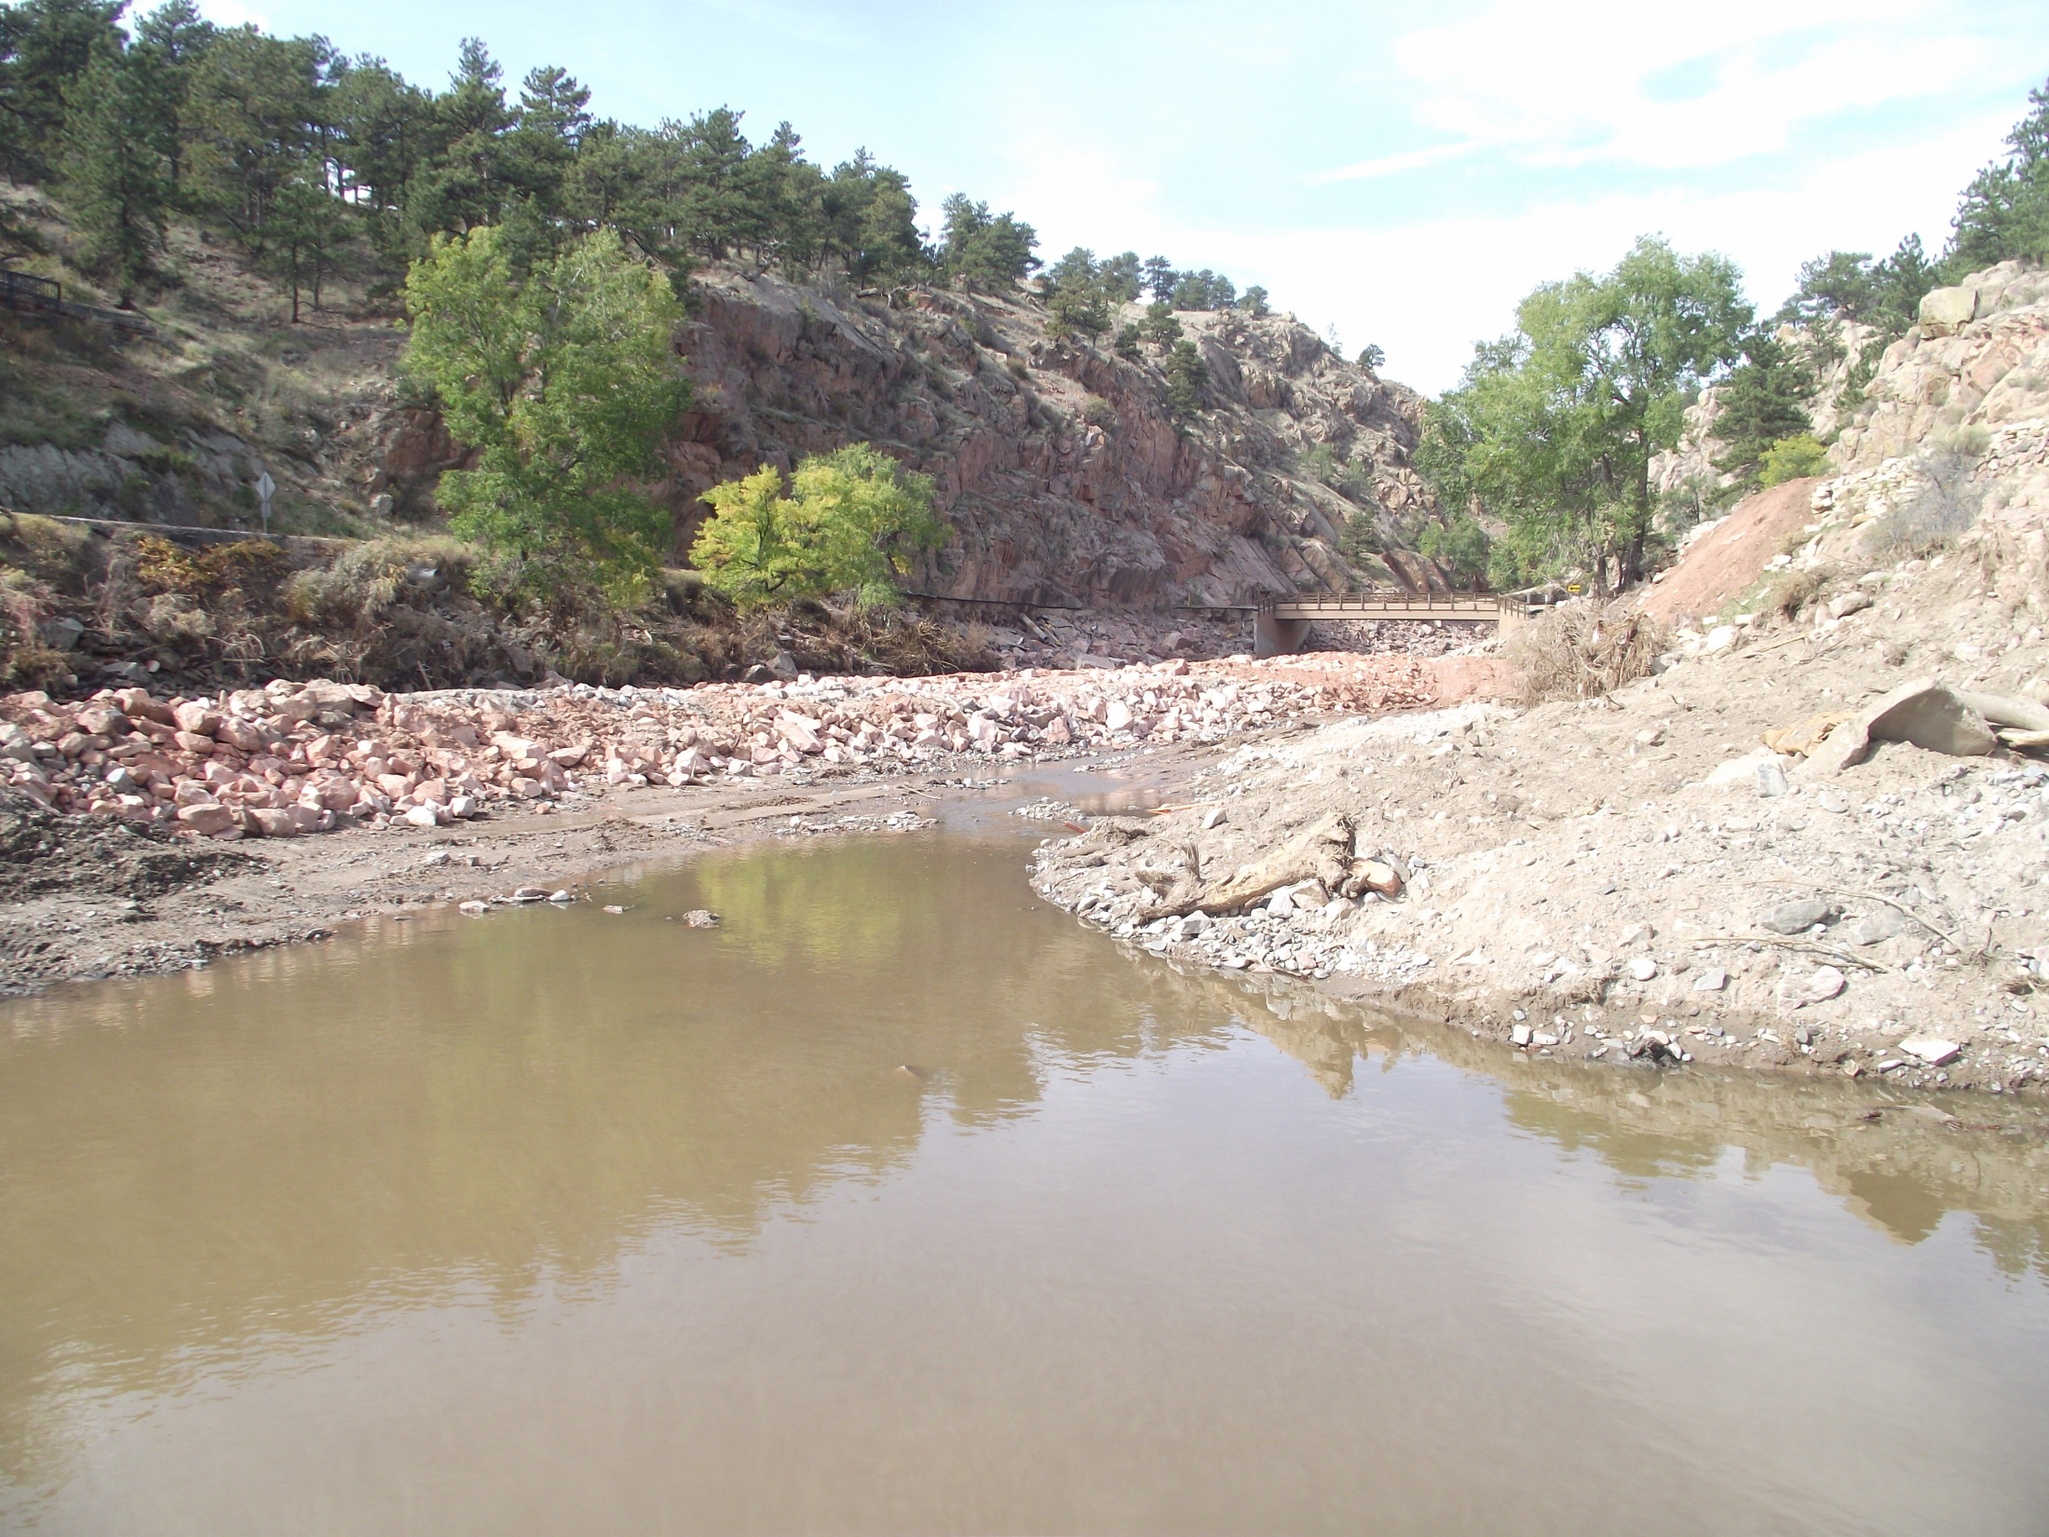
Looking Upstream from the City of Loveland Diversion Structure

Slide 6
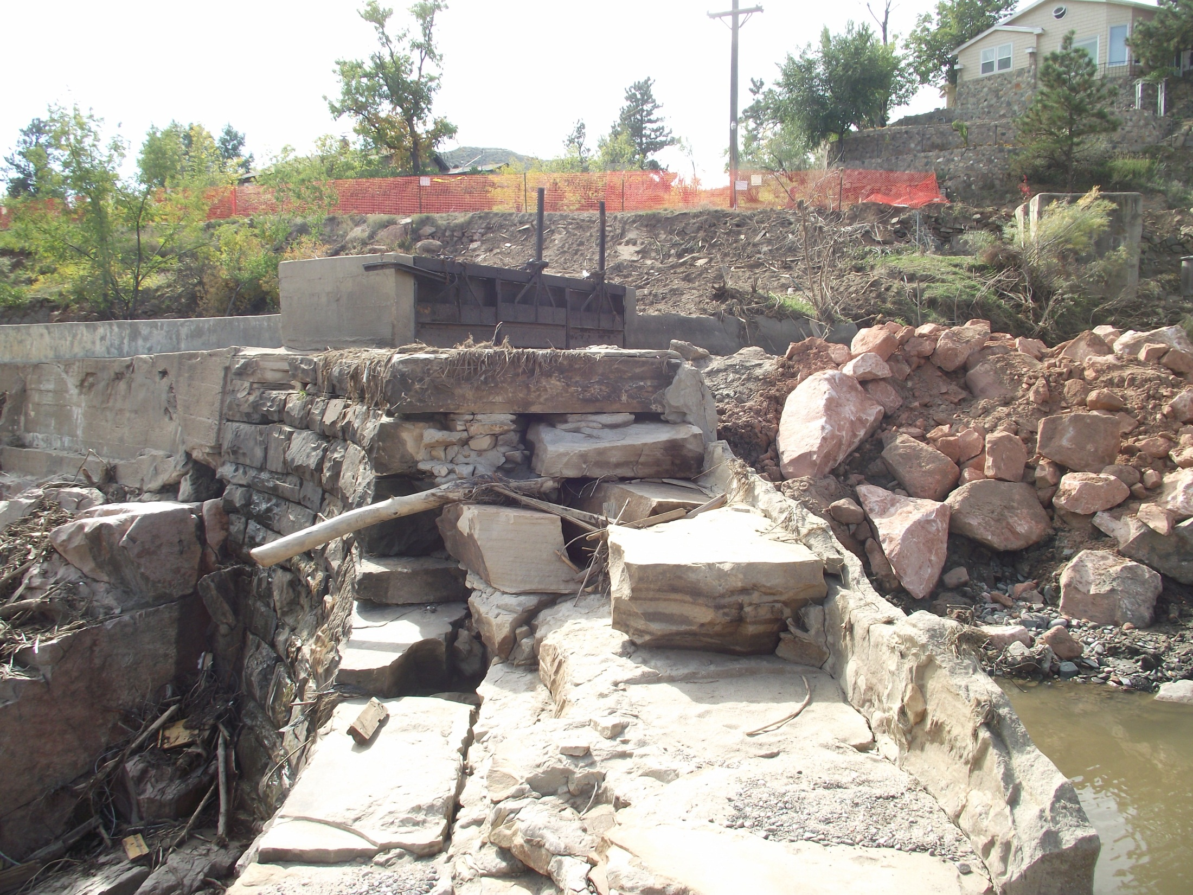
Looking Across Dam Crest at the Home Supply Diversion

Slide 7
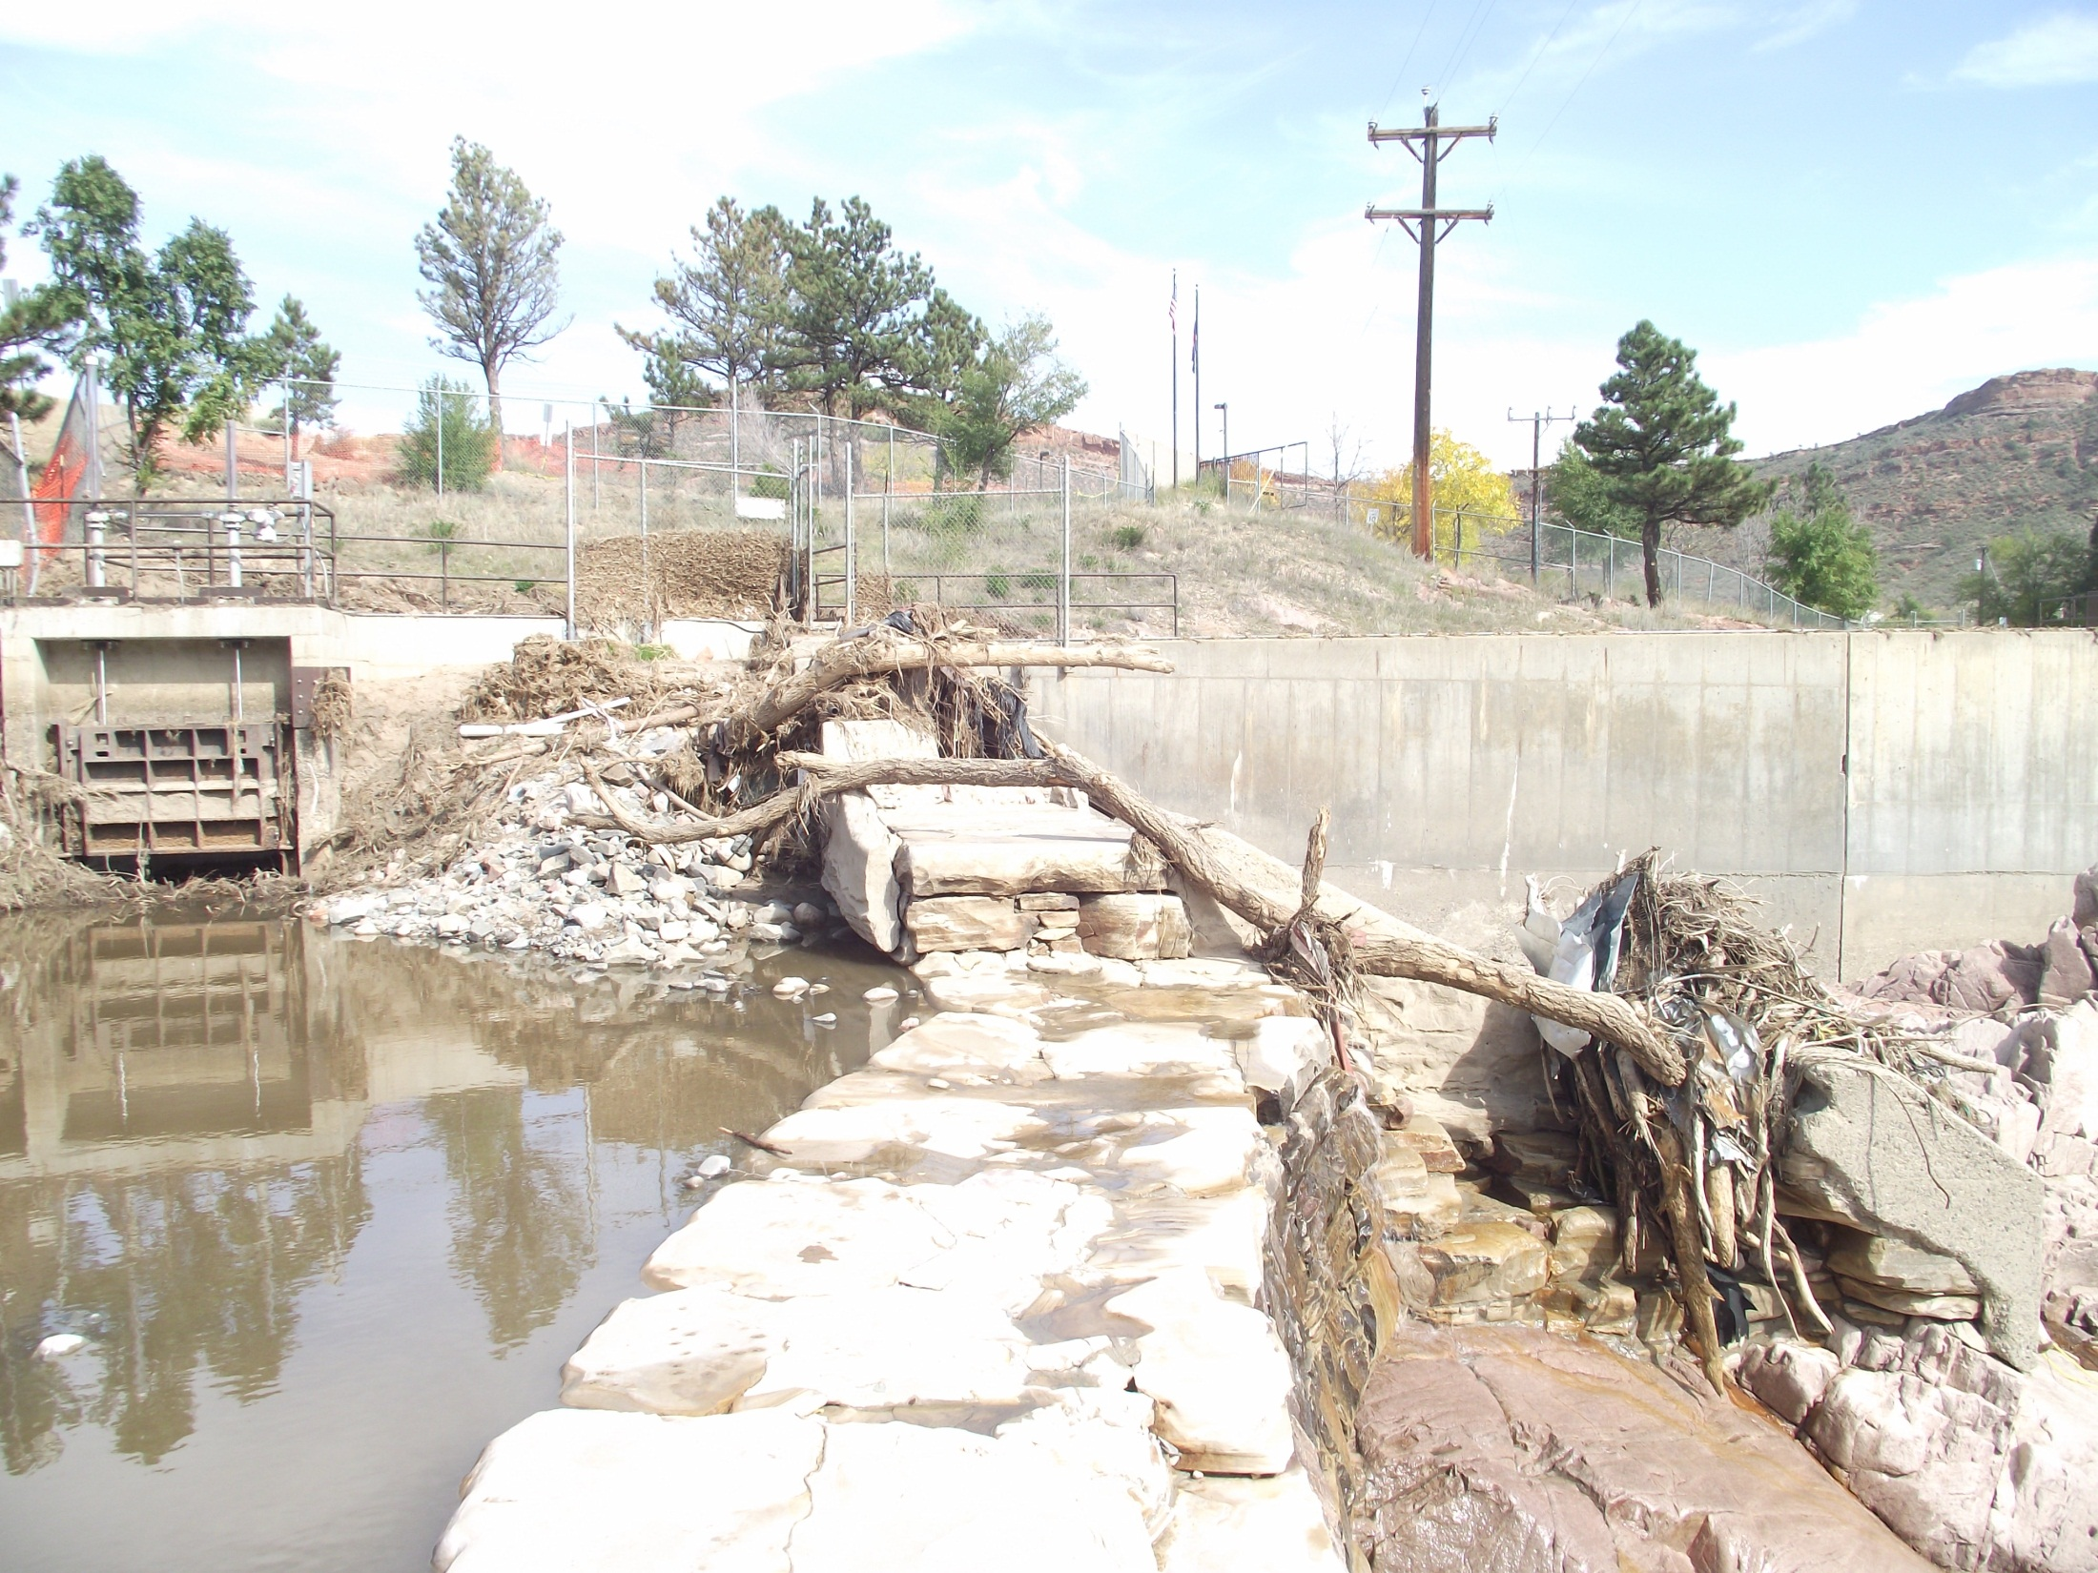
Looking Across Dam Crest to City of Loveland Diversion

Slide 8
Recent Use of Home Supply Dam
(AF)
City of Loveland
Share of Diversion at the Home Supply Structure
2008 - 2012
Water Year | Home Supply Diversion | Loveland Pipeline Diversion | Combined Diversion | Loveland's Share of Combined Diversion
2008 | 29,687 | 14,618 | 44,305 | 33%
2009 | 24,984 | 12,130 | 37,114 | 33%
2010 | 22,236 | 4,507 | 26,744 | 17%
2011 | 23,989 | 4,768 | 28,757 | 17%
2012 | 19,272 | 4,367 | 23,639 | 18%
Totals | 120,168 | 40,390 | 160,558 | 25%

Slide 9
Schedule
City Council Action Requested
On Proposed Agreement
November 5, 2013

